Slide 1
DENSITY SOLUTIONS ENGINEERING POWERPOINT

Slide 2
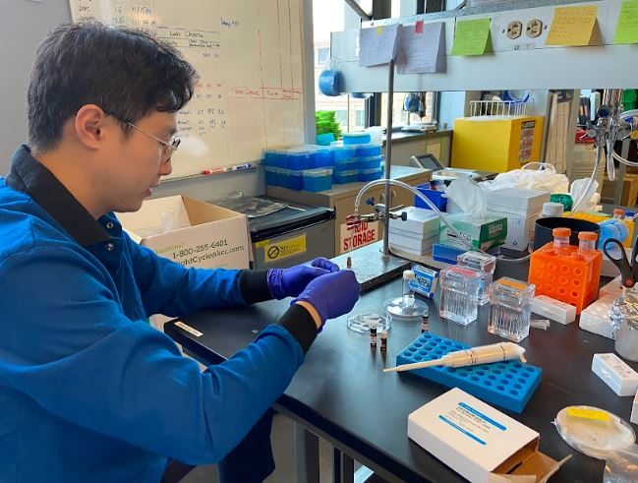
What is Engineering?
Engineering is designing and creating.
Engineers plan and improve bridges, roads, vehicles, computers, new foods, new materials, medicine… anything that is needed to make the world a better place.
#6091ba
#9fcc3b
#8d64aa
#f8a81b

Slide 3
What is an Engineer?
An engineer is someone who likes to work on a team to make discoveries and solve problems.
#6091ba
#9fcc3b
#8d64aa
#f8a81b

Slide 4
How Does Engineering Happen?
#6091ba
#9fcc3b
#8d64aa

