Slide 1
Designing Prototypes to Save Coral Reefs

Slide 2
What are coral reefs?
Watch: https://www.youtube.com/watch?v=ZiULxLLP32s (0:00 to 1:21)
Brainstorming: Why are coral reefs important?
Photos should be a
square like this.
Watch: https://www.youtube.com/watch?v=ZiULxLLP32s (1:22 – end)
#9fcc3b
Consider: What do all the negative impacts on coral reefs have in common?
The Answer: Humans

Slide 3
Pre-Activity Assessment
Quick Poll: Raise your hand if you think coral reefs are essential.
Why are they essential?
Photos should be a
square like this.
Brainstorming: Now you are going to brainstorm with your table/group the following question . . .
What are all the ways humans impact coral reefs?
#6091ba
#9fcc3b

Slide 4
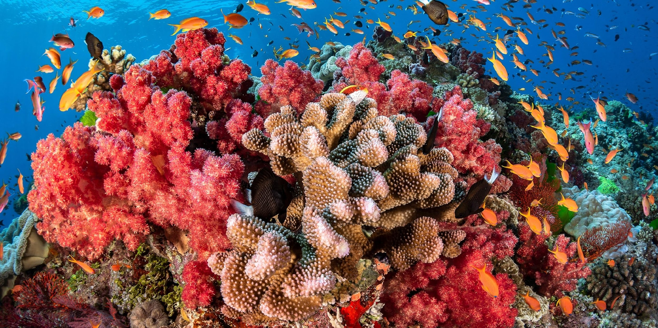
Importance of Coral Reefs Coral reefs are the most biologically diverse ecosystems on our planet. They are located along the coast in shallow, tropical water. Coral reefs are built by different species of hard corals and soft corals, which create the foundation for coral communities to grow on and live in.
Coral reef located in Fiji.
These ecosystems are a crucial resource for many countries around the world for food, tourism, and coastline protection. Coral reefs are estimated to generate around $375 billion a year in revenue.

Slide 5
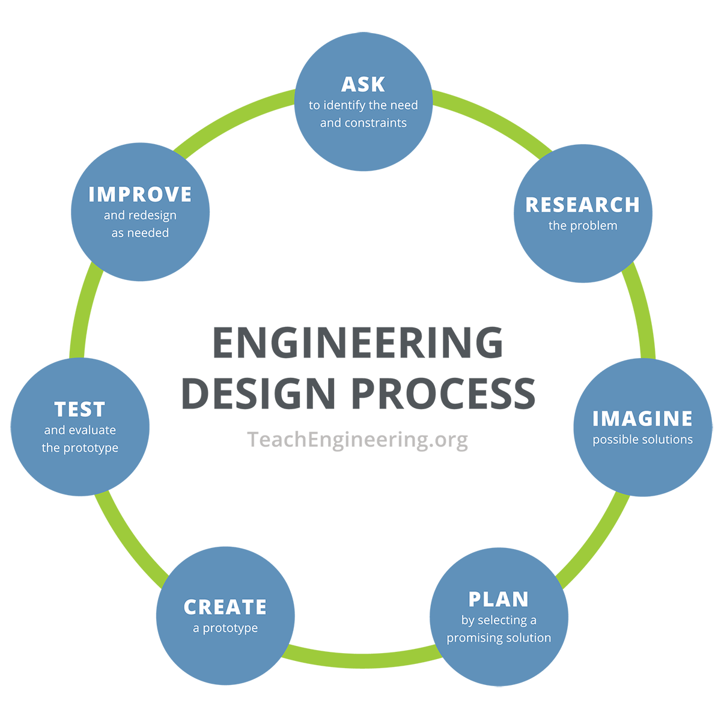
Engineering Design Process
What is engineering design? - When you have a problem that needs to be solved, you turn to engineering design to develop a solution. - The process has several steps to help guide you in finding a possible solution. - It is important to know that mistakes will be made, but just because you make a mistake does NOT mean you have to start over completely!

Slide 6
1. Ask: Ask questions to identify the need and constraints of the problem. 2. Research: Research the problem, get more information about the issue and current solutions. 3. Imagine: Brainstorm possible solution ideas; no idea is a bad idea in this step!
Steps in the Engineering Design Process
4. Plan: Create a drawing of your most promising solution. 5. Create: Create your prototype! 6. Test: Conduct various tests to see how your prototype fares. 7. Improve: Go back to your brainstorming when you need to redesign your prototype; this is only as needed.

Slide 7
Engineering Design Process: Example
Problem: We are running out of freshwater resources.
Step #1 Ask: What are possible solutions?
Photos should be a
square like this.
Freshwater Filtration
Desalination
Limit freshwater usage
#6091ba
#9fcc3b
Look on other planets
Create freshwater
Possible solutions we can design a prototype for!

Slide 8
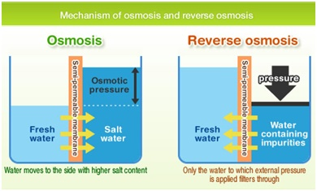
Engineering Design Process: Example
Problem: We are running out of freshwater resources.
Step #2 Research: What is desalination? What ways is it already used? What products are already out there? What do I want to design?
Photos should be a
square like this.
I use this information to define my problem:
I need a device that can desalinate small amounts of water for about 1-3 people, with no electricity, for people who live near a coastline.
I am asking questions to help further define the parameters of my prototype.

Slide 9
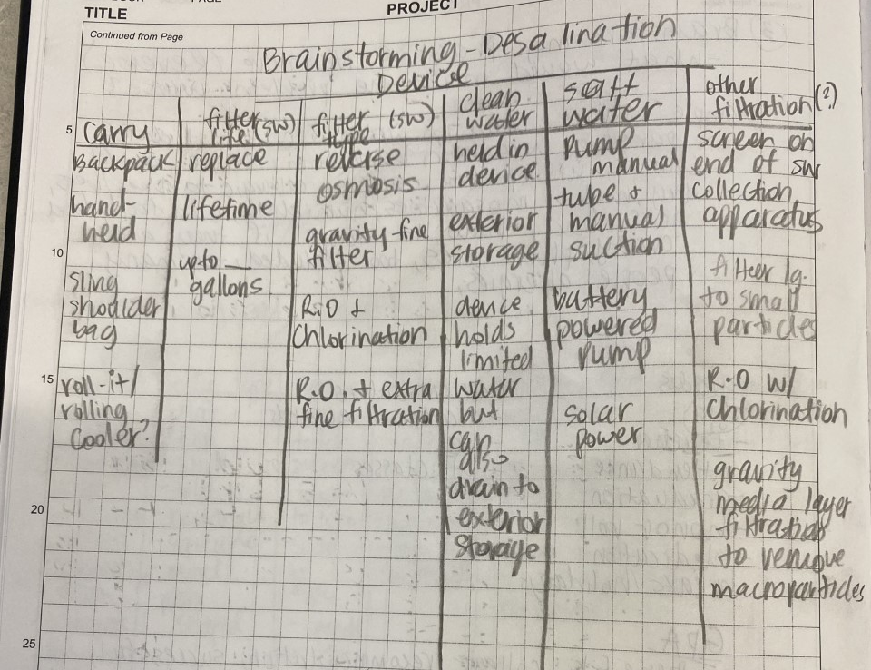
Engineering Design Process: Example
Problem: We are running out of freshwater resources.
Step #3 Imagine: What are all the possible parts I would need? What criteria do I need to meet my goal? What will I use? = Brainstorming time!
Photos should be a
square like this.

Slide 10
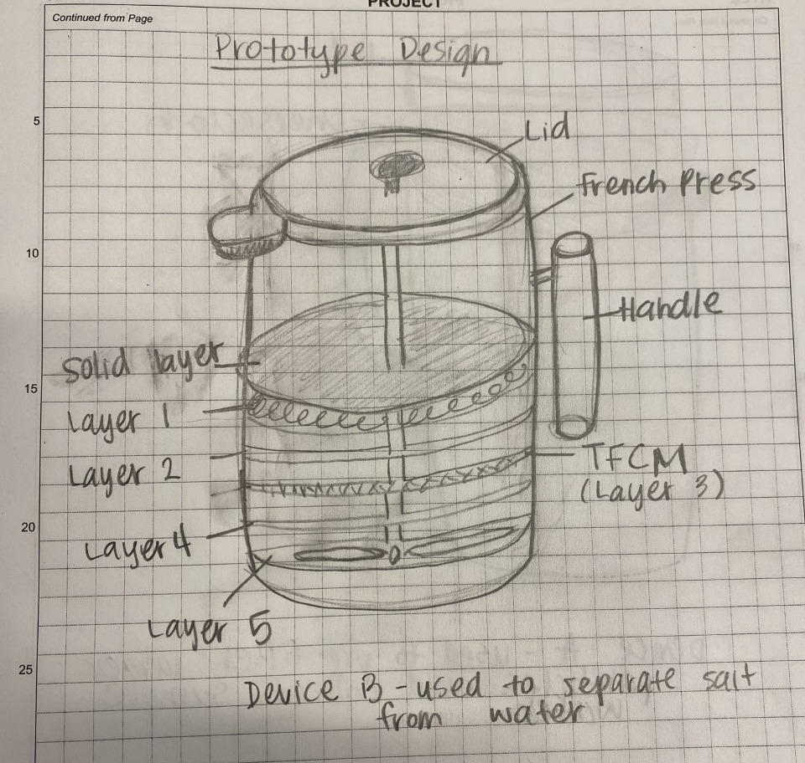
Engineering Design Process: Example
Problem: We are running out of freshwater resources.
Step #4 Plan: Choose the best conditions for the prototype and sketch a design!
Photos should be a
square like this.

Slide 11
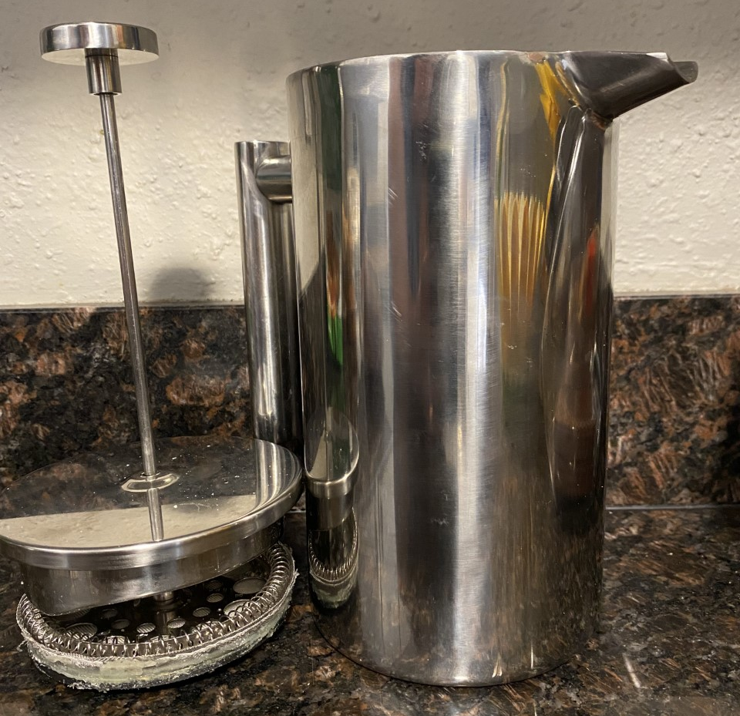
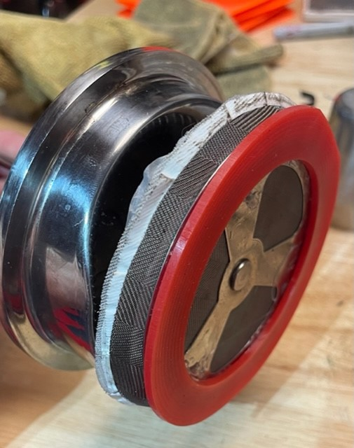
Engineering Design Process: Example
Problem: We are running out of freshwater resources.
Step #5 Create: Build your prototype!
Photos should be a
square like this.

Slide 12
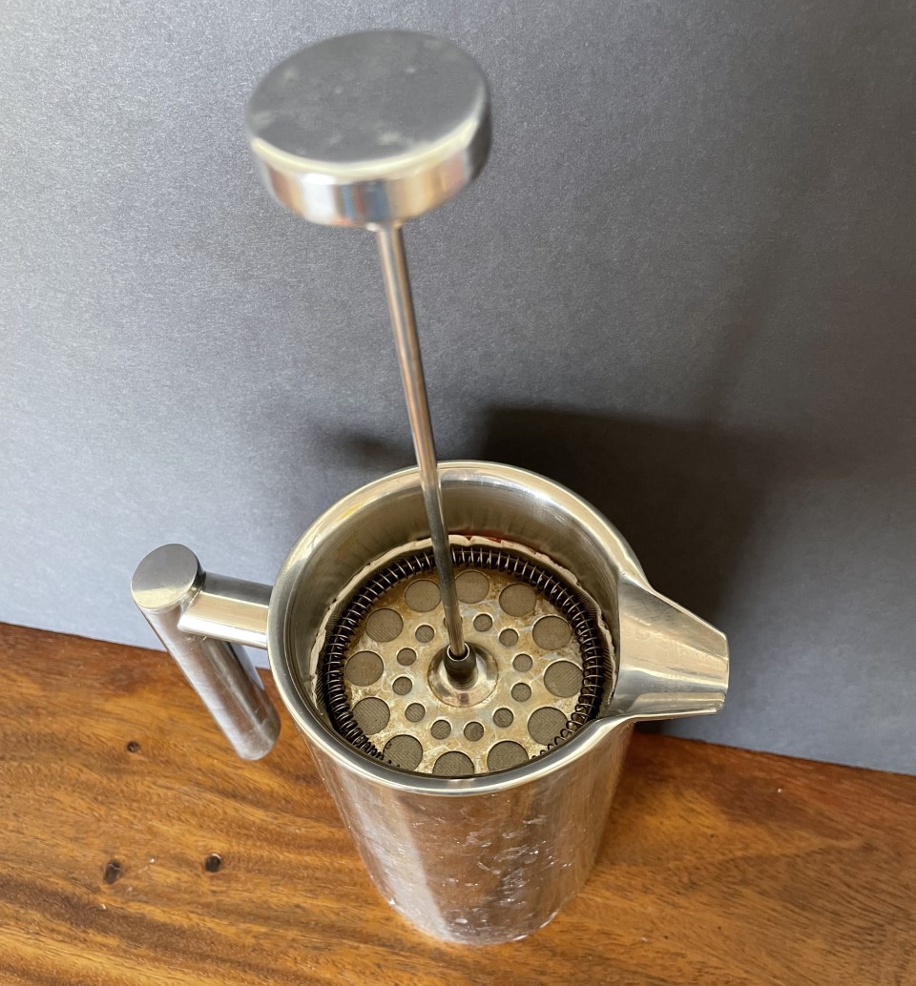
Engineering Design Process: Example
Problem: We are running out of freshwater resources.
Photos should be a
square like this.
Step #6 Test: Test your prototype!

Slide 13
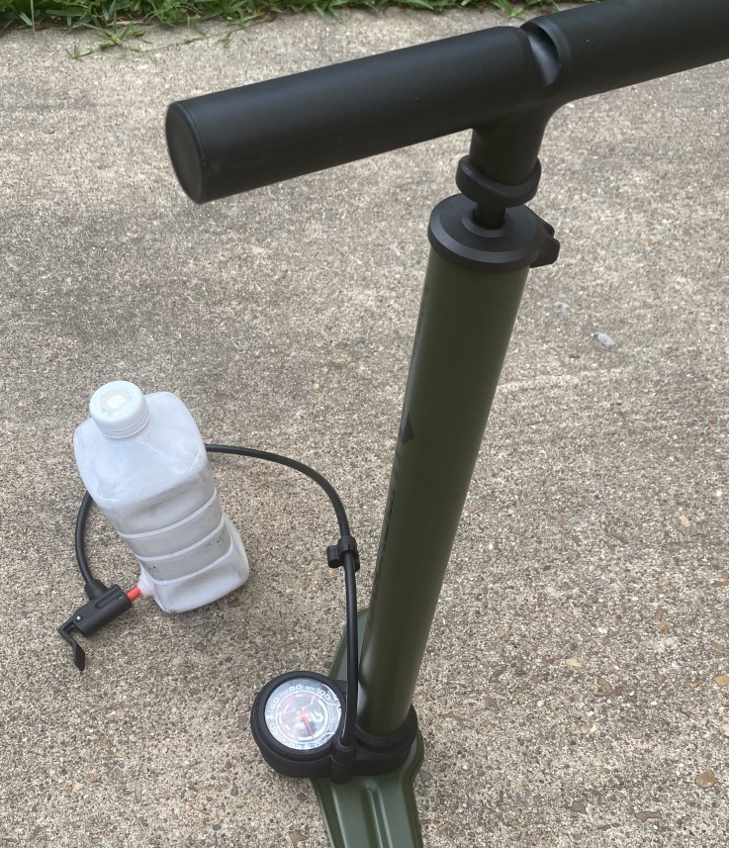
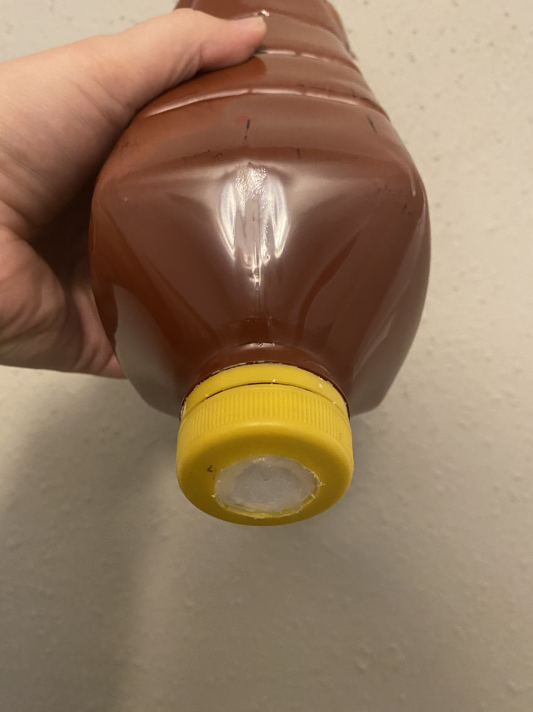
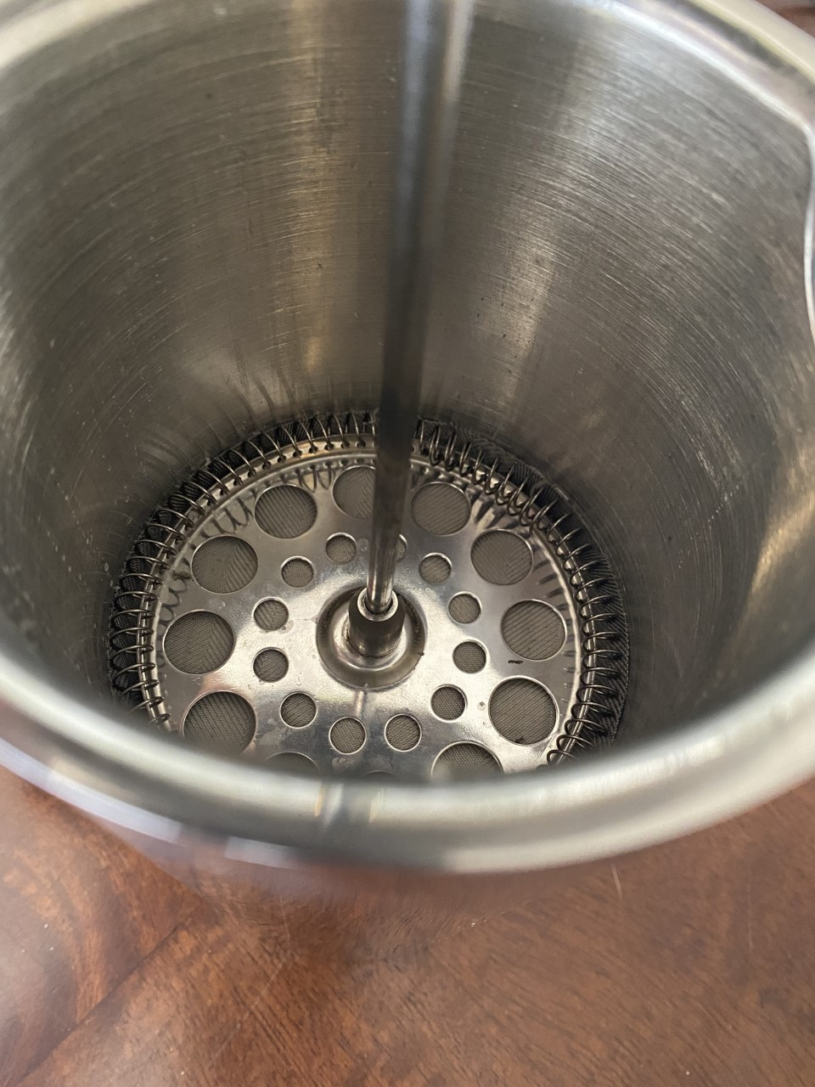
Engineering Design Process: Example
Problem: We are running out of freshwater resources.
Step #7 Improve: Improve your prototype!
Photos should be a
square like this.
In this case the original ended up being the best one!

Slide 14
Consider the following . . .
As a group, discuss the following questions: 1. Can we help coral reefs? 2. Why should we help coral reefs?
Coral reef located in Fiji.

Slide 15
Designing Prototypes to Save Coral Reefs
You and your group will be building a device that will help coral reefs survive based on your specific issue: Coral Bleaching Marine Debris Pollution Tourism Your prototype will be tested to ensure that it can be functional in water, it is designed to help lessen the effect of your human impact, and it is made using everyday items.

Slide 16
Engineering Design Process: Step #1 ASK
Brainstorm . . . What are possible constraints of your project?
Photos should be a
square like this.
#6091ba
#9fcc3b

Slide 17
Engineering Design Process: Step #2 RESEARCH
Each group will receive ‘Research Materials’ based on your specific issue. You will have _____ minutes or ____ class periods to conduct your research and define your problem (Define the Problem and Brainstorming Worksheet).
#6091ba
#9fcc3b

Slide 18
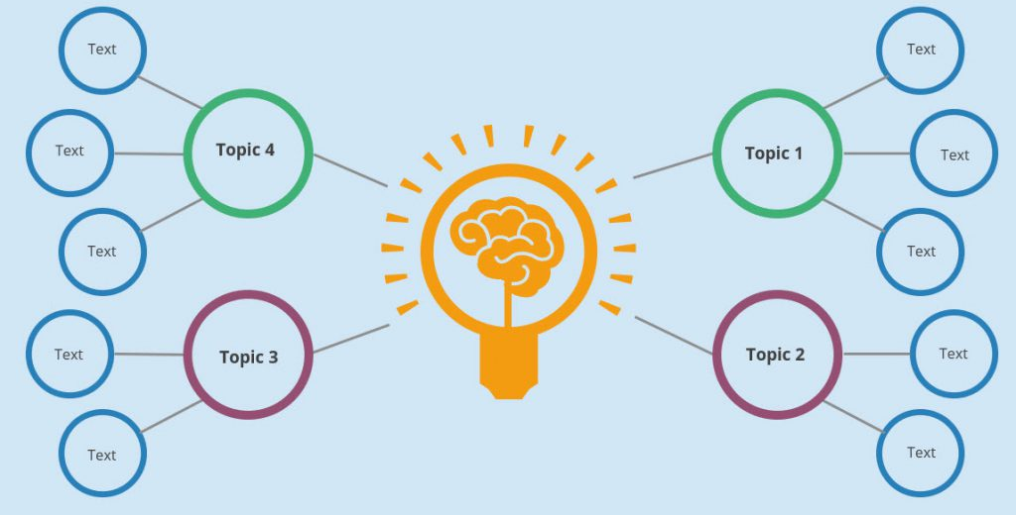
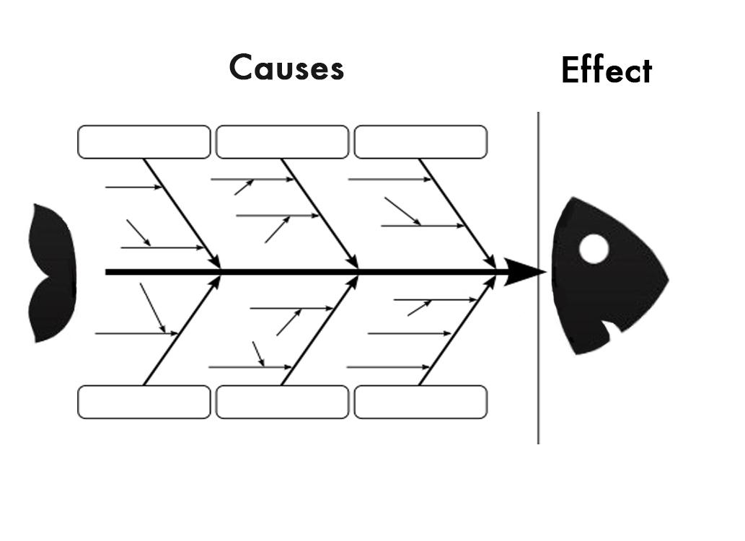
Engineering Design Process: Step #3 IMAGINE Individually on your ‘Define the Problem and Brainstorm’ worksheet, you will choose a brainstorming strategy and brainstorm ideas for your prototype. Rules: There are no bad ideas, we don’t judge other’s ideas, write everything down! Brainstorming Strategies Include:
Mind Mapping
Fish Skeleton
Morphological Chart
Category #1 | Category #2 | Category #3 | Category #4
Idea #1 | Idea #1 | Idea #1 | Idea #1
Idea #2 | Idea #2 | Idea #2 | Idea #2
Idea #3 | Idea #3 | Idea #3 | Idea #3
Idea # . . . | Idea # . . . | Idea # . . . | Idea # . . .

Slide 19
Engineering Design Process: Step #3 IMAGINE- Practice! Use any of the brainstorming methods from before to produce a possible solution for the following problem. Problem: Mark loves to take cold drinks with him wherever he goes. He wants a cup that is easily transportable, keeps his drinks cold, is easy to carry, won’t spill, and has a straw that can be removed.

Slide 20
Engineering Design Process: Step #3 IMAGINE- Practice! Problem: Mark loves to take cold drinks with him wherever he goes. He wants a cup that is easily transportable, keeps his drinks cold, is easy to carry, won’t spill, and has a straw that can be removed.
Cold Drink
Won’t Spill
Transport
Example Brainstorm: Fish Skeleton
Insulate with cooling metal
Twist-on lid
Has a handle
Rubber ring around lid
Has a hook to attach to a bag
Double layer cup
What other categories can we produce?

Slide 21
Defining Prototype Requirements:
Has to be easily used and maneuverable by people
Has to fit into a 29-gallon tank
Has to be able to be in the water without falling apart for a minimum of 5 minutes
Has to be able to sink/float/anchor according to your own expectations
Has to meet any additional requirements that you set for your prototype
Can only use the materials provided for you by your teacher, or any that you want to bring for yourself

Slide 22
Engineering Design Process: Step #4 PLAN Once your group has consolidated ideas and chosen the best for your goal, you will now draw your prototype #1. Complete the Prototype #1 Sketch worksheet with your group.

Slide 23
Engineering Design Process: Step #5 CREATE You will now BUILD your prototype with your group using the materials available to you that you selected!

Slide 24
Engineering Design Process: Step #6 TEST Next, you will test your prototype. We will place all prototypes in the designated saltwater containers overnight and reflect in the morning on how well they ‘survived’ in the water.

Slide 25
Engineering Design Process: Step #7 IMPROVE Complete the following: 1. Pull your prototype out of the water. 2. Collect a ‘Prototype Reflection’ worksheet for your group. 3. Complete the worksheet. Once your teacher has checked your worksheet, continue to make any modifications to your prototype.
Photos should be a
square like this.
#6091ba

Slide 26
Engineering Design Process: Step #6 & 7 TEST AND IMPROVE Continue to test and improve your prototypes as necessary.
Photos should be a
square like this.
#6091ba
#9fcc3b

Slide 27
Engineering Design Process: Reflection
For your final prototype, you will complete the ‘End Prototype’ worksheet with your group. Be sure to be thorough in your reflection answers about your prototype.

Slide 28
Peer Evaluations
Complete the peer evaluation for each of your group members.

