Slide 1
Mosquitos (Sucking the Fun out of Summer): Hydrology PowerPoint

Slide 2
What is hydrology?
Hydrology is the study of water’s movements, and how those movements affect the land surrounding them.
Hydro = water & logy = study of
A hydrologist is someone who studies hydrology. They look at erosion rates and water velocity to study how bodies of water change over time.
Hydrologists study previous flood data and use that to make predictions about future floods.

Slide 3
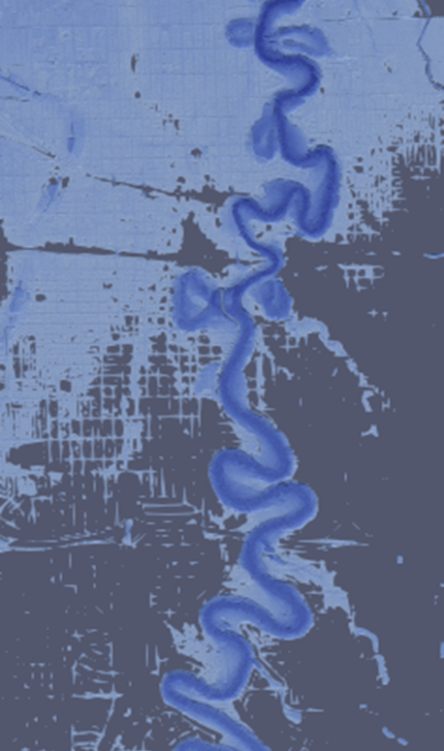
History: Fargo-Moorhead Flooding
In 1997, the Red River reached a peak discharge of 27,800 cubic feet per second, flooding the Fargo-Moorhead area. In 2009, the Red River reached a peak discharge of 29,100 cubic feet per second.
Prediction models indicate that the discharge level for a return period of 100 years is 39,071 cubic feet per second. If a flood with this much river discharge occurs, the entire Fargo-Moorhead area will be underwater.
How can hydrologists help to mitigate the damage from a severe flood?
Image source: Paraview
Notes:
How can hydrologists help to mitigate the damage from a severe flood?
Answer: Hydrologists use existing data to make predictions on future floods, which can be used to inform public policy. They can help make decisions about where buildings, roads, and bridges should be placed to avoid areas where flooding is likely to occur.

Slide 4
Diversion Project
Hydrologists have helped to create the river diversion project in the area, which has a total cost of approximately $3 billion.
How does the benefit of the diversion project outweigh the cost for our area?
Hydrologists have helped develop the diversion project – a channel designed to alleviate future flooding.

Slide 5
References
https://www.bls.gov/ooh/life-physical-and-social-science/hydrologists.htm#:~:text=in%20the%20field.-,Hydrologists%20study%20how%20water%20moves%20across%20and%20through%20the%20Earth's,or%20eventually%20reach%20the%20oceans.
https://fmdiversion.gov/about/faqs/
https://waterdata.usgs.gov/monitoring-location/05054000/

