Slide 1
Wildfire and Car CO2 Emissions Student Workbook – Answer Key

Slide 2
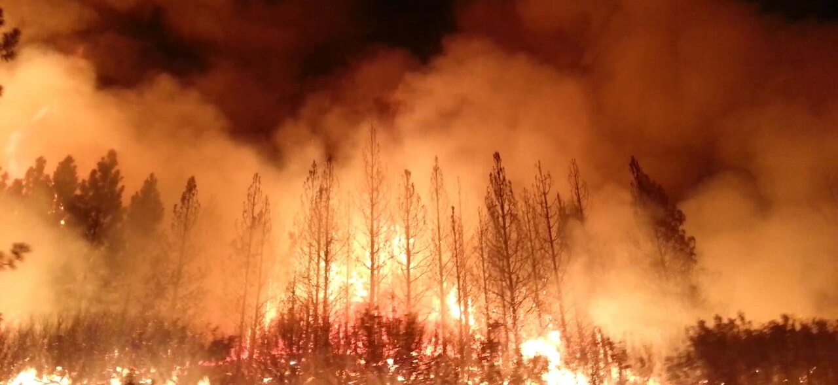
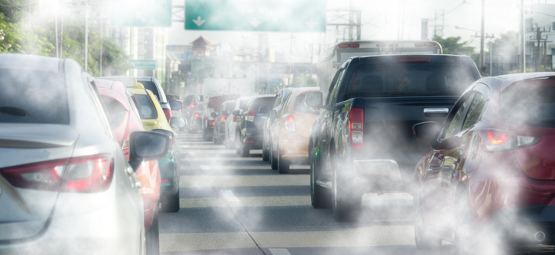
Wildfires and Cars KEY
Do they release CO₂?
Is one worse than the other?
https://en.wikipedia.org/wiki/Wildfire#/media/File:The_Rim_Fire_in_the_Stanislaus_National_Forest_near_in_California_began_on_Aug._17,_2013-0004.jpg
https://www.frost.com/frost-perspectives/eu-sets-100-reduction-target-in-vehicle-co2-emissions

Slide 3
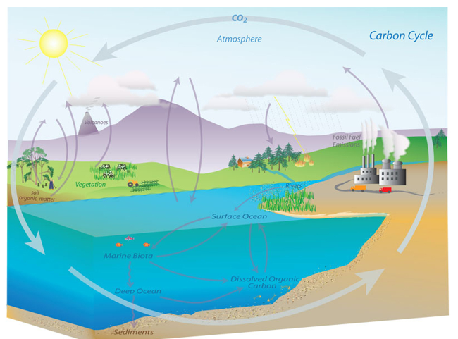
Carbon Cycle Review
Using the diagram, list how CO₂ is released and absorbed in a cycle.
CO₂ Released
CO₂ Absorbed (Sink)
Burning fossil fuels
Driving cars
Driving tractors
Mining/agriculture that releases CO₂ in the soil
Forest fires
Volcanoes erupting
Respiration (exhale CO₂)
Cows chewing cud, release CH₄ that converts to CO₂
COLD ocean water
Death/decomposition
Plants (absorb CO₂ and release O₂)
The carbon cycle. (Image credit: NOAA)
Why is the cycle out of balance? What is the result of an imbalanced cycle?
From the list, we can see that the cycle is releasing much more CO₂ than it is absorbing. As more CO₂ is released into the atmosphere, it is causing climate change, with warmer temps, warmer ocean water, droughts AND big storms, stronger hurricanes, and more forest fires.

Slide 4
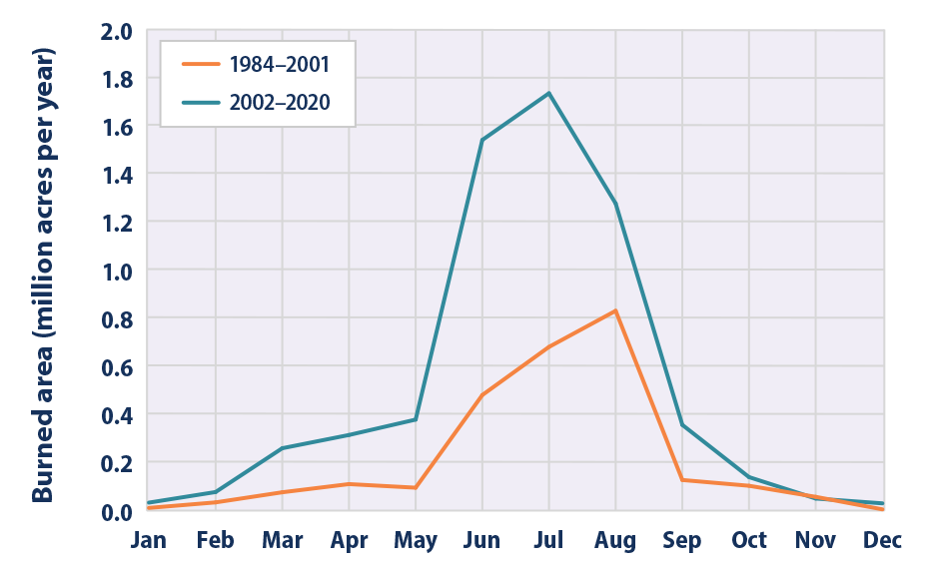
Comparison of Monthly Burned Area Due to Wildfires in the US between 1984-2001 and 2002- 2020
Turn and Talk: Write two conclusions from the graph.
The graph shows that there is more area burned in 2002-2020 than there was from 1984-2001.
It also shows that the forest fire season in 2002-2020 is longer. It is starting earlier, with an increase in fires in February, as compared to May in the 1984-2001 line.
Data Source: EPA website, MTBS (Monitoring Trends in Burn Severity), 2022

Slide 5
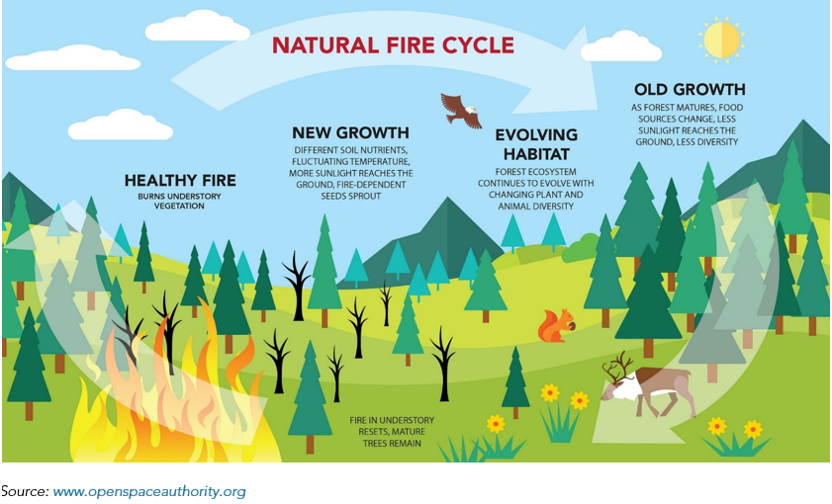
Fire Management
Not every fire is a wildfire. How is this diagram demonstrating a healthy forest?
Forest fires are necessary to burn the underbrush. It encourages new growth from fire-dependent seeds, and more nutritious soil. Fires help forests maintain their biodiversity.
Healthy fires do not destroy trees. They may have a burn scar, but it will not always kill the tree.

Slide 6
Forest Management: The Story of the 1988 Yellowstone Fire
Answer the questions while watching the video: https://www.youtube.com/watch?v=CAgP9fo3f7s
Why did park officials originally just let the fires burn in Yellowstone?
Since 1972, fires would just burn out from years of data.
On July 21, 1988, what did park officials decide to do about the fire?
The fires kept burning and they were getting out of control.
What was a result of the hugely popular Smokey the Bear campaign?
Tons of underbrush built up, setting the stage for huge fires, then in 1988, it was dry and windy.
What finally put out the fires?
A quarter inch of snow!
After the fires, how did the park change?
Plants began to grow, bison were having babies, lodgepole pines require fire to open the cones for new trees to grow, but can be a slow process, taking 200-300 years for the lodgepole pines to grow to full height.
Why is letting some fires burn no longer an option in some places?
There are many populated areas, so saving people and homes that are threatened by fire is imperative.

Slide 7
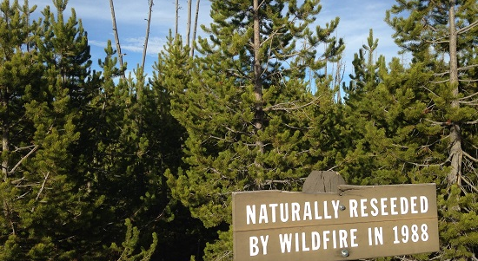
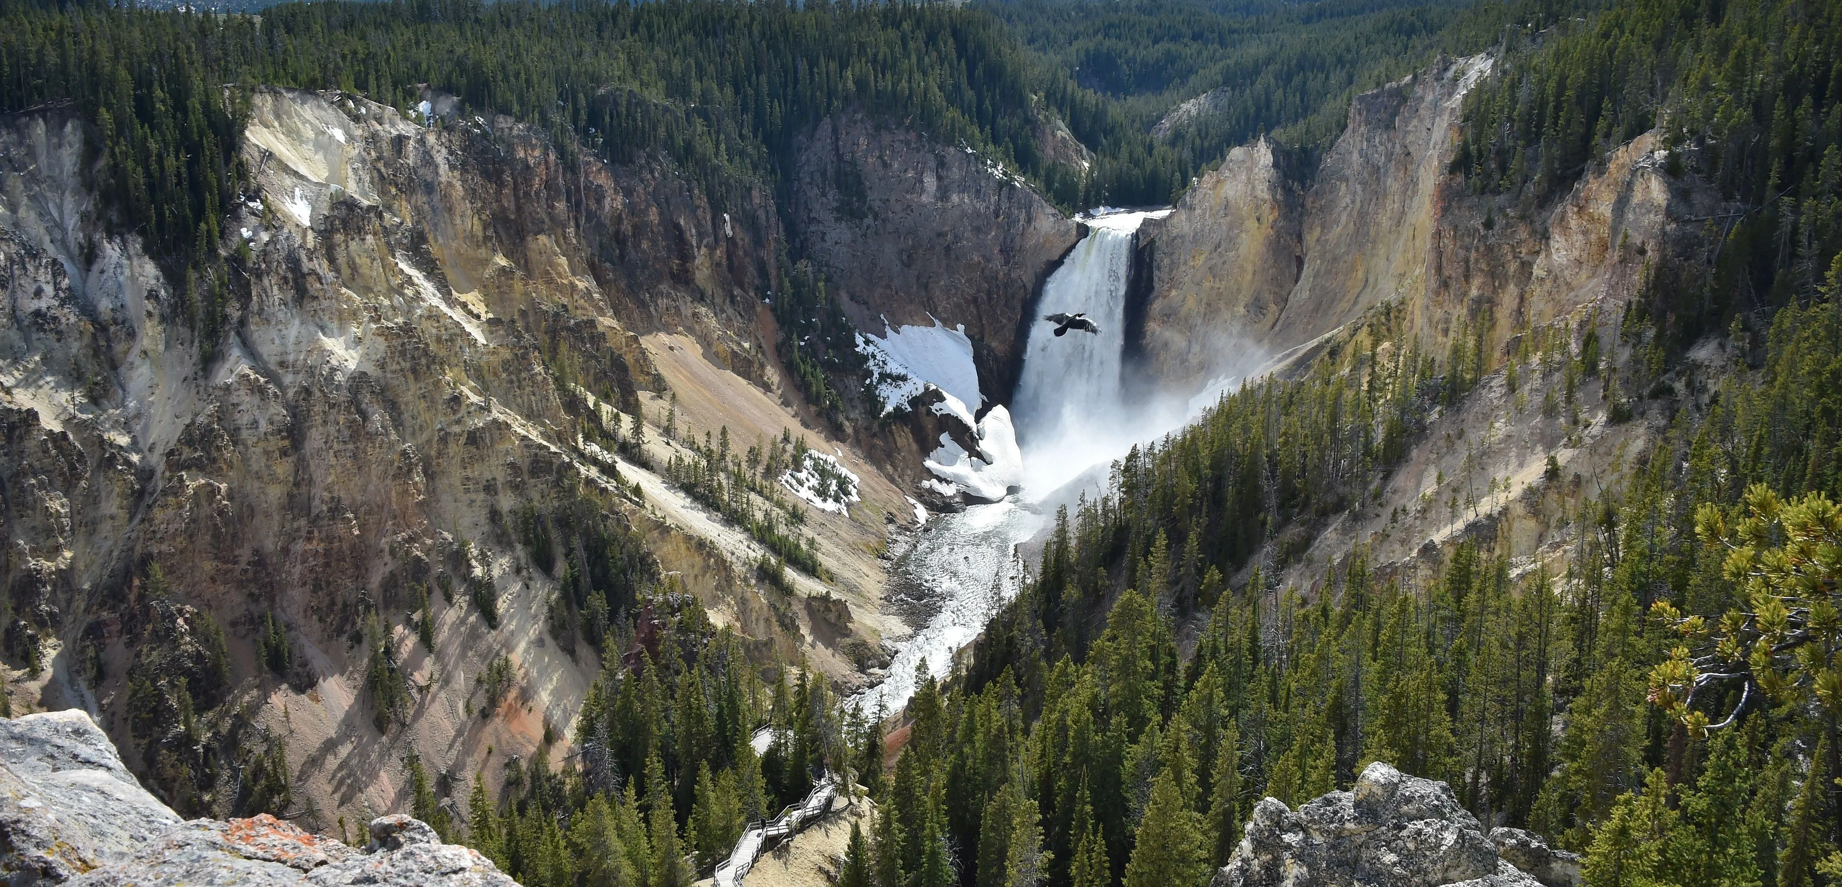
Secondary succession in action!

Slide 8
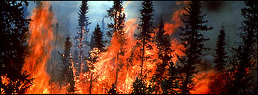
Climate Change and Fire (Positive Feedback)
How does changing the climate impacting wildfires?
More _CO2____ in the atmosphere
When trees burn, what do they release?
CO2
Which does what to the temperature?
Temps rise
If there are more droughts, there will be more __FIRES__
Which the leads to what type of weather conditions?
Drier/drought conditions

Slide 9
Wildfire Evacuation
Stop at 7:43 https://www.youtube.com/watch?v=Y9r4hlk1_Zg
60 Minutes Rewind--Paradise Lost: Inside California's Camp Fire, 60 Minutes' 2018 report
1. Write five observations about the mass evacuation.
It was very chaotic. People didn’t know where to go, traffic jams as people tried to evacuate.
Fire is everywhere, moving very fast. An inferno.
It killed 90 people and destroyed 19,000 buildings, businesses, and homes in just a few hours.
It was dark; the smoke blocked the sun.
Some people gave up and tried to walk out, but there wasn’t anywhere to go until a firefighter picked them up.
Firefighters kept going back into the fire to save people.
2. How did the fire start?
Campfire
3. What factors made the Paradise fire and extreme wildfire in California?
40 mph winds from the north, growing an acre (one football field) every second
5 years of drought
Vegetation is very dry
Temperatures are increasing
4. How many acres were consumed in 12 hours? 153,300 acres

Slide 10
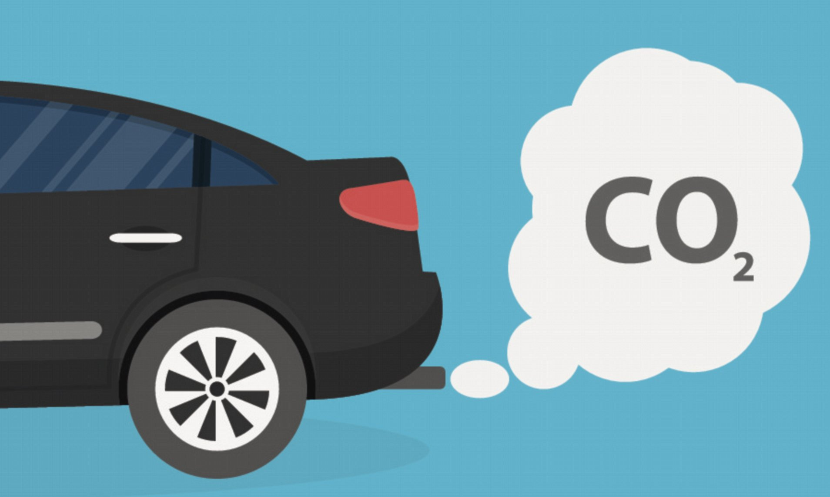
Cars and Exhaust
How do emissions from cars affect our atmosphere?
Picture: https://www.sustained-quality.com/automotive-industry-criticizes-europes-co2-reduction-target
Data Source: https://www.epa.gov/greenvehicles/light-duty-vehicle-emissions

Slide 11
TWO types of gases released from cars
Greenhouse gas (GHG) emissions
CO₂, 99% of the GHG released from tailpipe.
Stays in the atmosphere for 100 years.
Blankets the earth, causing it to warm, sea levels rise, glaciers melt.
Changing climate.
Can adversely affect humans with changing ecosystems.
Smog emissions (air pollution)
NO_{x} (nitrogen oxides), irritates eyes, nose, throat.
Particulate matter (PM), which can get into your throat or collect on buildings.
CO (carbon monoxide), colorless, odorless, but poisonous.
HCHO (formaldehyde), can irritate lungs and is a carcinogen.

Slide 12
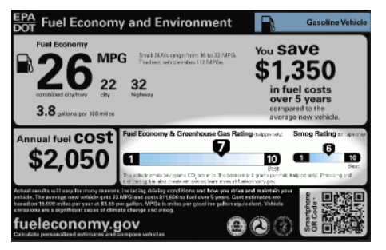
When purchasing a vehicle, look for the emissions sticker from the EPA
What information does this emission sticker give you? List five items from the sticker below.
Fuel economy (miles per gallon) for both city and highway driving
Cost of fuel per year
Savings in fuel costs
Greenhouse Gas (GHG) rating
Smog rating

Slide 13
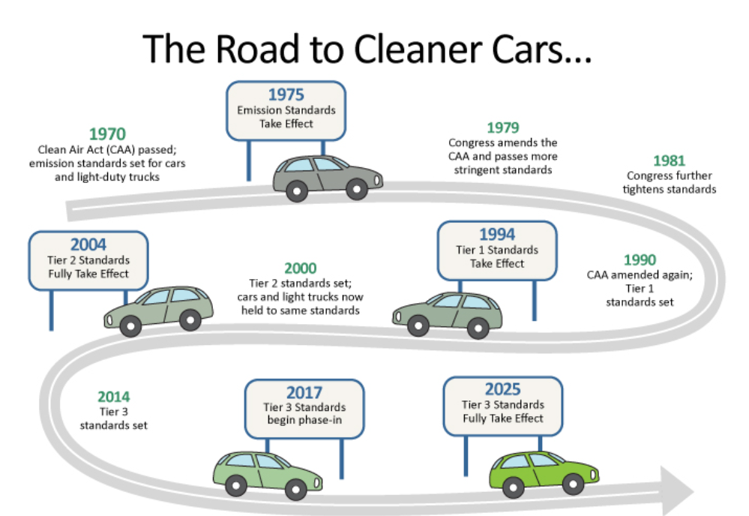
Turn and Talk:
What are your wonderings/observations from this diagram?
Making changes to reduce vehicle emissions is a slow process.
Changes are being made to help the climate, reduce emissions.
What is a tier 1, 2, 3 standard? (these could be further researched)

