Slide 1
Investigations With Nitinol: The Metal With Shape Memory!
Introduction and Motivation

Slide 2
Nitinol: A Shape Memory Alloy
The material you are seeing in the demonstration is called Nitinol (NiTi), and it is a shape memory alloy.
Nitinol was first developed in the 1960s by a team of researchers at the United States Naval Ordnance Laboratory.
The name Nitinol is an acronym for: Nickel Titanium Naval Ordnance Laboratories.
Supposedly, its shape-changing properties were found accidentally.
Shape memory alloys are metals that exhibit shape-changing properties when heated.
When used in advanced applications, these alloys are often called smart metals.

Slide 3
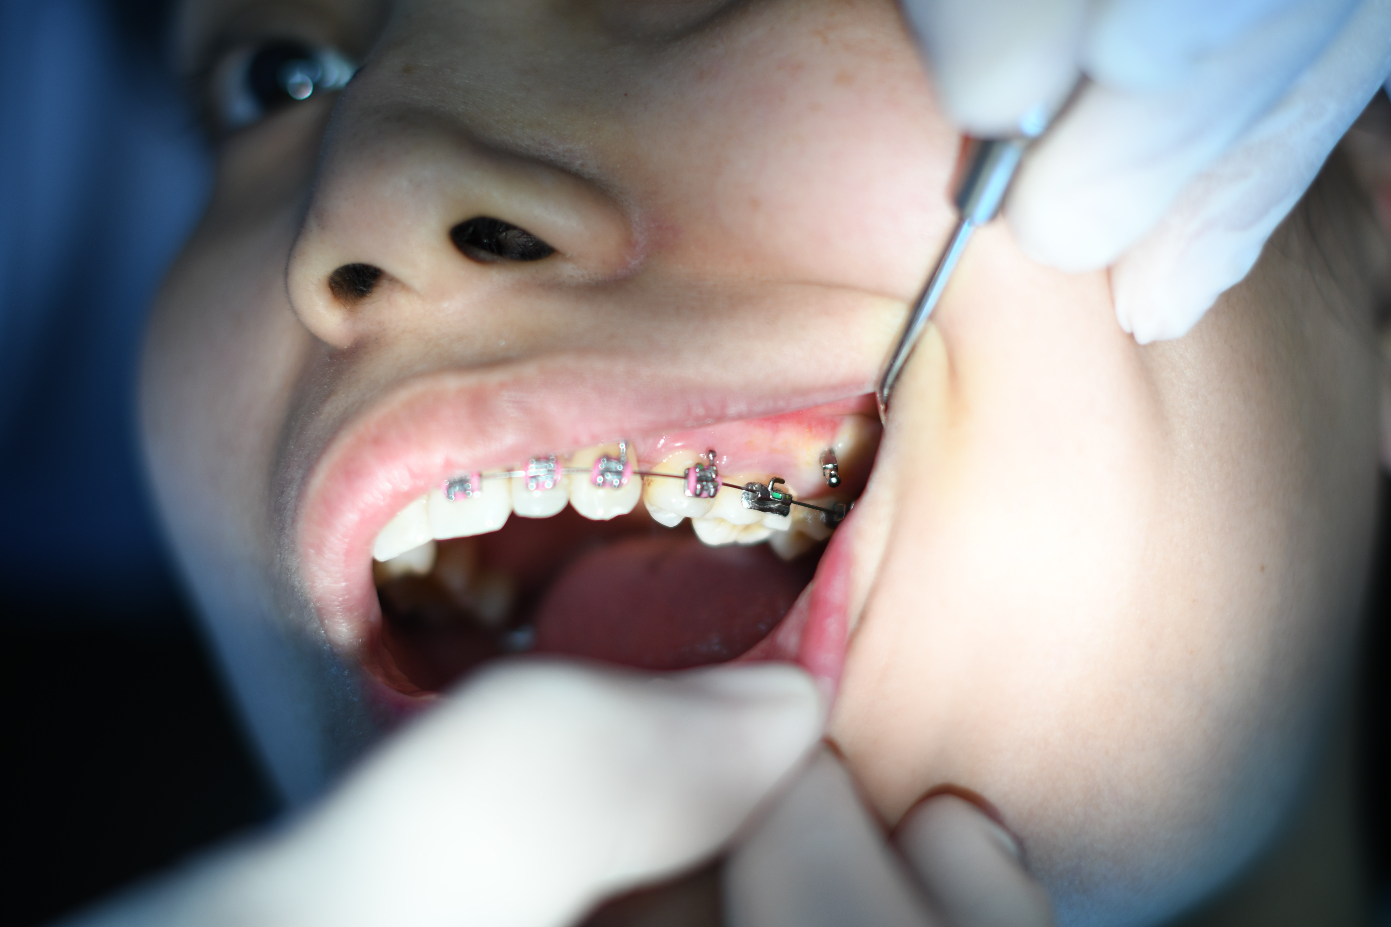
Smart Metals and Their Applications
Because of the shape-changing ability of smart metals, there are many uses for them.
Art and Jewelry
Photo from https://shopinde.com/product/7746?v=15646
Aviation
Video from https://www.nasa.gov/feature/glenn/2019/memory-metals-are-shaping-the-evolution-of-aviation
Braces
Photo by Atikah Akhtar on Unsplash

Slide 4
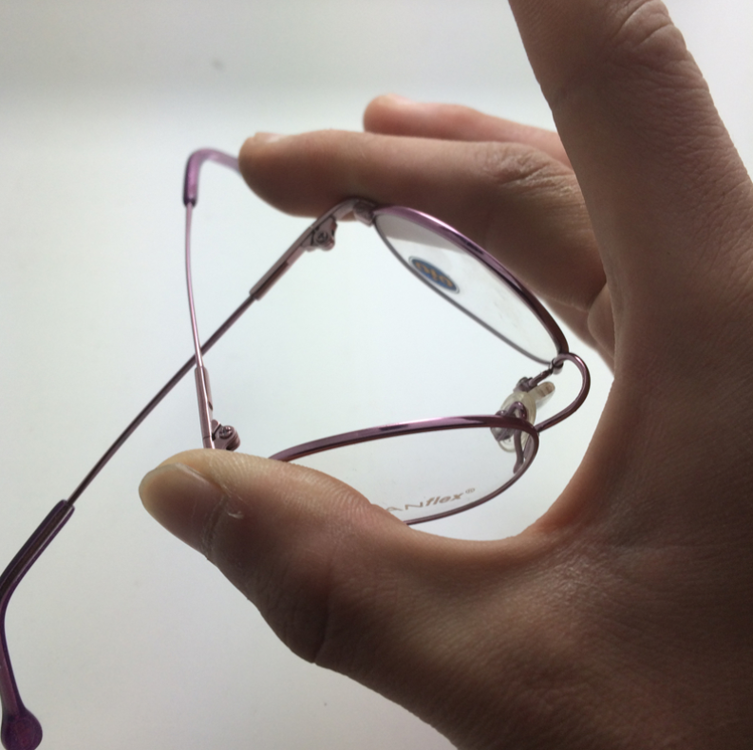
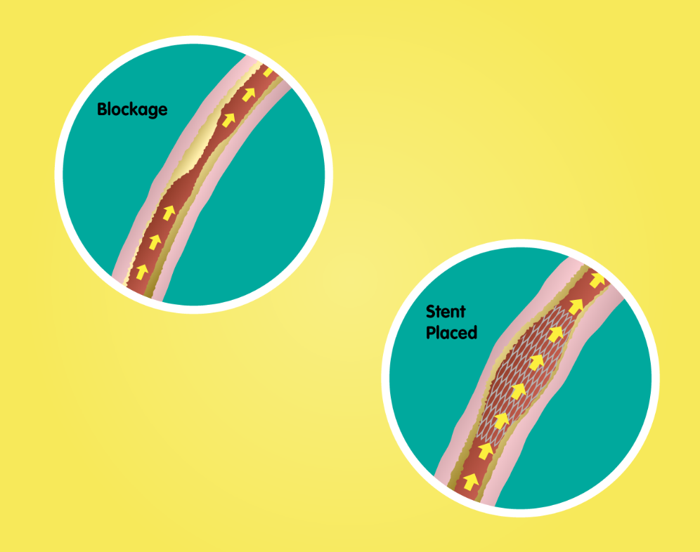
Smart Metals and Their Applications
Eyeglasses
Photo from http://resource.download.wjec.co.uk.s3.amazonaws.com/vtc/2016-17/16-17_1-4/website/category/2/shape-memory-alloys-sma/index.html
Rover Wheel
Video from NASA Glenn Research Center
Artery Stint
Photo from http://resource.download.wjec.co.uk.s3.amazonaws.com/vtc/2016-17/16-17_1-4/website/category/2/shape-memory-alloys-sma/index.html

Slide 5
Engineering Design Challenge
Use the engineering design process to invent your own use for Nitinol.
Think of eyeglasses that repair themselves, or robots that move without motors. Let’s see if you can turn this strange wire into the next big thing in technology.

Slide 6
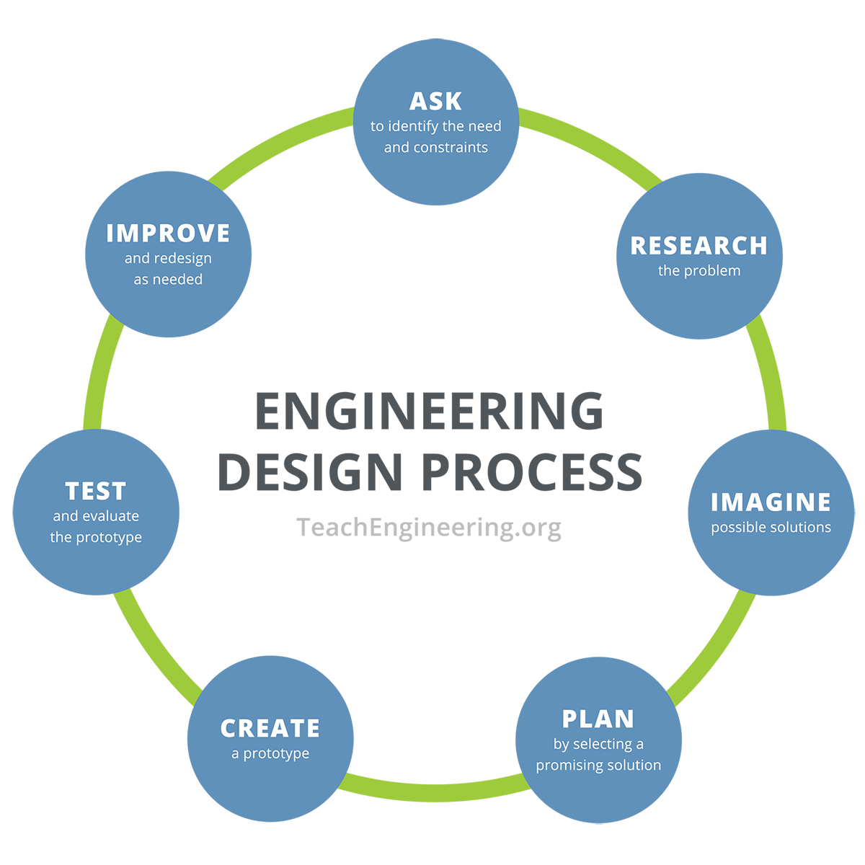
Engineering Design Process

Slide 7
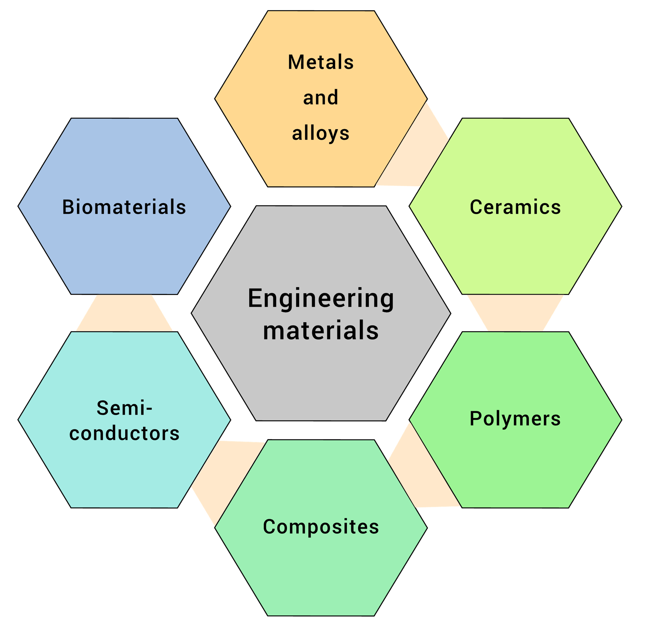
Materials Science and Engineering
In this activity, we will be learning about materials science:
Materials scientists work in an interdisciplinary field, discovering new materials and understanding their properties.
In this activity, we will be thinking like materials engineers:
Materials engineers focus on understanding the properties of materials and applying that knowledge to design, develop, and improve materials for use in various industries and fields.
By raster original by Mohanp06vectorization by B. Jankuloski. - File: Materials classification.png, CC BY-SA 4.0, https://commons.wikimedia.org/w/index.php?curid=128648098

Slide 8
Thinking Like an Engineer
Engineers use a specific process to produce designs and solve problems.
You will be using this process in your activity today. This process is called the engineering design process, and it contains the following steps:
Define the problem
Research the problem
Imagine solutions
Plan a solution
Create a prototype design
Test and evaluate the prototype
Improve design as needed
This process can repeat over and over again because the goal is the best possible solution!

Slide 9
Background Information
Which of the following are nonmetals? How do you know?
Which of the following are metals? How do you know?
Ni Ca Ti O N F C
Remember:
Nonmetals are dull, brittle, poor conductors of heat and electricity—located on the right side of the periodic table.
Metals are shiny, malleable, and good conductors of heat and electricity—located on the left side of the periodic table.

Slide 10
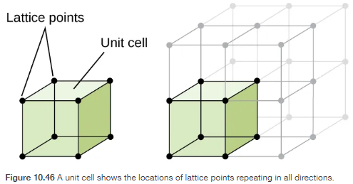
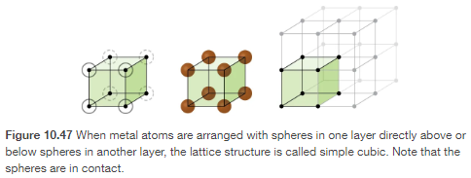
Structure of Metals and Alloys
Metals have a specific repeating micro-structure called a unit cell.
Unit cells have lattice points that show the position of each of the atoms.
One type of unit cell pattern is called a simple cubic structure.

Slide 11
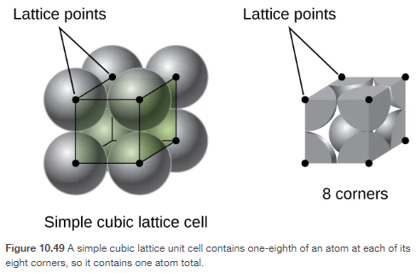
Microscopic and Macroscopic
The regular arrangement of the simple cubic structure is reflected on the macroscopic level.
Macroscopic properties such as strength of metals are due to features of the microscopic arrangement.
The size of atoms, arrangement of atoms, and distance to other atoms all affect macroscopic properties such as strength.

Slide 12
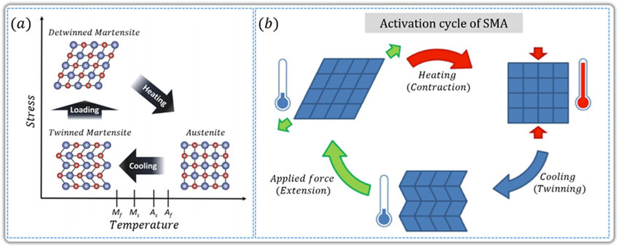
Structure of Nitinol (NiTi)
The macroscopic changes in the shape of NiTi are due to microscopic changes in its structure.
The NiTi structure in a straight wire starts as a cubic structure called austenite and changes to a squished cube structure called martensite.

Slide 13
Changes in NiTi Microstructure
Austenite
Martensite
Let’s walk through the demonstration from the beginning of class and discuss the changes that occurred in the macroscopic, along with the changes in the microscopic.

Slide 14
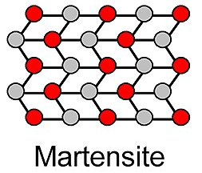
Changes in NiTi Microstructure
Microscopic
Macroscopic
When we started the demonstration, what did the metal look like?
What is the temperature of the metal?
Are there any stresses on the metal?

Slide 15
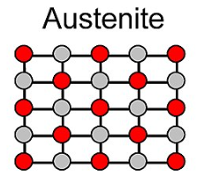
Changes in NiTi Microstructure
Microscopic
Macroscopic
At the end of the demonstration, what did the metal look like?
What is the temperature of the metal?
Are there any stresses on the metal?

Slide 16
Changes in NiTi Microstructure
Microscopic
Macroscopic
When we started the demonstration, what did the metal look like?
What is the temperature of the metal?
Are there any stresses on the metal?

Slide 17
Changes in NiTi Microstructure
Microscopic
Macroscopic
At the end of the demonstration, what did the metal look like?
What is the temperature of the metal?
Are there any stresses on the metal?

Slide 18
Design Challenge
Design a device that performs a mechanical task using the shape memory properties of NiTi.
You can use any of the following materials: paper, scissors tape, glue, stapler, other small objects, and power supply with alligator clips.
The goal of this task is to create a working design that performs a mechanical task with NiTi.
You will use the engineering design process to create your prototype.

Slide 19
Example Procedure: Mechanical Design
Make a small pocket out of paper and tape to hold pennies.
Loop into or run the wire through the paper pocket.
Tape the wire to a lab table surface, allowing it to hang off the edge.
Add a few pennies to the pocket, causing it to droop down below the table surface.
Connect the alligator clips to each end of your wire.
Turn on the power supply to cause your design to move and lift.

Slide 20
Nitinol: Board Requirements
Use a good layout for your board: Think “webpage,” not paragraphs or lists.
Make sure you EXPLAIN the microscopic and macroscopic changes in your prototype.
Your board must include:
Name of your prototype.
Sketch of your team’s prototype.
Explanation of macro/microscopic changes that occur in your prototype.
Use of new vocabulary.
Difficulties your group faced, and how you persevered.
Ways to improve your prototype.

