Slide 1
Rube Goldberg Machine

Slide 2
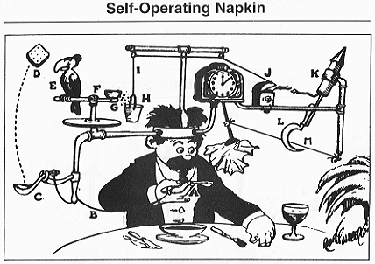
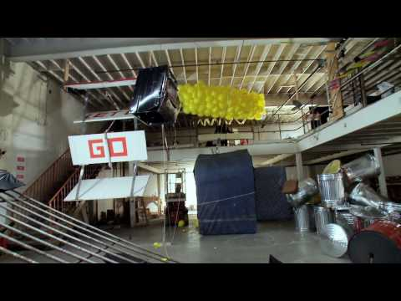
What is a Rube Goldberg Machine?

Slide 3
Q&A
What makes a Rube Goldberg device unique?
Who can name a simple machine?
Bonus: How many types of simple machines exist?

Slide 4
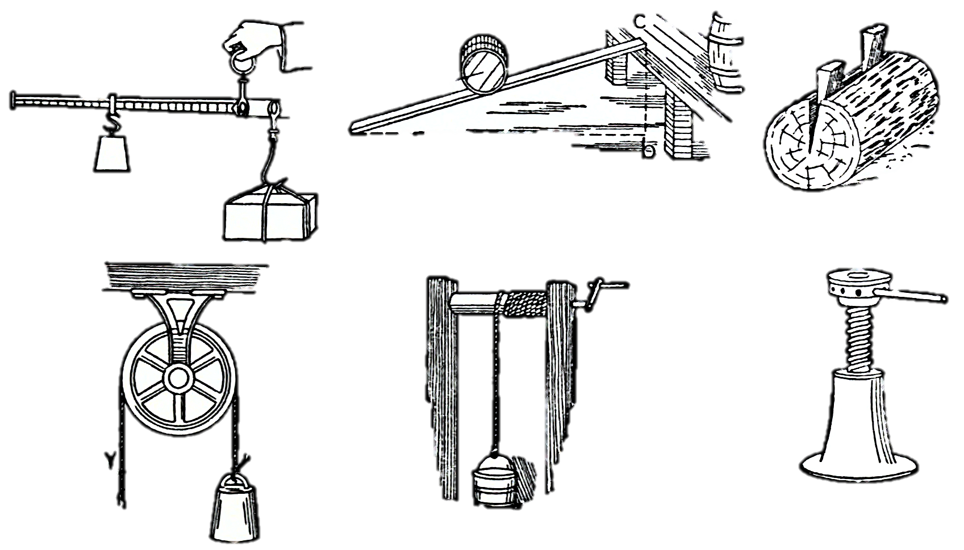
Simple Machines
Lever
Wheel and axle
Pulley
Inclined plane
Wedge
Screw

Slide 5
Simple Machines
Design a Rube Goldberg device that uses at least six simple machines sequentially.
Try to use most materials: cardboard, tape, hot glue, popsicle sticks, string, marbles, cardboard tubes, drinking straws, plastic soda bottles, and dominoes.
Remember, you’re not limited to just these materials; be creative!
Use 3D printed components, if a printer is available.
Each team member is responsible for at least two stages.
Record your design in your notebook.

