Slide 1
Engineering a Better Cast – Prototype Examples

Slide 2
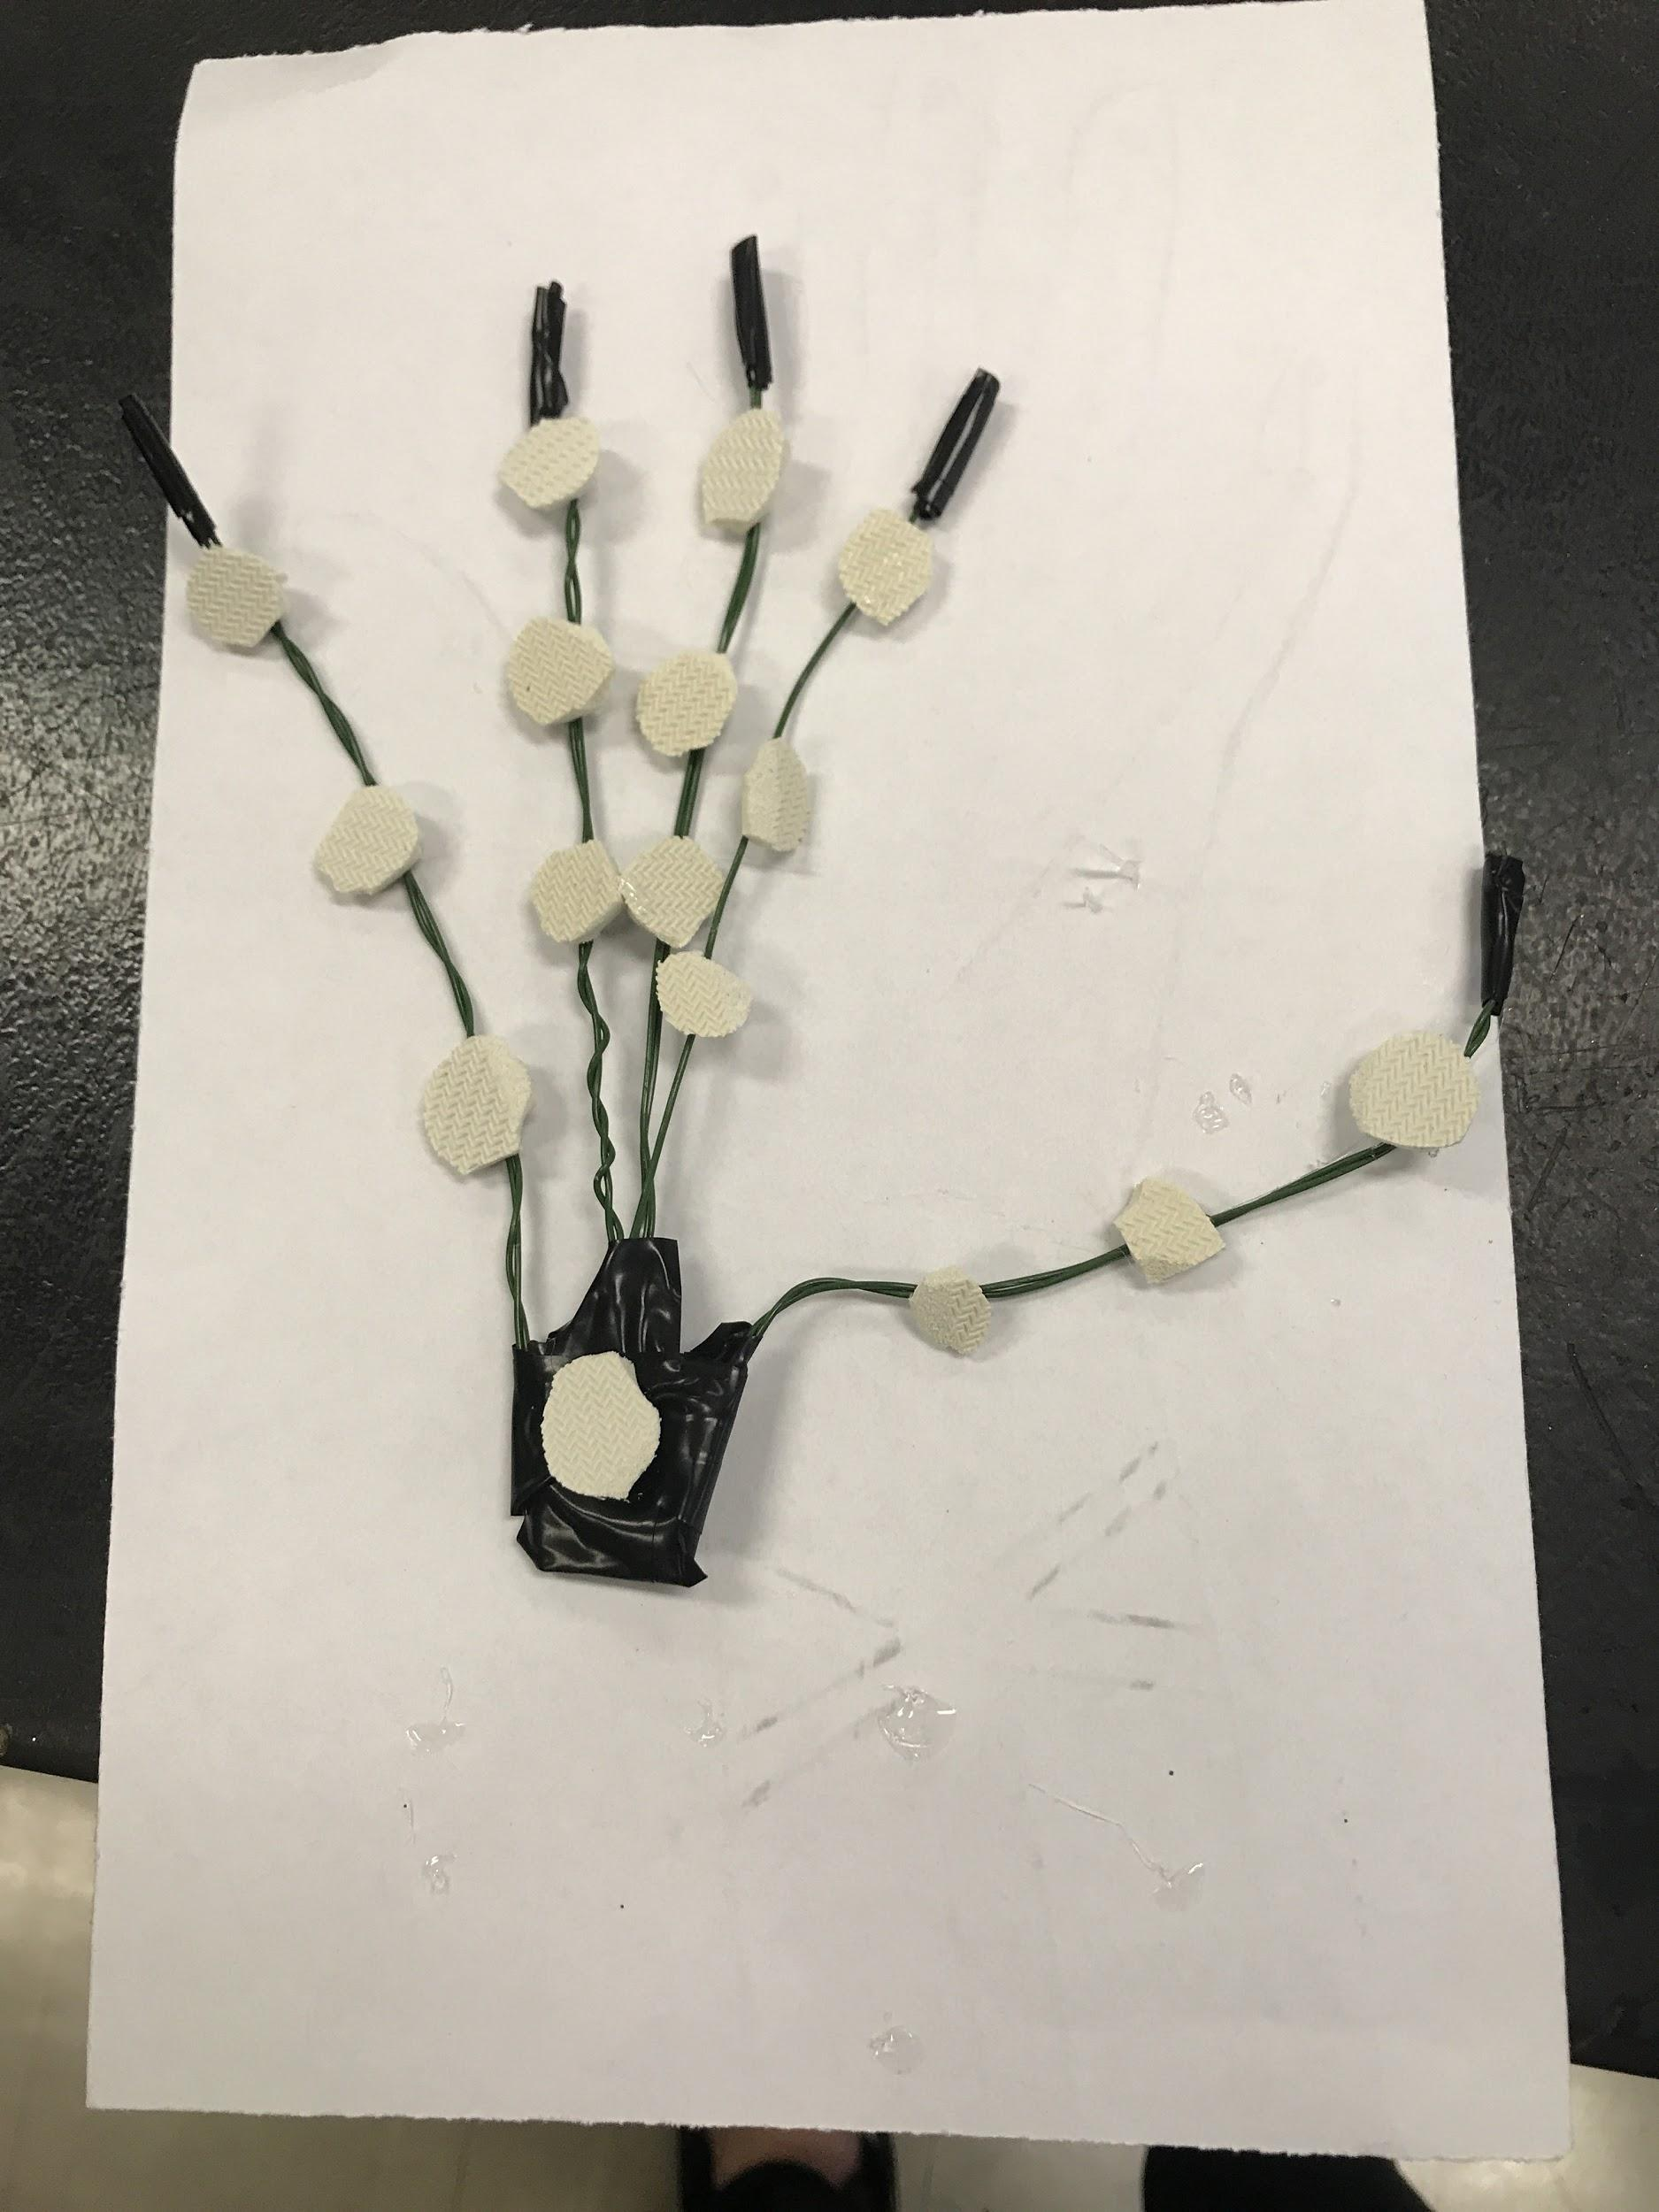
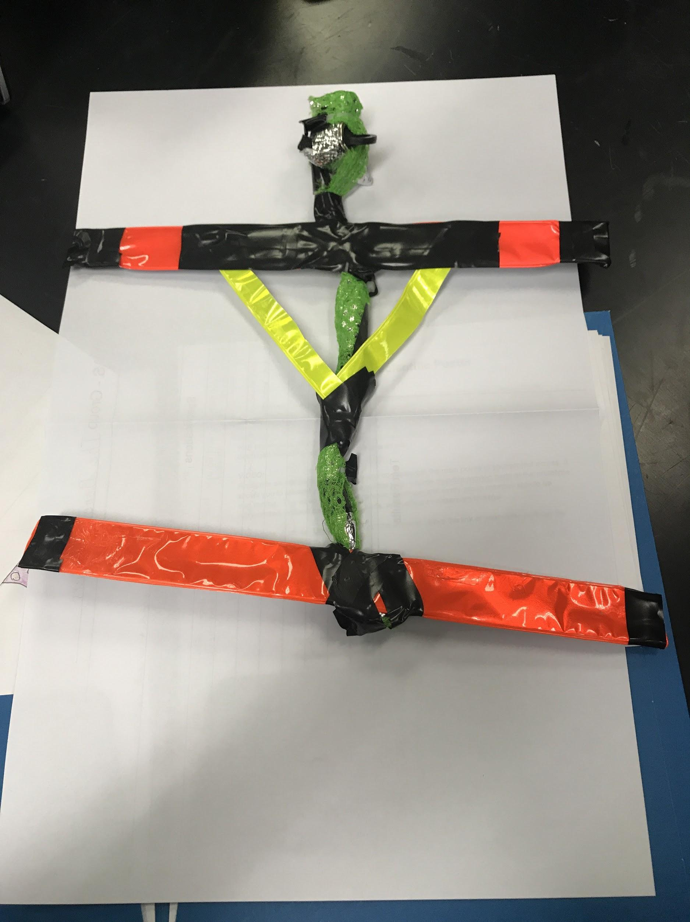

Slide 3
