Slide 1
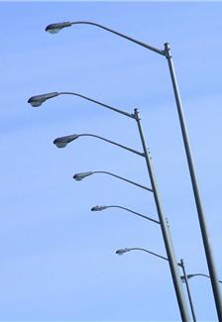
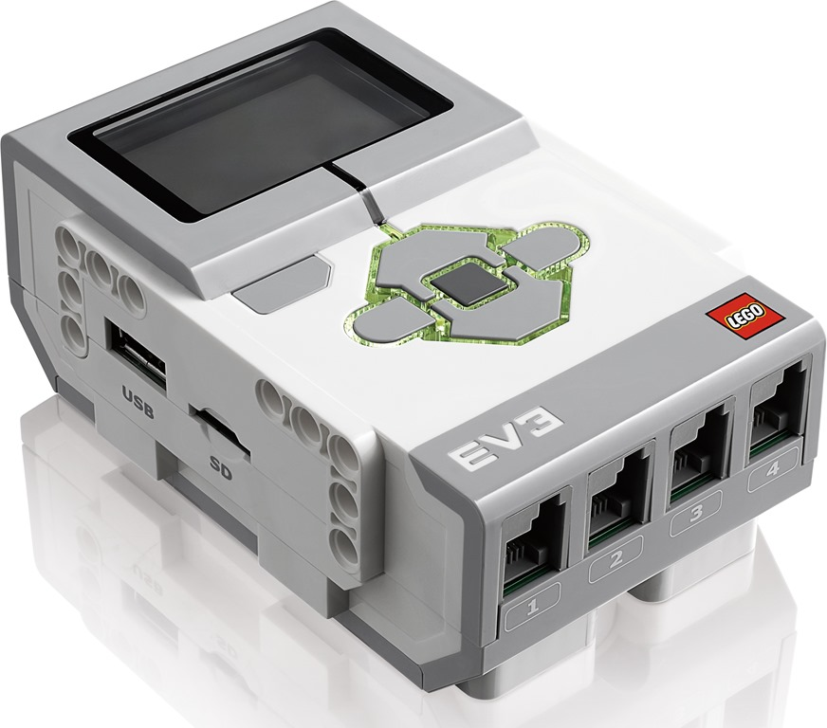
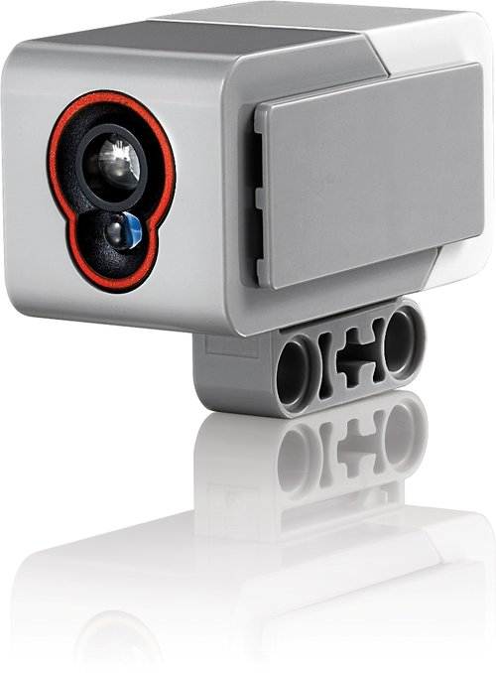
How Does a Color Sensor Work?
Notes:
How Does a Color Sensor Work? Presentation > TeachEngineering.org

Slide 2
Color Sensor Pre-Quiz
How do humans sense light?
Provide an example “stimulus-sensor-coordinator-effector-response” framework using human eyes as the color sensor.
Give some examples of color sensors in engineering systems.

Slide 3
Color Sensor Pre-Quiz Answers
How do humans sense light?
Humans have two eyes that collect light that falls on objects in front of them, and helps them to “see” the objects.
Provide an example “stimulus-sensor-coordinator-effector-response” framework using human eyes as the color sensor.
Example: sight of a scary object such as a wasp > two eyes > signals to human brain via nerves > signal to leg muscles > run to safety
Give some examples of color sensors in engineering systems.
Examples: cameras; sensors that turn lights on when it gets dark outside; porch lights, streetlights and car headlights that turn on automatically in low light or at night

Slide 4
Review: From Stimulus to Response
stimulus > sensor > coordinator > effector > response
light > eyes > nervous system > muscle > run
From the sequence of steps above, what might happen in the example of a child seeing a wasp? The stimulus is light from wasp, the sensor is the eye that senses it and relays it to the nervous system (spinal cord and brain) which is the coordinator. The coordinator makes the decision of how to react, and then commands the leg muscles (the effector) to run for shelter quickly. So, we go from stimulus (sight) to response (movement of legs).
Do This: Sketch out a stimulus-to-response sequence for how this might be implemented in a robot. Identify all the components, as in the example above.
Notes:
An example answer is provided on the post-quiz answer key on slide 16. Review student answers as a class.

Slide 5
Sense of Sight
Close your eyes for a second. Then open your eyes and look around you.
Have you ever wondered, how you are able to see things around you? How do your eyes function?
When light rays fall on the eye they pass through the pupil of the eye.
The iris changes the size of the pupil depending on the amount of light. It shrinks in the presence of less light and enlarges in the presence of more light.
Then, what happens at the back of the eye ball?

Slide 6
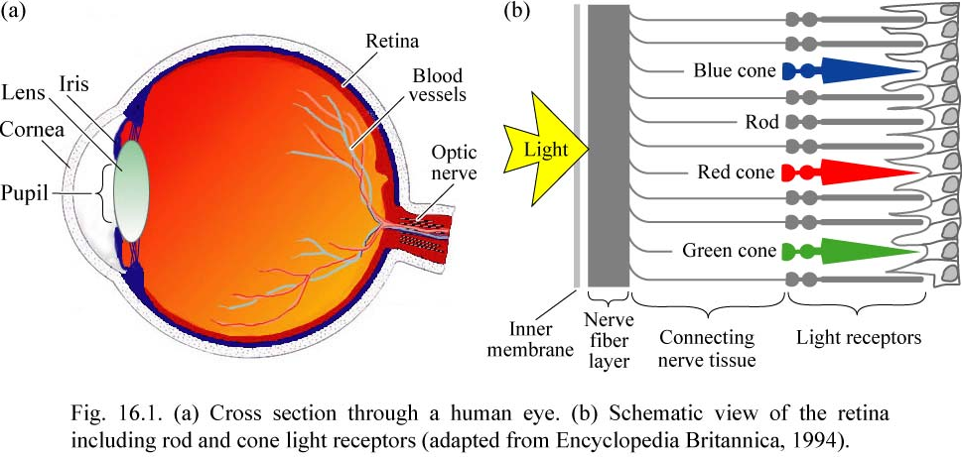
Vision & Human Eye Anatomy

Slide 7
Sense of Sight (continued)
A lens behind the pupil focuses the image onto the retina.
The image is upside down, but the visual cortex in the brain helps you identify the image.
The retina is filled with light-sensitive cells called rods and cones.
Rods identify shapes.
Cones identify color.

Slide 8
Sense of Sight (continued)
Watch the “Sense of Sight – How Human Eyes Work” video (1:39 minutes) and try the activity in the video:
http://www.youtube.com/watch?v=ZH8L3i-qxuE
(optional) Watch this optical illusion:
http://www.michaelbach.de/ot/index.html

Slide 9
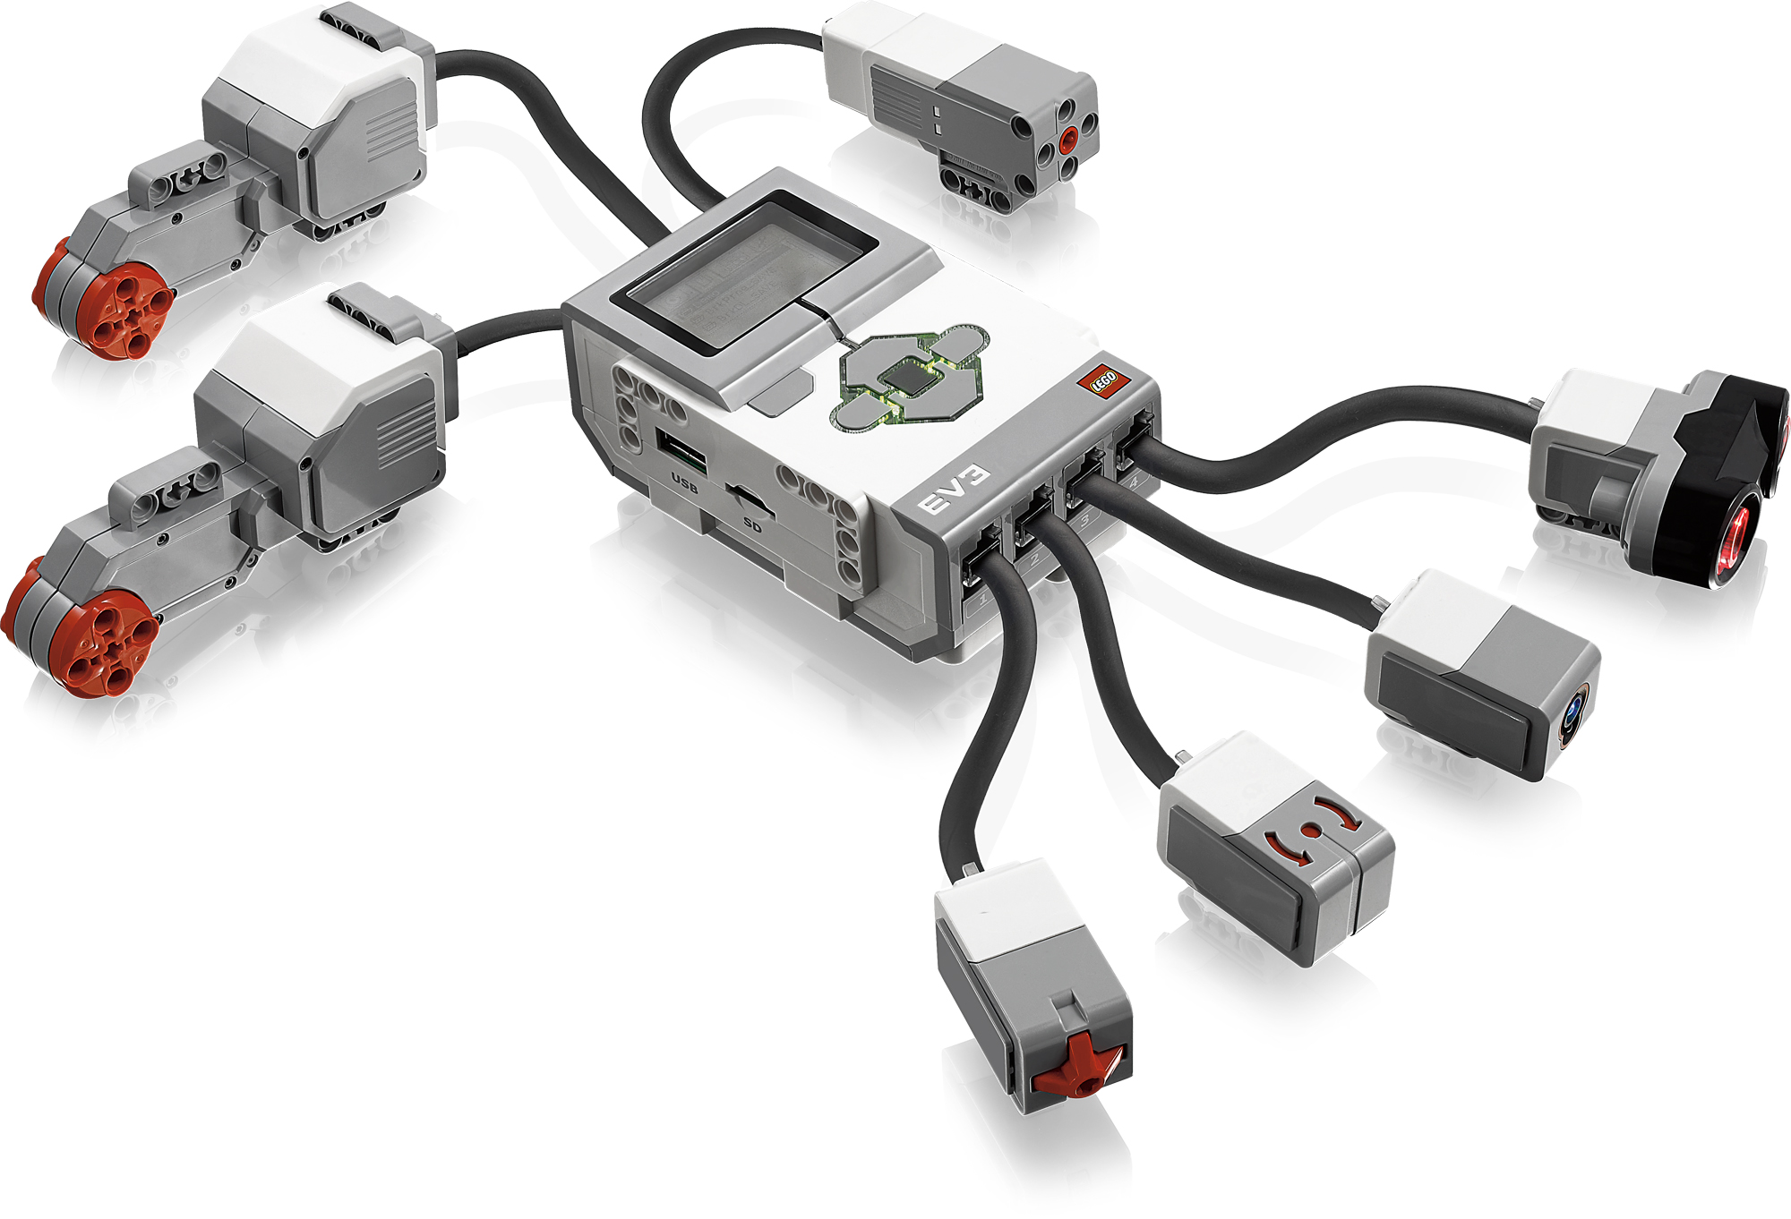
Review: Robot Sensors
(As stated in an earlier activity,) robot sensors:
Gather information from the surroundings and send it to the computer brick
Robot sensors can only be used if a robot’s program asks for information from them!
Similarly, a robot can only act on information from the sensors if its program tells it to do so!
How do sensors send signals to the EV3 brick?
The sensors send information through the wires (similar to the nervous system in your body) that connect them to the computer brick, which uses the information if its program requires it.

Slide 10
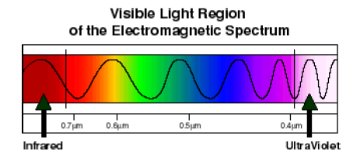
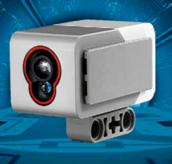
How Are Color Sensors Made?
Color sensors are made using electronics.
The electronics enable the sensor to distinguish between the different colors in the light spectrum.
The EV3 color sensor detects colors and brightness, also called intensity.

Slide 11
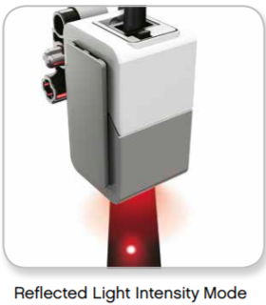
How Does the EV3 Color Sensor Work?
top: color sensor
bottom: lamp (sends out light)
The LEGO MINDSTORMS EV3 color sensor works in 3 different modes:
In Reflected Light Intensity Mode, the sensor measures the intensity of light reflected back from a red light–emitting lamp. The sensor uses a scale of 0 (very dark) to 100 (very light). → ‘COL-REFLECT’

Slide 12
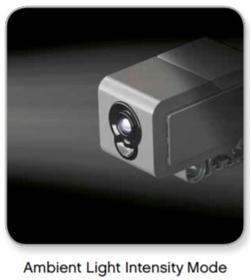
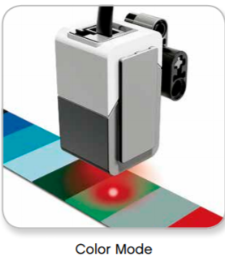
How Does the EV3 Color Sensor Work?
In Ambient Light Intensity Mode, the sensor measures the strength of light that enters the window from its environment, such as sunlight or the beam of a flashlight. The sensor uses a scale of 0 (very dark) to 100 (very light). → ‘COL-AMBIENT’
In Color Mode, the sensor recognizes seven colors—black (1), blue (2), green (3), yellow (4), red (5), white (6), and brown (7)—plus No Color (0). → ‘COL-COLOR’
We will use the first two modes in this lesson (not color mode)

Slide 13
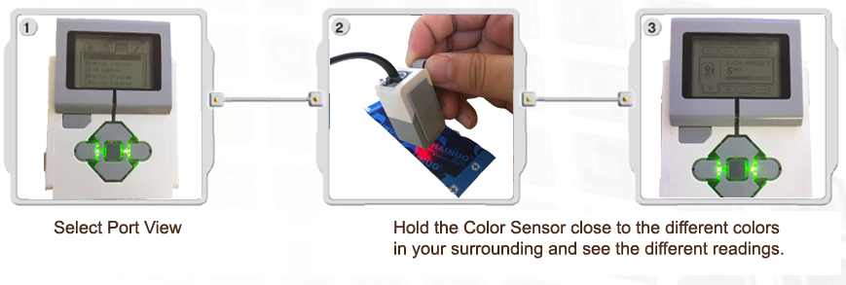
Let’s Investigate
How does the brick read the signal from the light sensor?
Do This: Attach the sensor to the LEGO brick. Then use the VIEW command and go to the color sensor. Test the color sensor in 2 modes.
In the “reflected light” mode, the sensor’s flood light (the bottom) is turned on. Follow the instructions in the diagram below.
Higher numbers indicate BRIGHTER light
Lower numbers indicate a lower brightness of light (darker).

Slide 14
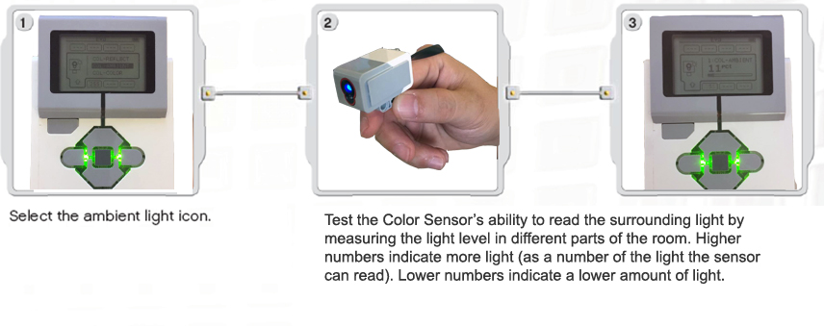
Let’s Investigate (continued)
In the “ambient light” mode, the flood light is turned off. Follow the instructions in the diagram below.

Slide 15
Color Sensor Post-Quiz
How does the LEGO EV3 color sensor work?
Provide an example “stimulus-sensor-coordinator-effector-response” framework using the EV3 color sensor.
Give some examples of color sensors in engineering systems.

Slide 16
Color Sensor Post-Quiz Answers
How does the LEGO EV3 color sensor work?
The color sensor detects the color and brightness of light it receives and uses a scale of 0 (very dark) – 100 (very light).
Provide an example “stimulus-sensor-coordinator-effector-response” framework using the EV3 color sensor.
Example: light > LEGO EV3 color sensor > (transmission to coordinator) value sent to EV3 brick via wire > brick sends a signal to the EV3 motors > robot moves
Give some examples of color sensors in engineering systems.
Examples: cameras; sensors that turn lights on when it gets dark outside; porch lights, streetlights and car headlights that turn on automatically in the low light or at night

Slide 17
Vocabulary
sensor: A device that converts one type of signal to another; for instance, the speedometer in a car collects physical data and calculates and displays the speed the car is moving.
visual: Related to seeing.
transducer: Another term for a sensor (see above).
peripheral: Surrounding.

Slide 18
Image Sources
Slide 1: row of streetlights; source: Microsoft® clipart: http://office.microsoft.com/en-us/images/results.aspx?qu=street+lights&ex=1#ai:MP900385958|
Slides 1, 9-15: LEGO device & instruction images; source: LEGO MINDSTORMS EV3 User’s Guide file:///C:/Users/Dua/Downloads/User%20Guide%20LEGO%20MINDSTORMS%20EV3%2010%20All%20ENUS.pdf
Slide 5: closed eyes; source: Microsoft® clipart: http://office.microsoft.com/en-us/images/results.aspx?qu=eyes&ex=1#ai:MP900426560|mt:2|
Slide 6: cross-section of human eye and rod & cones diagram; adapted from Encyclopedia Brittanica, 1994
Slide 8: child’s brown eyes; source: Microsoft® clipart: http://office.microsoft.com/en-us/images/results.aspx?qu=eyes&ex=1#ai:MP900423034|mt:2|
Slide 10: light spectrum chart; source: NASA: http://science.hq.nasa.gov/kids/imagers/ems/visible.html
Slide 13-14: screen captures; source: author

