Slide 1
AEROGEL COOKIES

Slide 2
Intro to STEM Education
STEM is integrated problem based learning → Solving real world problems
In STEM, your teacher is not your main source of information.
In STEM, you are:
to integrate information you’ve learned in various classes
to research, ask each other questions—recognize all of your resources
Notes:
You have a great mind so we don’t want you memorizing information. We want you solving real problems. When you ask me questions, you will often hear me say, That is a good question. How can you go about finding the answer to this question?’
You will lose points if the answer to your question is on your lab paper.
You teacher is not the sole source of information. Your teacher will not answer questions that you can solve on your own or by using other resources you have available to you. Your teacher will guide you but not give out information.

Slide 3
Intro cont’d
You are
to read and ask thoughtful questions
to try various strategies--think creatively & critically
to discuss, design, explain, try again, present, & ...
to, most of all, NOT GIVE UP

Slide 4
STEM Habits of Mind (Expectations)
You are to demonstrate growth in the
Engineering Design Process
21st Century Skills (Soft Skills):
Collaboration
Creativity
Critical Thinking (try multiple strategies; be able to explain why you chose them, etc)
Perseverance
Communication
Conflict Resolution

Slide 5
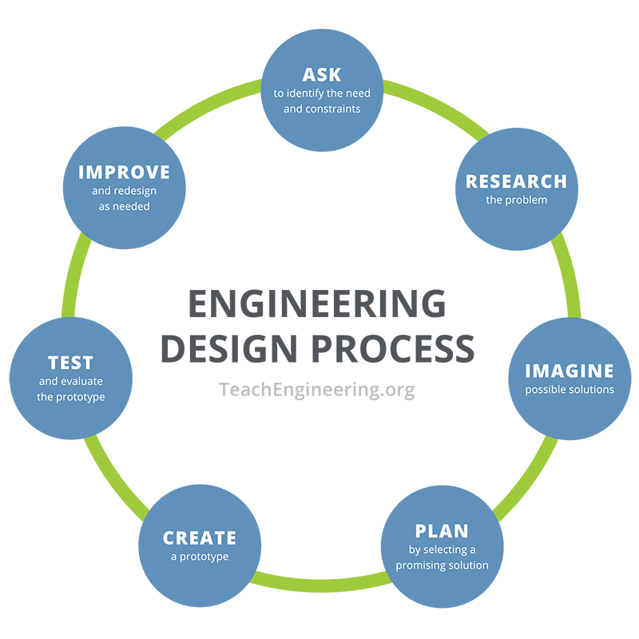
Engineering Design Process

Slide 6
Who Cares about Soft Skills? Employers!
Articles about the importance of soft skills
https://www.inc.com/lou-adler/hiring-guide-soft-skills.html
http://workforcesolutions.stlcc.edu/2013/time-soft-skill-deficiencies-college-graduates/
https://www.goskills.com/Soft-Skills/Articles/Skills-gap
https://www.shrm.org/hr-today/news/hr-magazine/0416/Pages/HRs-Hard-Challenge-When-Employees-Lack-Soft-Skills.aspx
https://www.fastcompany.com/3059940/these-are-the-biggest-skills-that-new-graduates-lack
https://www.fastcompany.com/3059940/these-are-the-biggest-skills-that-new-graduates-lack
https://www.dailymail.co.uk/wires/pa/article-2909129/Many-workers-lack-soft-skills.html
https://www.monster.com/career-advice/article/soft-skills-you-need
https://www.monster.com/career-advice/article/soft-skills-you-need
https://www.fool.com/investing/general/2013/12/07/college-graduates-suffer-from-a-lack-of-soft-skill.aspx
https://www.amle.org/BrowsebyTopic/WhatsNew/WNDet/TabId/270/ArtMID/888/ArticleID/585/Soft-Skills-Preparing-Kids-for-Life-After-School.aspx
The list goes on and on. . .

Slide 7
STEM?
What is a STEM Career?
Click to see a HUGE list: https://www.cscc.edu/academics/departments/science/futurescientists/what.shtml

Slide 8
Why Else Consider a STEM Career?
http://www.wherestemcantakeyou.co.uk/docs/Why_STEM_Careers.pdf
https://www.napequity.org/professional-development/counselor-training/stem-careers-students/
https://study.com/articles/Ten_Reasons_to_Consider_a_Career_in_the_STEM_Fields.html
https://examinedexistence.com/what-is-stem-and-why-is-it-important/
https://blogs.gcu.edu/college-of-science-engineering-and-technology/pursue-stem-career/
https://www.ctelearning.com/best-stem-careers-2018/
https://www.idtech.com/blog/why-is-stem-important
https://www.precipart.com/blog/5-reasons-stem-career/
http://stem.getintoenergy.com/why-a-stem-career/
https://blogs.cisco.com/ciscoit/why-i-chose-a-stem-science-technology-engineering-and-math-career
http://stemcareer.com/why-stem/
https://www.youtube.com/watch?v=3bnMBhO0LnU https://careerwise.minnstate.edu/careers/stemcareers
The list goes on and on. . .

Slide 9
Thank you for listening!

