Slide 1
Much More Than Pretty Colors

Slide 2
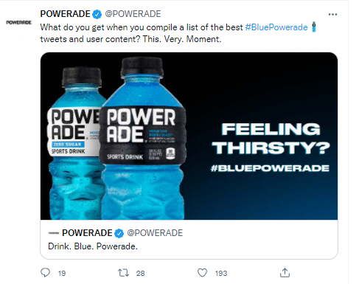
#f8a81b

Slide 3
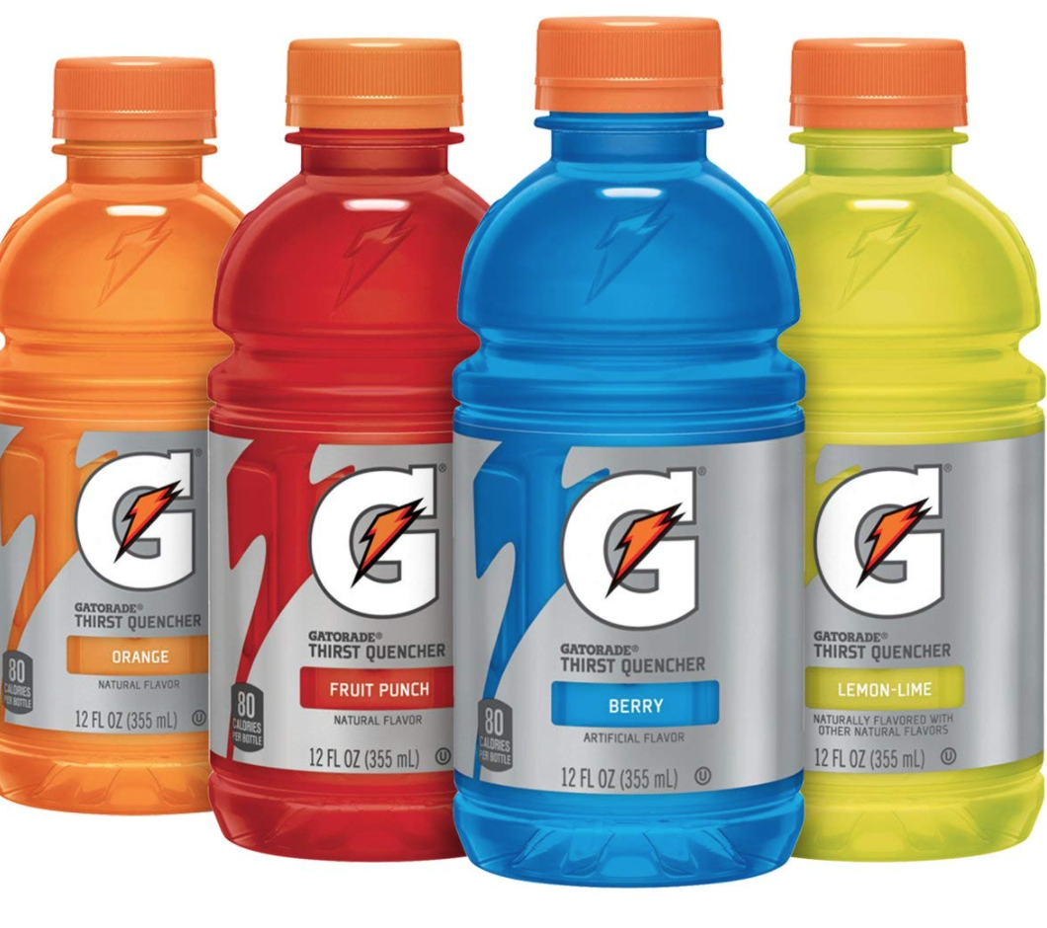

Slide 4
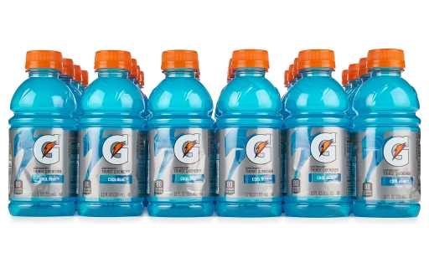
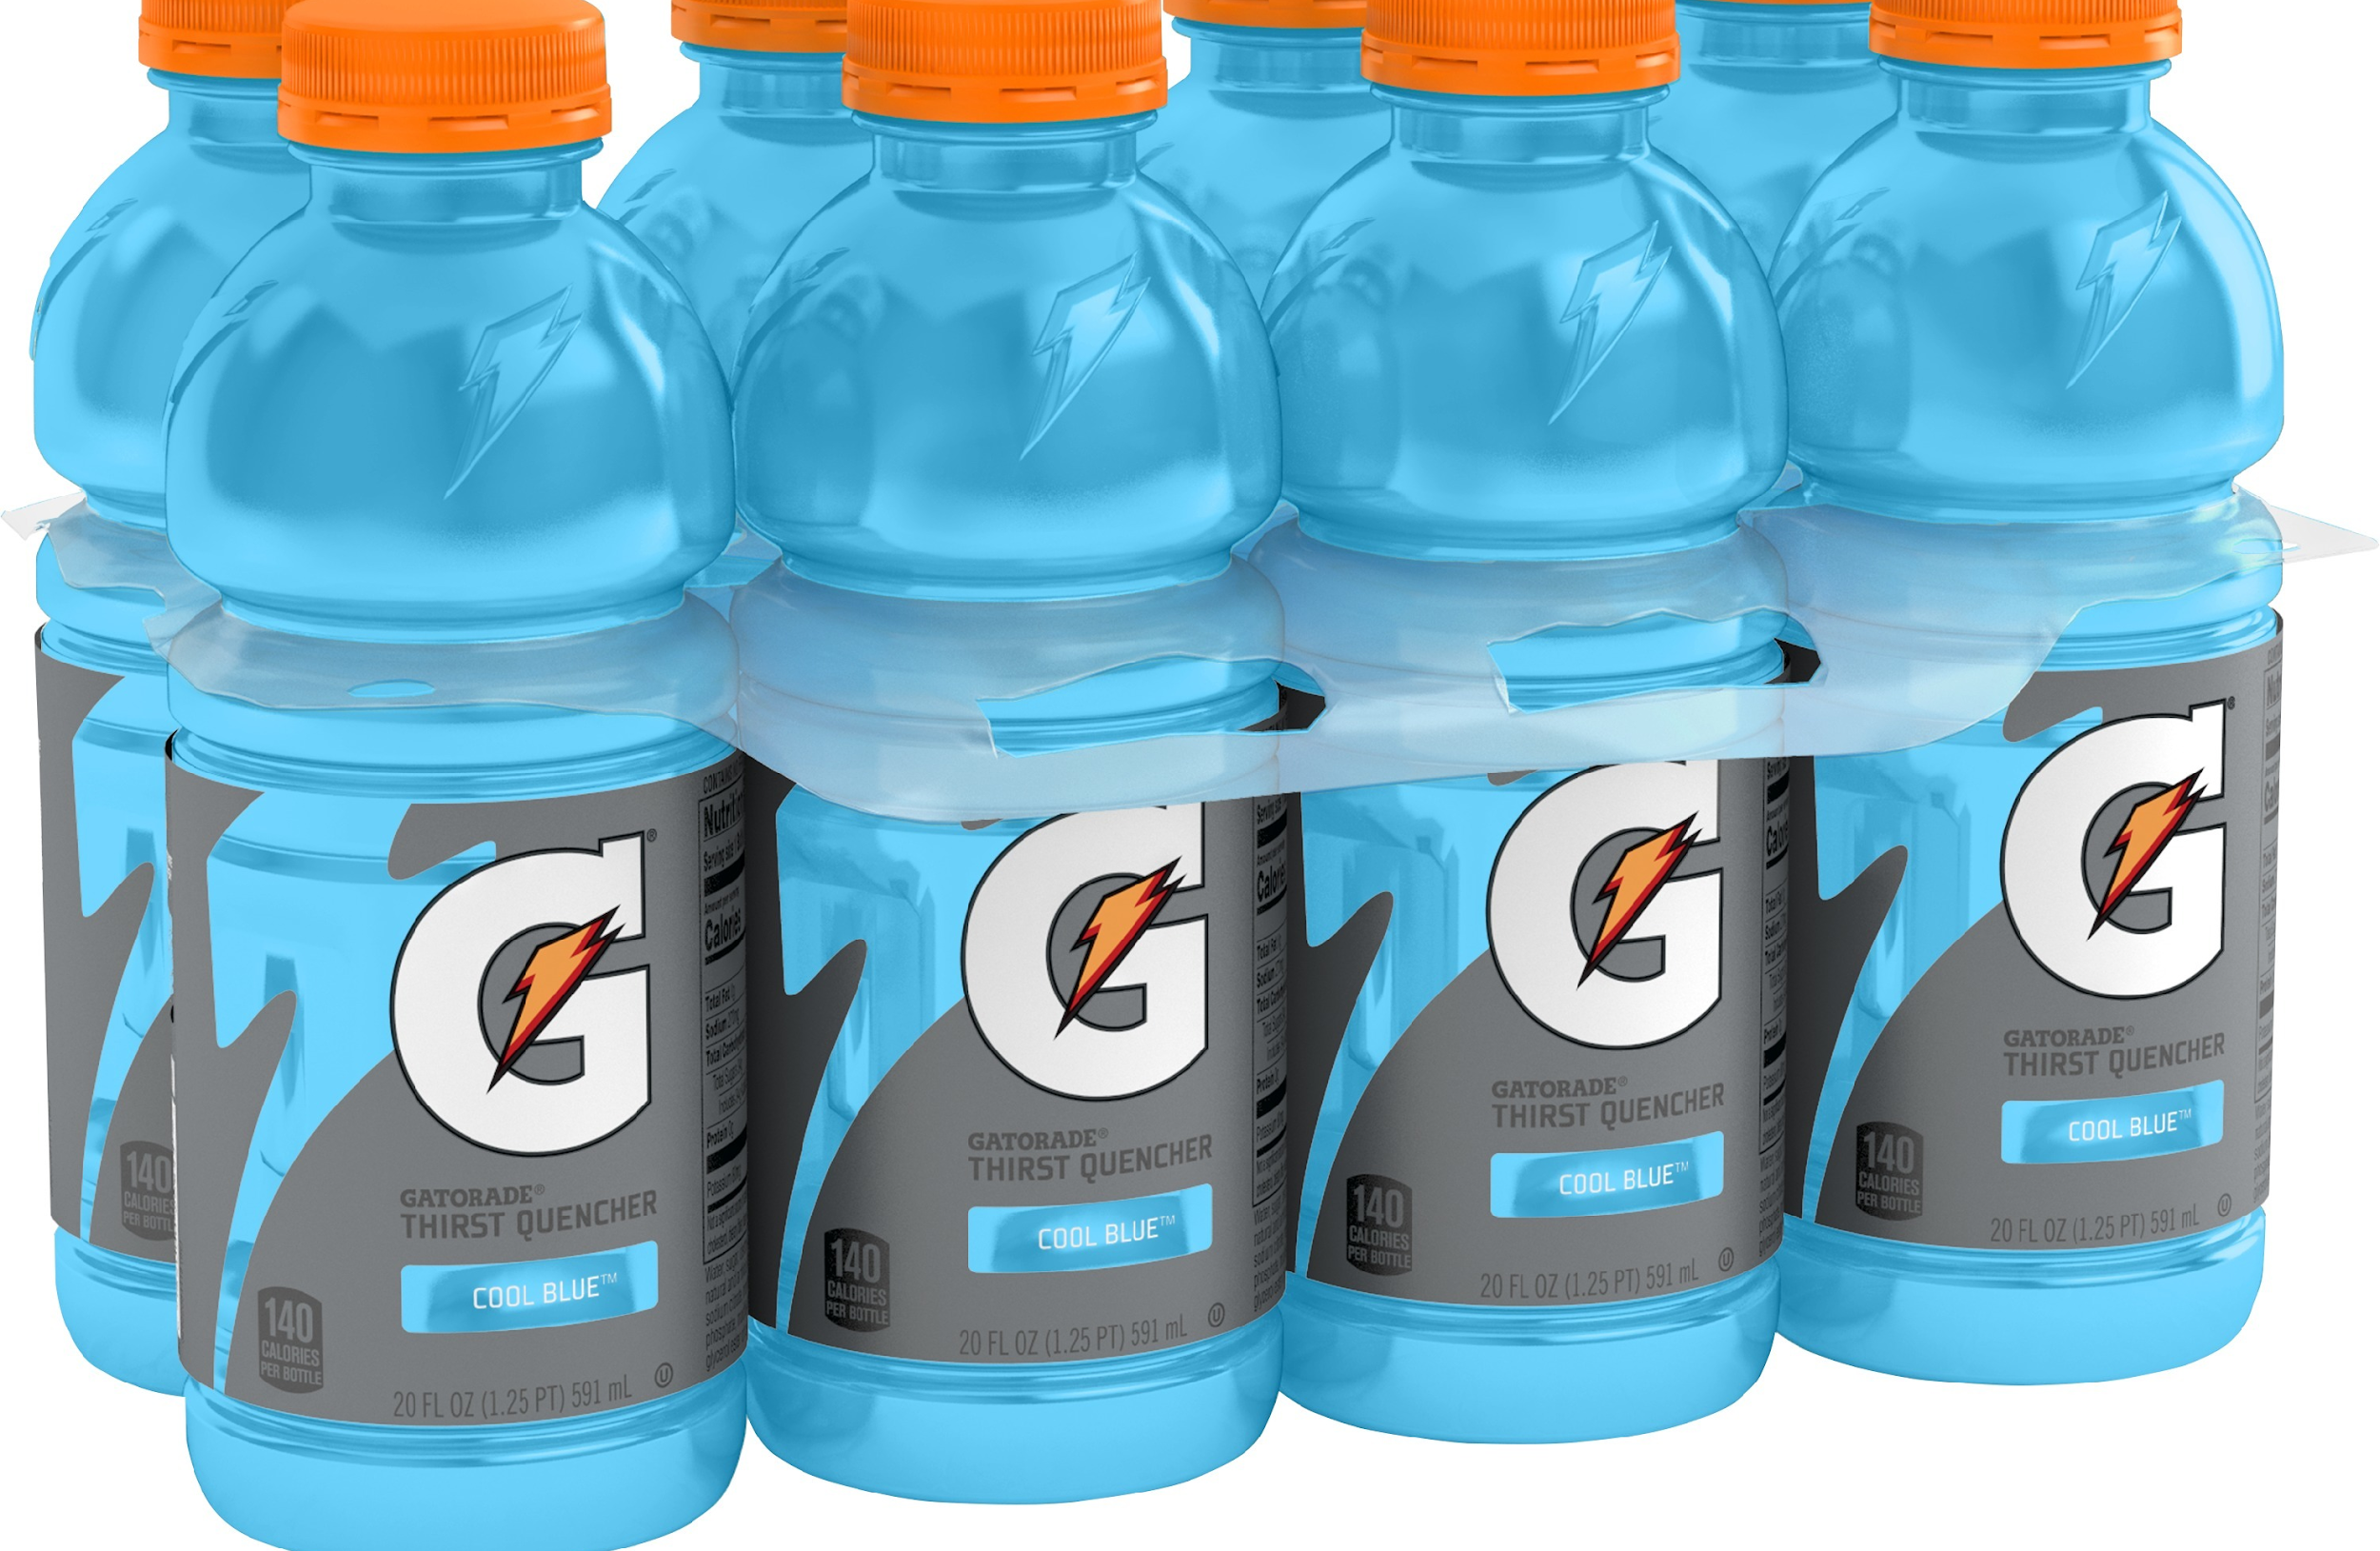
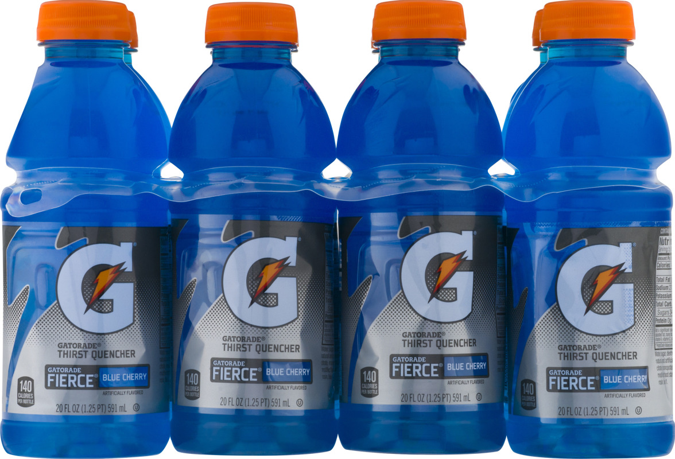
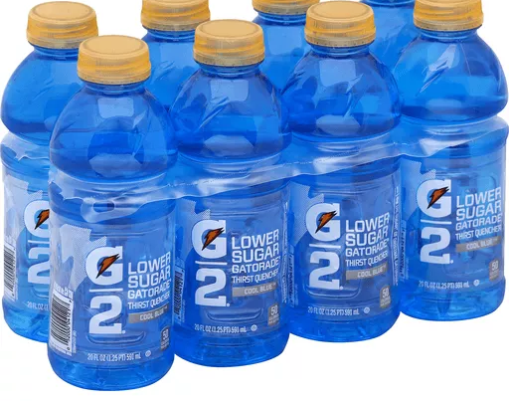
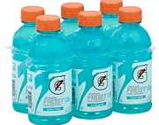

Slide 5
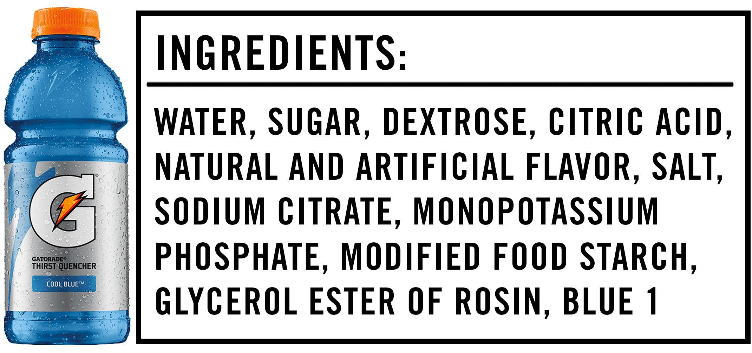

Slide 6
Have you ever thought about what makes a good food coloring?

Slide 7
A good food coloring needs to be:
Soluble in water
Able to retain their color for a long time

Slide 8
How is that possible?

Slide 9
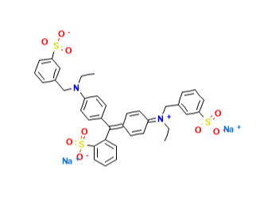
FD&C blue dye #1
Ionic compounds that dissolve in water are polar.

Slide 10
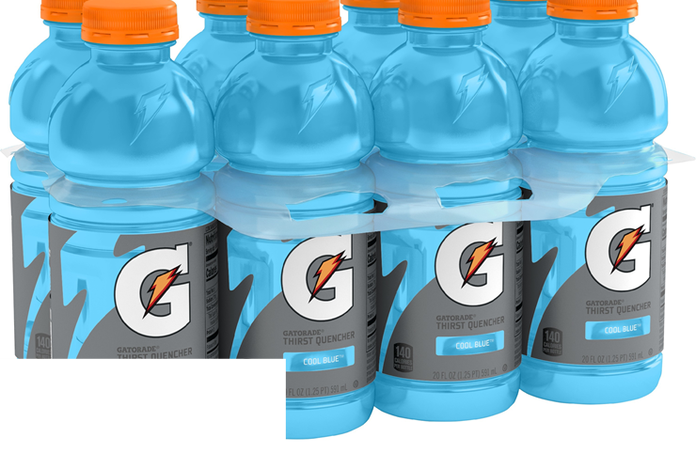
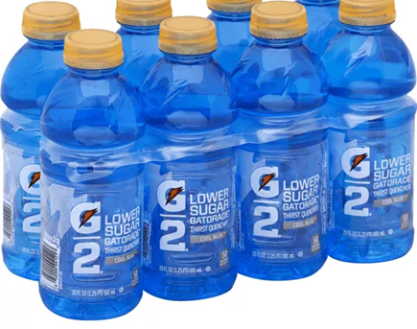
Food dyes absorb and transmit a certain color
How much?
Absorbance and concentration are related

Slide 11
Engineers use this relationship in quality control laboratories for food and pharmaceutical industries.

Slide 12
Today’s Activity
Lab Connection: Measuring the absorbance of solutions with various concentrations of food dye and measure the concentration of a Gatorade sample.
Engineering: To design/construct a spectrophotometer/measuring instrument/analyzers

Slide 13
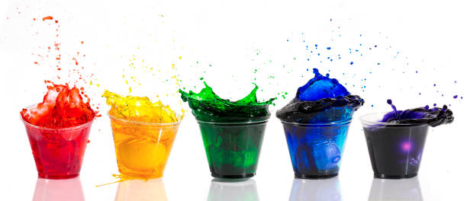
Teacher Demonstration - Absorbance
Food dyes have molecules that absorb some wavelengths of light and let others pass through.
Absorption is caused by bringing an electron in a molecule, atom, or ion to a higher energy level.

Slide 14
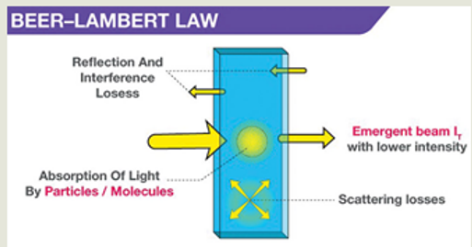
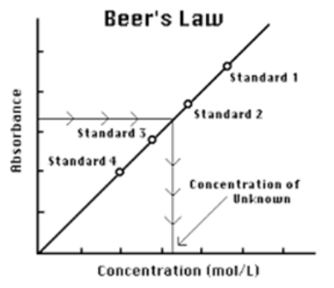
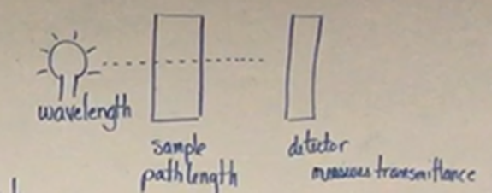
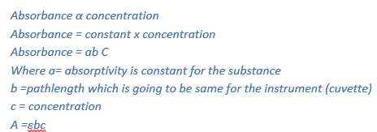
y=mx + b
b= 0= y intercept is zero
y= abc

Slide 15
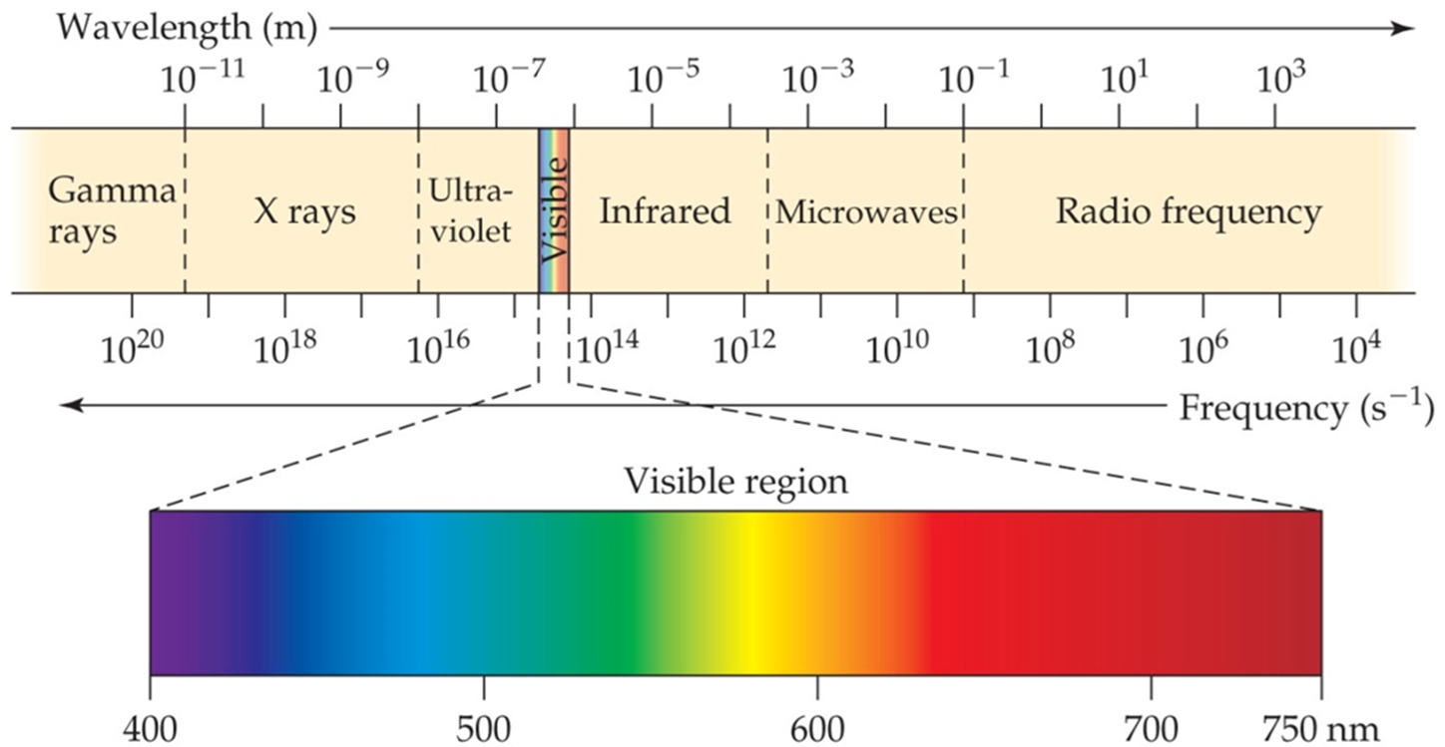
Spectroscopy is the study of the interaction of light and matter as a function of wavelength.
Engineers and scientists use spectroscopy as a tool to analyze the interaction between light and matter.

Slide 16
Unknown Sample - Gatorade
Known Sample - Stock solution with blue food color

Slide 17
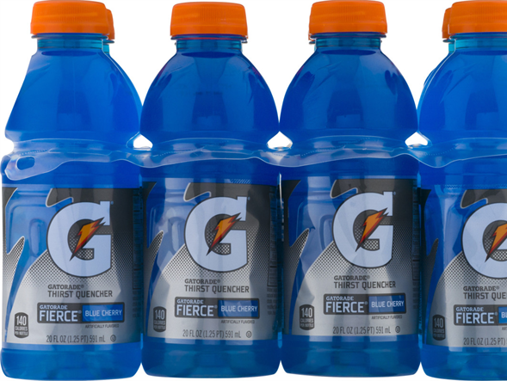
What is the unit of concentration of a solution?
Molarity (M)

Slide 18
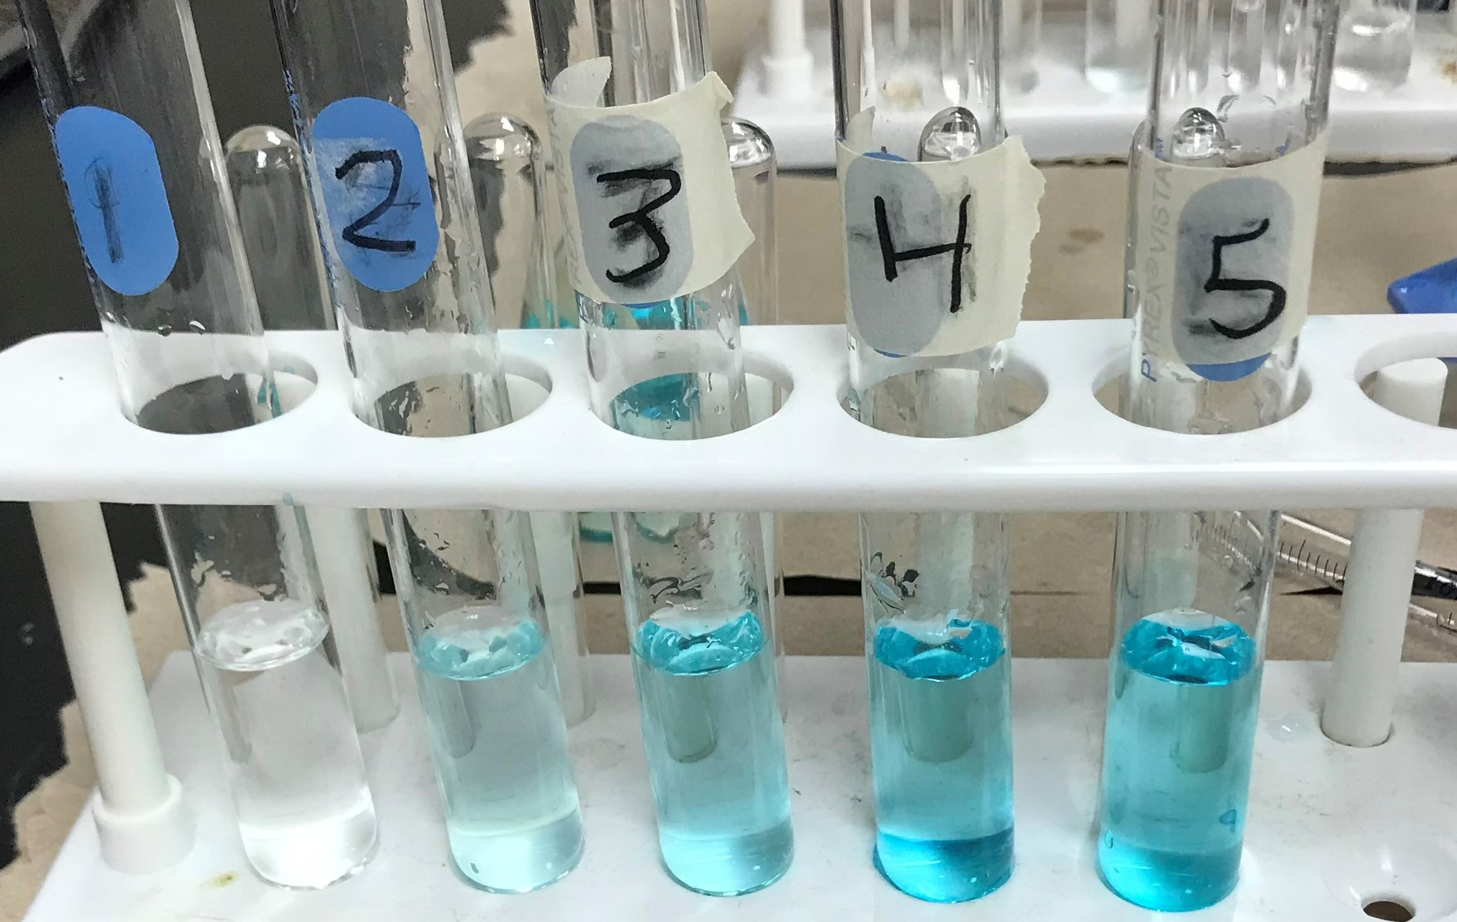
Write the dilution formula
M₁V₁=M₂V₂

Slide 19
M₁= 6 x 10⁻⁶ (for all)
V₂ = 10 ml (for all)
V₁ from the data table
Substitute and calculate M₂
M₁V₁=M₂V₂
6 x 10⁻⁶ x 2 = M₂ x 10
M₂ = (6 x 10⁻⁶ x 2)/10

Slide 20
Data Table
M₁= 6 x 10⁻⁶ (for all) V2 = 10 ml (for all)
V₁ (from the data table) Substitute and calculate M₂
Test tube # | Volume of the stock solution (ml) V1 | Volume of water (ml) | Concentration of diluted sample (M) M₁V₁=M₂V₂
1 Blank | 0 | 10 | 0
2 | 2 | 8 | 1.2 x 10 -6
3 | 4 | 6 | 2.4 x 10-6
4 | 6 | 4 | 3.6 x 10-6
5 | 8 | 2 | 4.8 x 10 -6

Slide 21
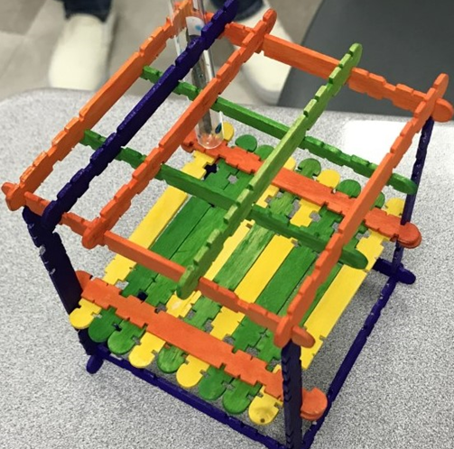
Construct a spectrophotometer with the given popsicle sticks.
Make a sample holder that holds the sample, the detector and light source at an appropriate distance.

Slide 22
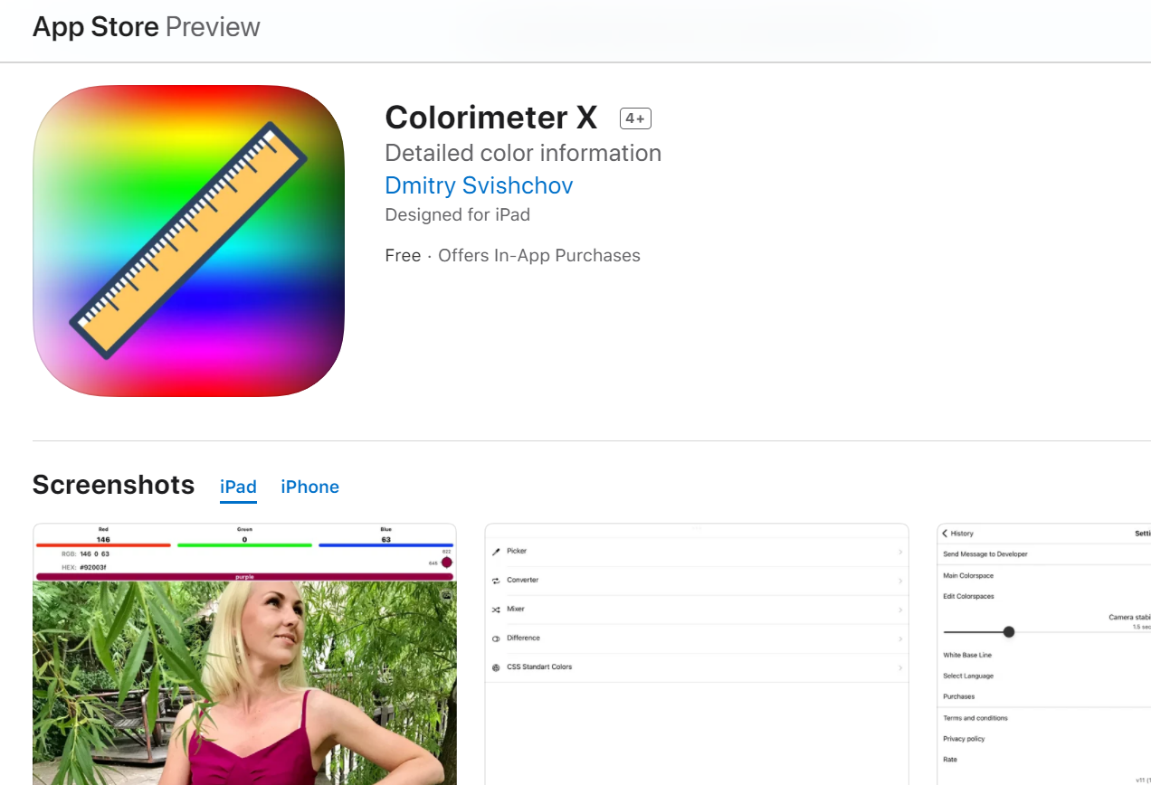
Download ColorimeterX on your smartphone

Slide 23
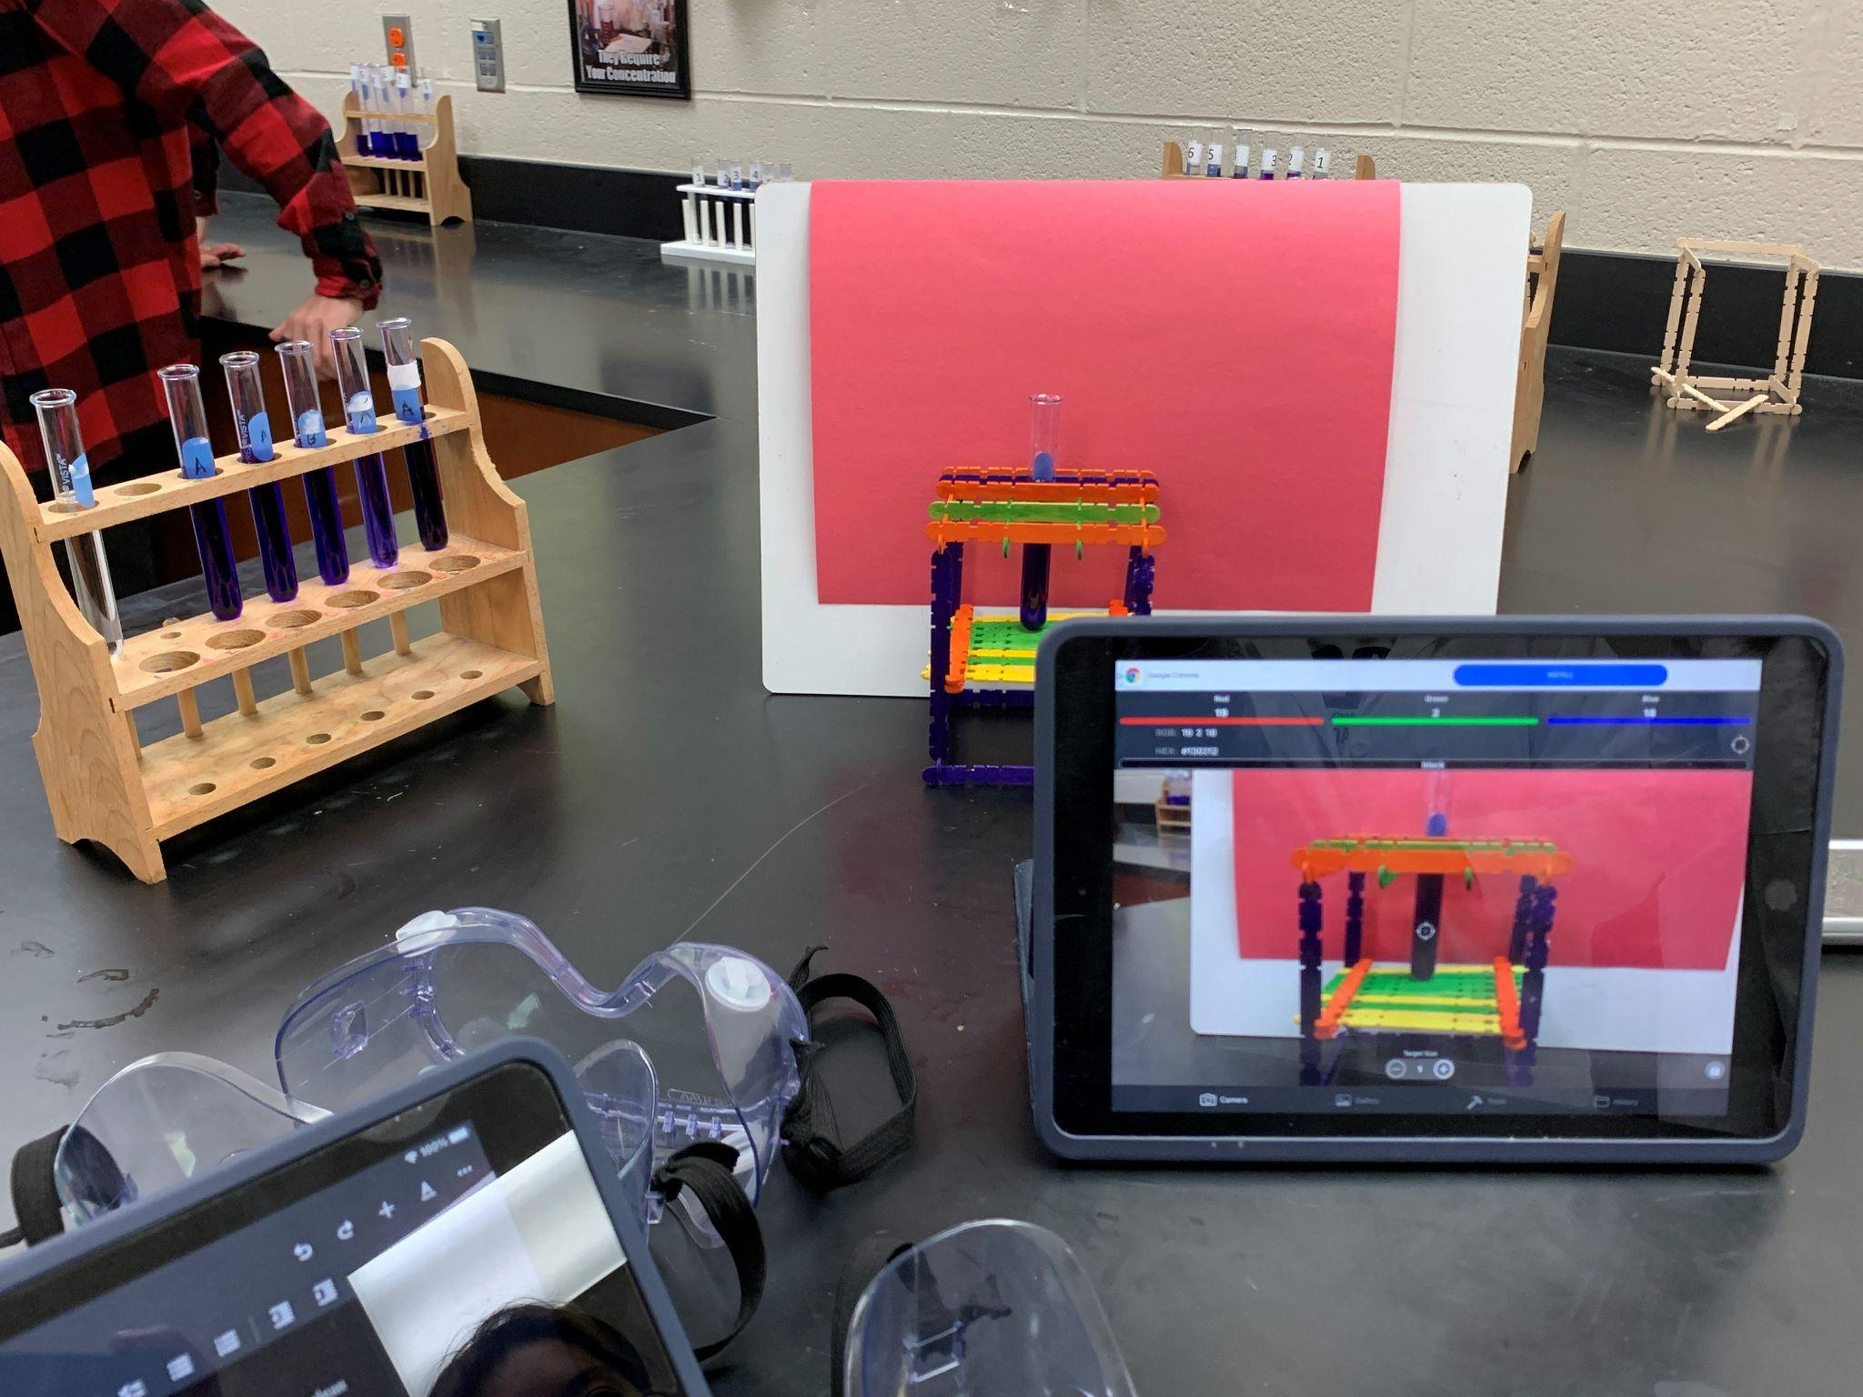

Slide 24
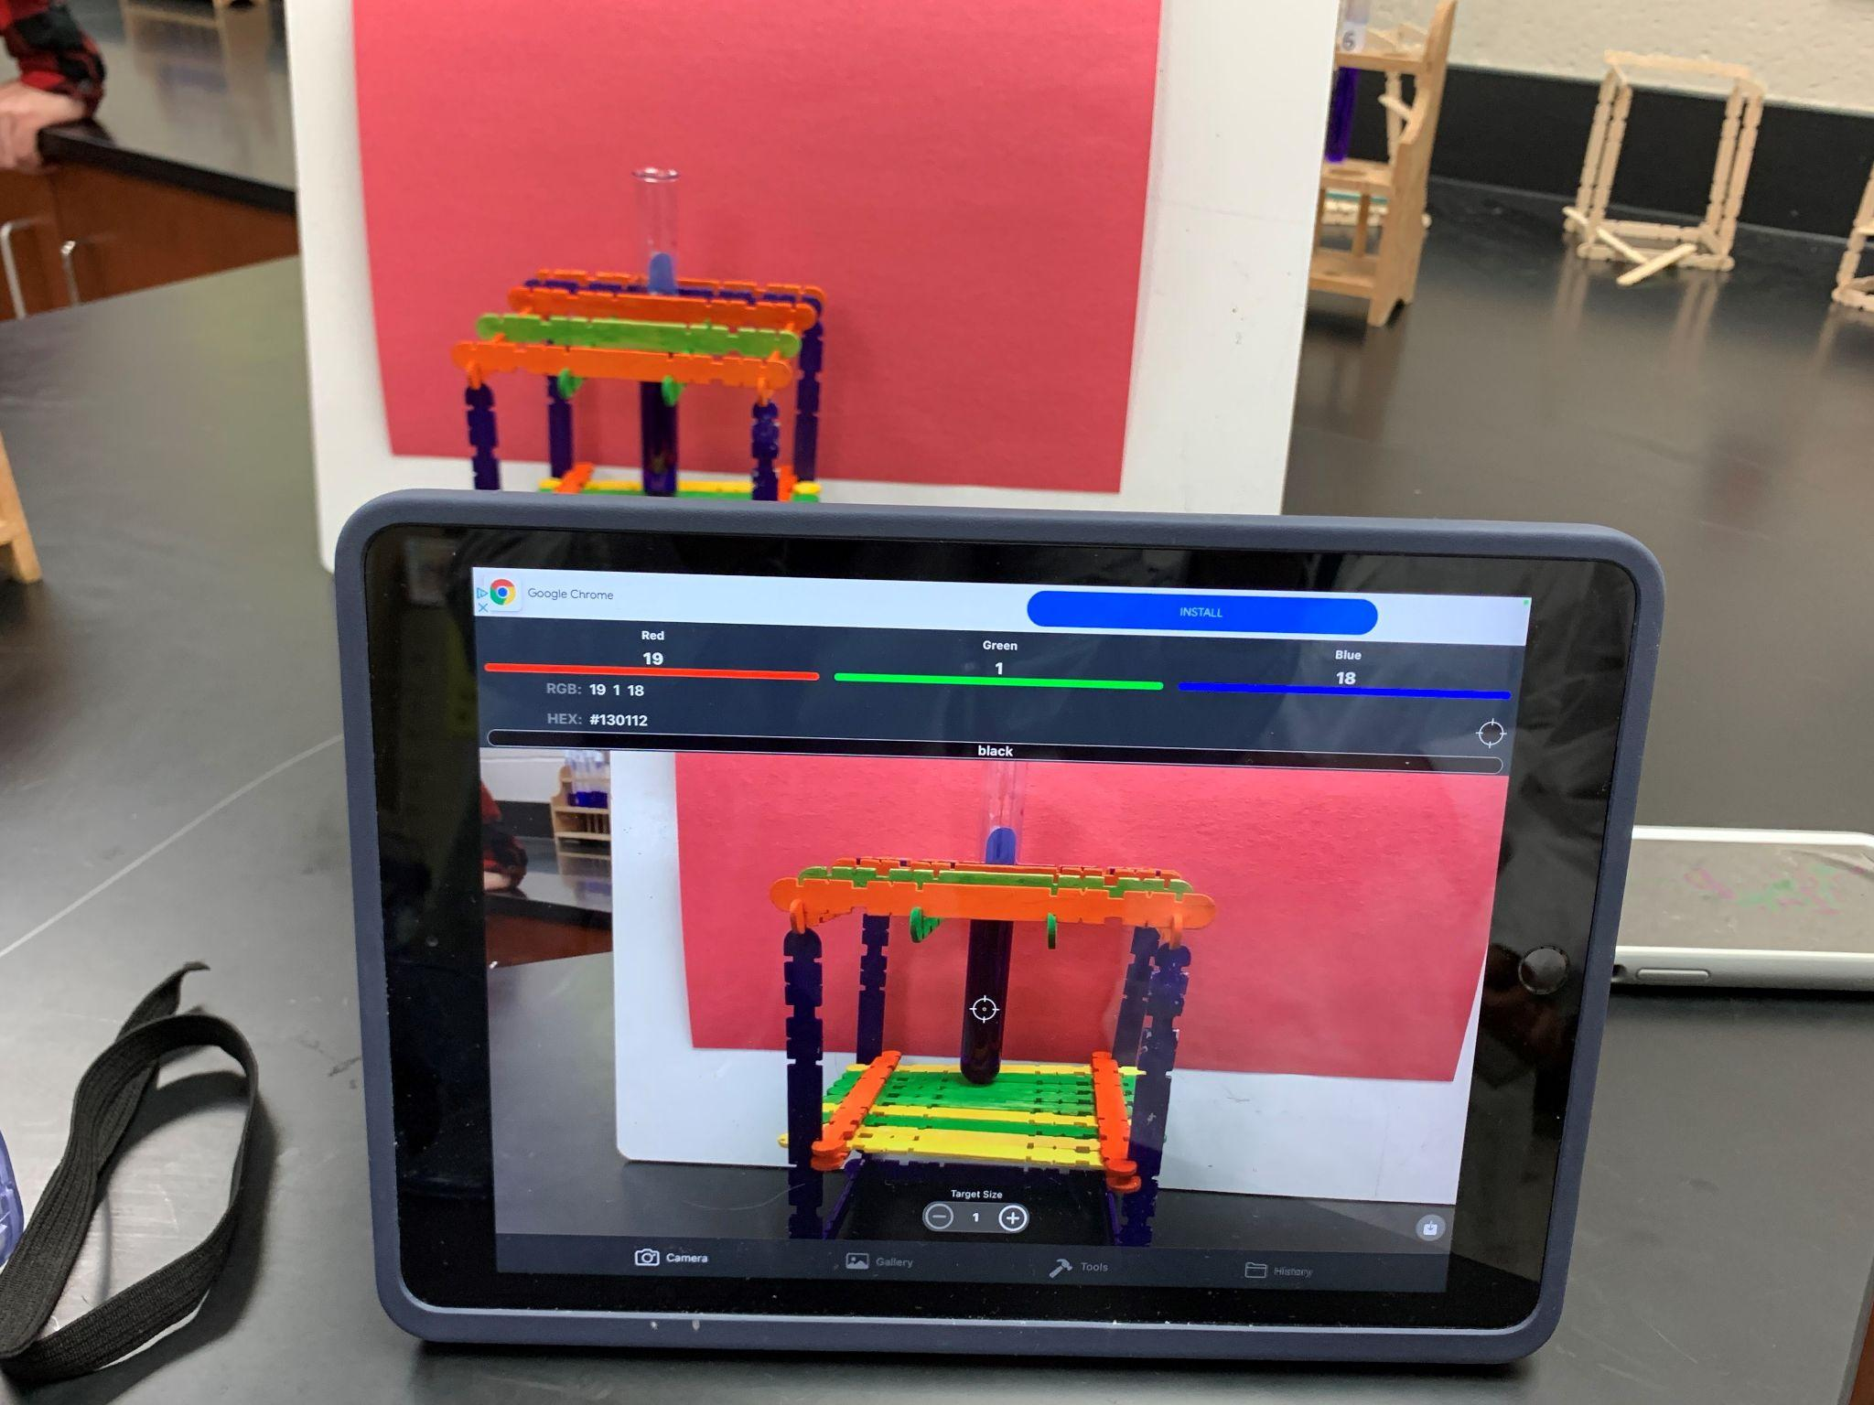

Slide 25
Procedure to measure absorbance:
Take 10 ml of the blank (distilled water) and wipe the side to make it clean and dry.
Tap the color identifier on your smartphone and record the red value on your data sheet.
Repeat steps 1-3 with diluted samples # 2-5.
Record the data in the data table in the appropriate concentration row.
Take a picture of your experimental setup and include it in your lab report.
Measure the absorbance of the unknown sample.

Slide 26
Data Table
Test tube | Stock Solution (6 x 10⁻⁶ M) | H₂O (ml) | Concentration (M) | R value | Absorbance = -log(I/I₀)
1 | 0 | 10 | 0.00
2 | 2 | 8
3 | 4 | 6
4 | 6 | 4
5 | 8 | 2
6 | 10 | 0 | 6 x 10⁻⁶

Slide 27
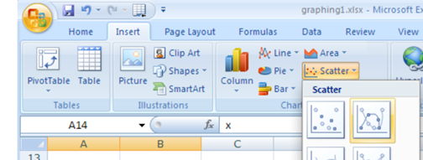
Plot a graph on Excel.
Graph the data concentration (x-axis) vs. absorbance (y-axis).
Provide an appropriate title and label x and y axes.
Enter the values of concentration and absorbance into two columns.
Highlight the cells and click on scatter plot.
Right click on the graph and click on Trend Line.
Then click on add equation and display equation. You will get an equation in y = mx +c format.
Select Linear as the Fit Equation → The best -fit linear regression line will be shown on the graph for your five data points.

Slide 28
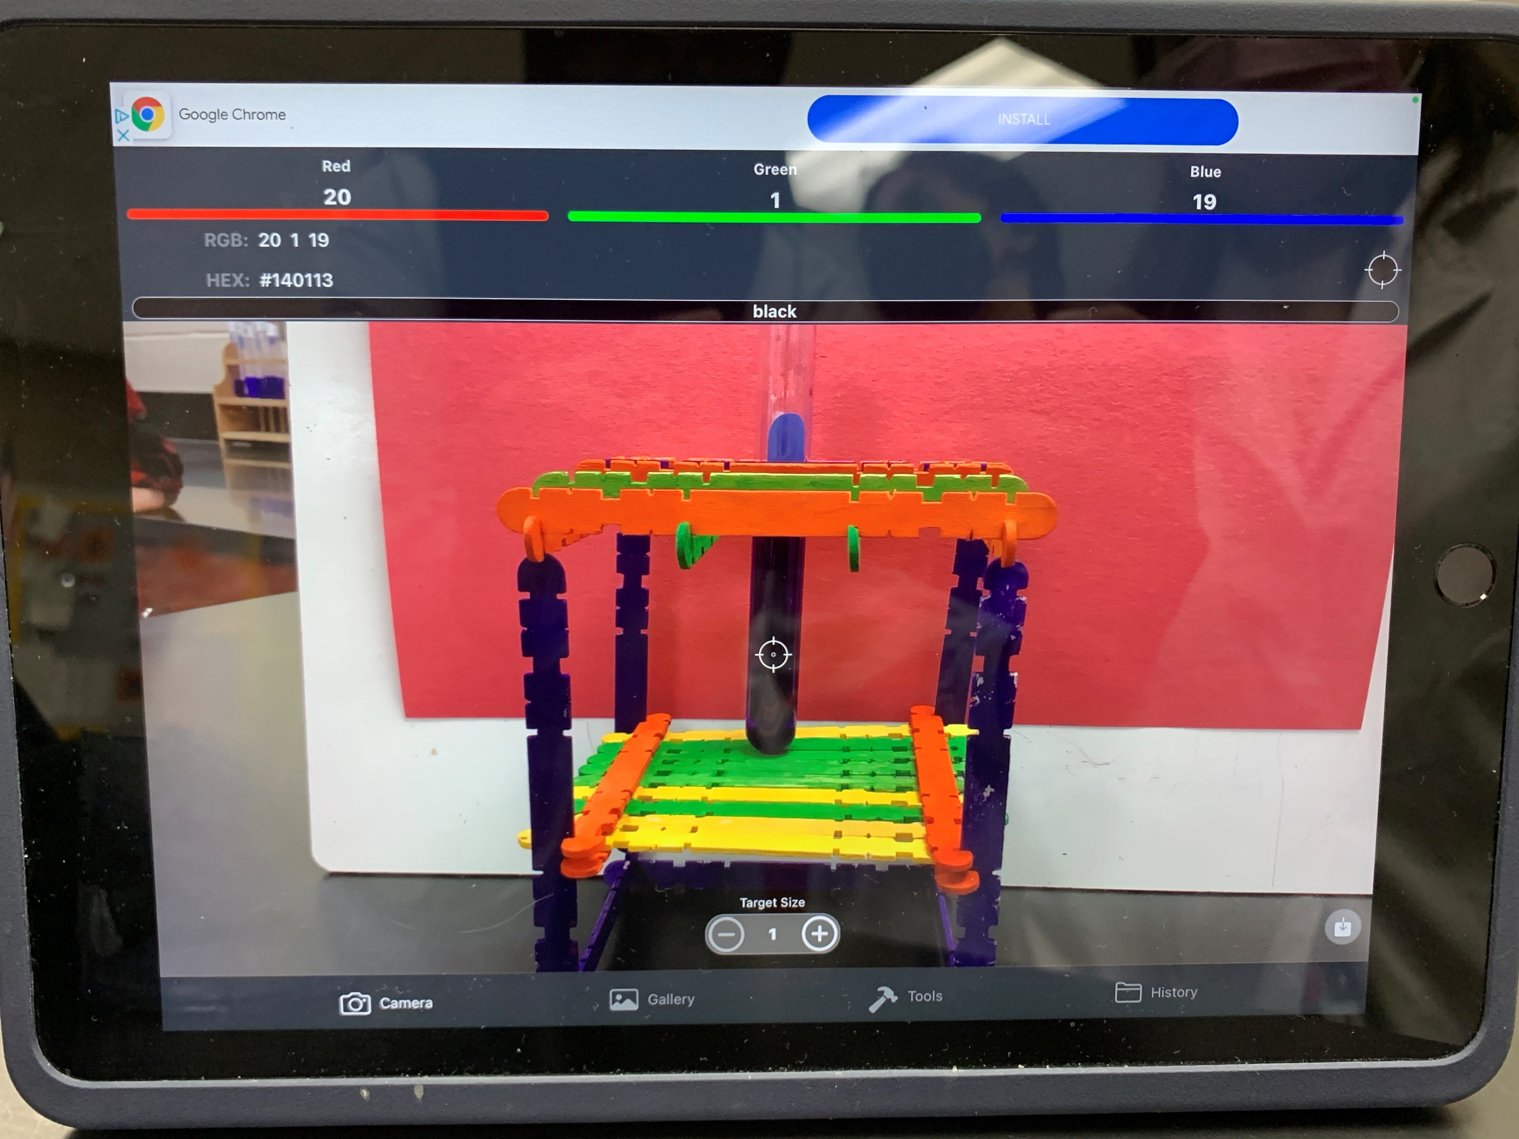
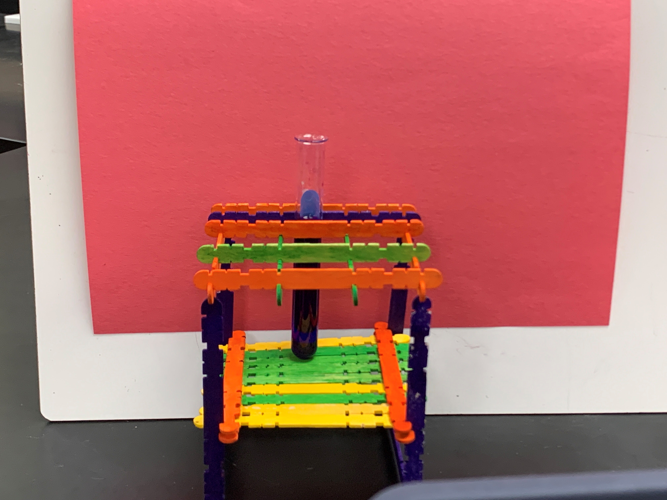
Additional Pictures of Experimental Set up

