Slide 1
Fabrication of a Resin Keychain or Key Ring

Slide 2
Engineering – defined
creative application of math and science principles to design or develop structures, machines, apparatus, or manufacturing processes, or actions of using them singly or in combination
to construct or operate the same objects with full thought about their design structures and functions
to predict how objects will behave under specific environmental conditions
to engineer a design that provides the intended function with consideration given to the cost of operation and safety to life and property
American Engineers' Council for Professional Development. Wikipedia. 2020

Slide 3
Steps in the Engineering Process
Thumbnail Sketch
quick, abbreviated drawings
remember important features of a subject
Model
non-working representation that illustrates product
may be constructed at any stage in product cycle
Prototype
full scale working model
working representation which detect flaws or problems
occurs in advance of production

Slide 4
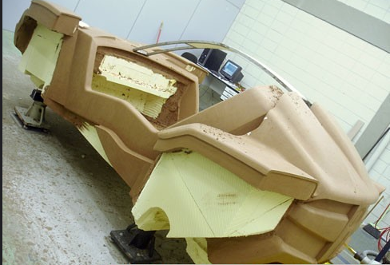
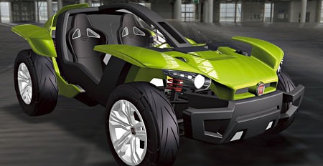
Model vs. Prototype
Model
Not necessarily functional (does not need to work).
Prototype
Is fully functional, but not fault-proof.
Can be to any scale (usually smaller but can also be of the original size or bigger).
Used for Display or/and [Visual] Demonstration of product.
May consist of only the exterior of the object/product it replicates.
Relatively cheap to manufacture.
Is an actual working version of the intended product.
Used for performance evaluation and further improvement of product.
Contains complete interior and exterior.
Is relatively expensive to produce.

Slide 5
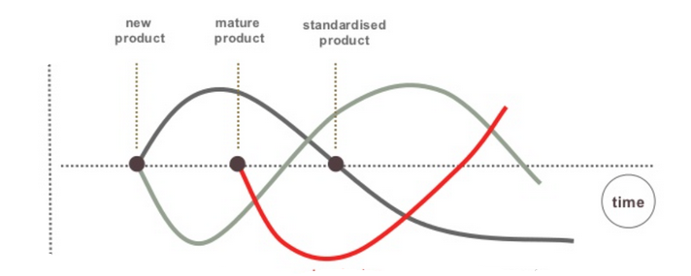
Early vs. Late Prototyping Varied Purposes
Early Prototyping
Evaluates function to solve problem or complete a task
Determines interface with internal components and external environment
Late Prototyping
Used to evaluate performance level or process of carrying out or accomplishing an action, task, or function

Slide 6
“Throw away” (“Rapid Prototyping”)
Used primarily in requirements gathering
Low cost with limited quality & functionality
Incremental (Functional)
Working still needs variables added &/or adjusted to integrate system
Delivery of prioritized functions incrementally added &/or adjusted to the single, overall design
Evolutionary (“Rapid Application Development”, RAD)
Performs original functions and is “state of the art” but will continue to evolve in design
Evolution dependent on internal components and interactions with environment
Throwaway vs. Evolutionary vs. Incremental

Slide 7
Embedded Assessment
1) What is a characteristic of all designed products and services?
How a product will work
What are the best materials
How product will be designed
All of the above
3) Step 1 of the engineering process is:
Plan & design
Make a model
Make a prototype
Identify & describe the problem
5) The Engineering Process is the same as the Scientific Process.
A) True B) False
6) Materials used in new models and prototypes do not need to be tested in different environments.
A) True B) False
2) When designing an object, a person must use:
Creativity
Imagination
Inspiration
All of the above
4) A model is:
A) The final working object
B) Never changed
C) Is full scale
D) None of the above
7) Successful engineers are good in creative and critical thinking that involves math, reading, writing and communication.
A) True B) False
Notes:
1) D; 2) D; 3) D; 4) D; 5) B; 6) B; 7) A

Slide 8
How are these pictures related?
They show either natural tree resin or
products made from natural or synthetic resin.

Slide 9
Resin – Organic Polymer
Monomer – single unit
Polymer – usually many units of same type of monomer
Polymerization occurs through a series of chemical reactions by which the polymer (a macromolecule) is formed by the linking of monomers
Types : Condensation Polymerization
Addition Polymerization
Copolymer – possible two or more monomer species; different monomers with diverse chemical functionalities results in variation of resin properties (active engineering research area ex. Exxon Mobil)
Bisphenol A diglycidyl ether; ‎C₂₁H₂₄O₄
Notes:
Resin Polymer = Bisphenol A diglycidyl ether; Carbon rings = organic polymer

Slide 10
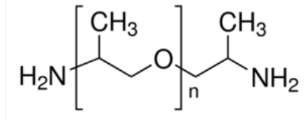
Curing Agent
Polypropylene glycol or polypropylene oxide (C₃H₈O₂)
organic polymer of propylene glycol
often used as curing agent for hardening resin into a solid
Poly(propylene glycol) bis(2-aminopropyl ether)

Slide 11
Resin Crosslinked by Curing Agent
Crosslink
covalent or ionic bond that links one polymer chain to another
cross-links to promote a change in the polymers' physical properties
T Okabe et.al. Molecular dynamics simulation of crosslinked epoxy resins: Curing and mechanical properties. European Polymer Journal 80:78-88 (2016)
Notes:
Viscous resin liquid crosslinked by polypropylene glycol into a solid. (change in Young Modulus)

Slide 12
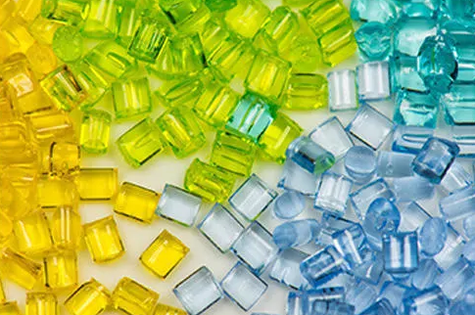
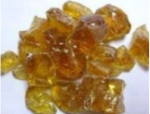
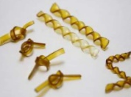
Resin – Component in Making Plastics
Resin Polymers - two types depending on reaction to heat
Thermoplastic polymer –
can repeat softening by heating and hardening by cooling for reshaping and recycling
original chemical structure as no chemical reaction changes structure
Thermoset polymer –
prepolymers in a soft solid or viscous state that change irreversibly when heated
process called curing results in covalent crosslinks that change chemical structure
natural resin
Notes:
Topic – Good for Related Research Paper/Project = Chemical Engineering of Plastics (Big/Active Business)

Slide 13
Embedded Assessment
Provide the best match the following:
1) Thermoset polymer
2) Copolymer
3) Monomer
4) Polymer
5) Plant resin
6) Synthetic resin 7) Thermoplastic polymer
A) many monomers
B) single unit
C) can be reshaped after cooling and heating
D) two or more monomers of different species
E) used as basis of plastics, adhesives, varnishes & other products
F) covalent crosslinks during curing changes structure G) tree fluid
Notes:
(1)F (2)D (3)B (4)A (5)G (6)E (7)F

Slide 14
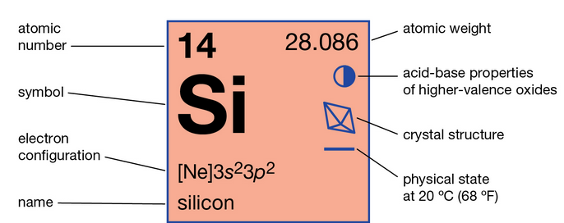
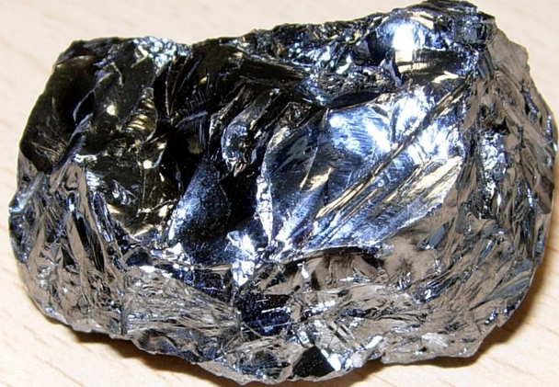
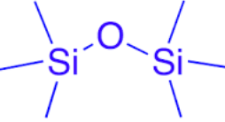
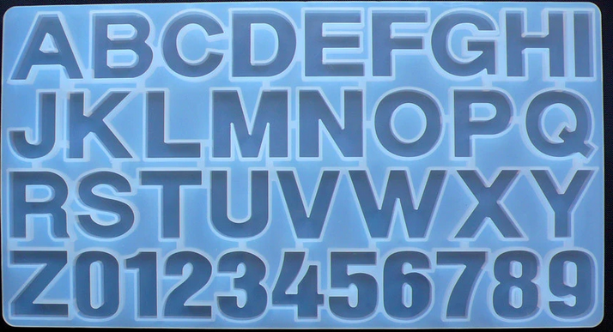
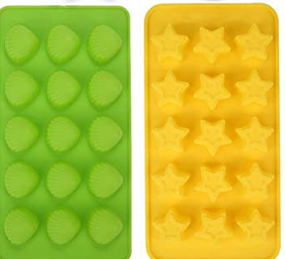
Silicone Mold
Silicon
chemical element with the symbol Si
mineral
Siloxane
a functional group
characterized by chain of alternating silicon and oxygen atoms
Silicone
a polymer material made from polymerized siloxanes or polysiloxanes
consist of an inorganic silicon–oxygen backbone chain (⋯−SiO−Si−O−Si−O−⋯)

Slide 15
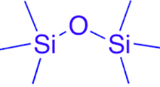
Embedded Assessment
Match the following terms (use terms twice)
A)
B)
C)
1) Silicone
2) Silicon
D) functional group
E) material
F) element
3) Siloxane
Notes:
1)C,E 2)A,F 3)B,D

Slide 16
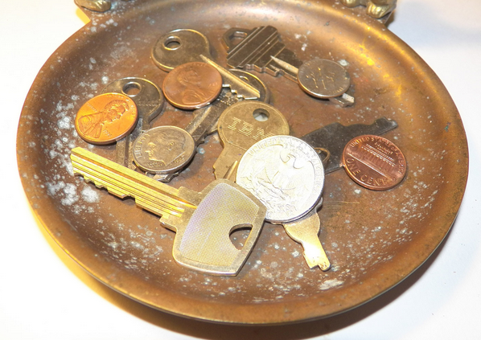
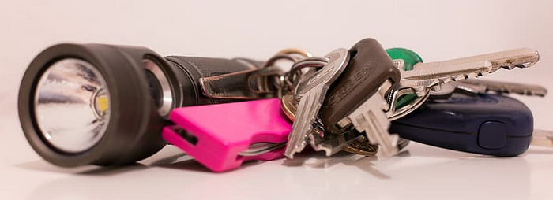
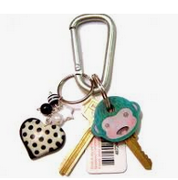
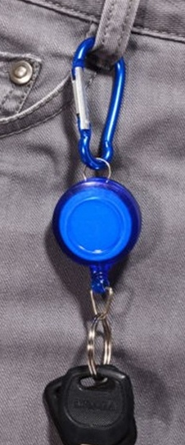
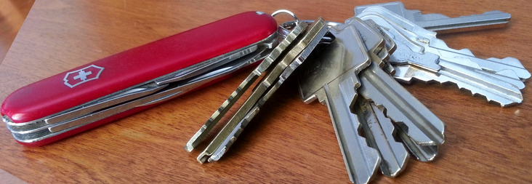
Keychain Designed for Function
Design-for-assembly
Design-for-manufacture
Notes:
Keyrings and keychains help prevent loss of loose keys. Many designs shown here.
Design-for-assembly focuses mostly on fabricating products with the end goal of low-cost assembly.
Design-for-manufacture focuses more on simplifying, optimizing and refining the product design with an end goal of producing a better product at a lower cost.

Slide 17
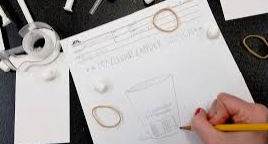
Suggested Videos
What's an Engineer? Crash Course Kids #12.1
https://www.youtube.com/watch?v=owHF9iLyxic
Prototyping and Model making - Students of Product Design Episode 6
https://www.youtube.com/watch?v=Oee8VfjR1CE
Resin Keychains Tutorial - First Time Making Resin Keychains
https://www.youtube.com/watch?v=Uf6z3SIzn9w
Notes:
Note: Stop Tutorial video at 16:40 (language warning)

