Slide 1
Designing Polymers to Clean Water

Slide 2
A Riddle: What Am I?
I can be sparkling but I’m not a star I can run but I don’t have any legs I can fall but I don’t get hurt I’m found in a bath but I’m not a rubber duck I can help you clean but I’m not soap
Notes:
What do we use water for? Ask the students the different things they use water for. Some examples can also be found in this riddle.

Slide 3
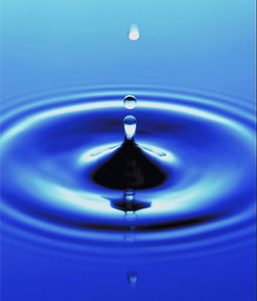
Clean Water
Water needs to be clean in order to be safe to drink.
Notes:
One of the most important ways we use water is for drinking.

Slide 4
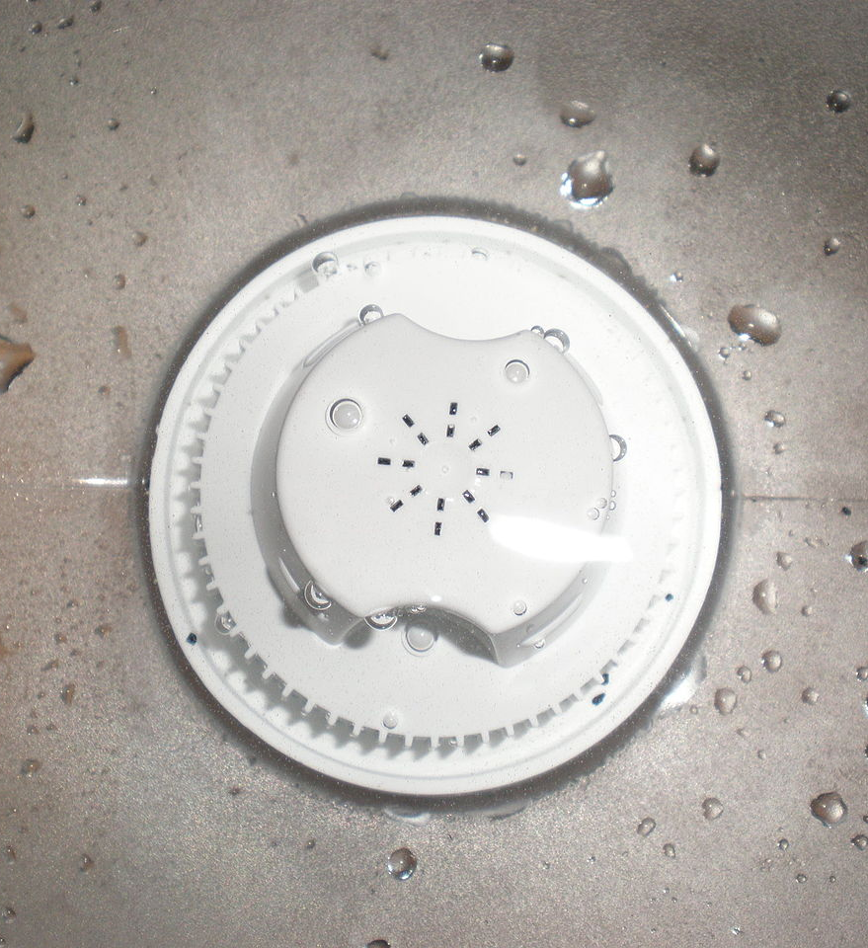
Water Filters
Water filters are one method used for purification of water.
Notes:
Filters are commonly used to further purify tap water and other water sources found in homes such as rainwater. Filters are also important for use in water filtration applications in developing nations where clean water is much harder to obtain.

Slide 5
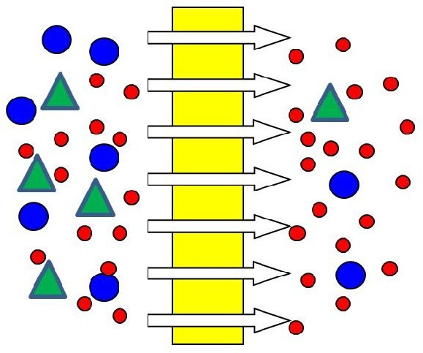
What do you notice about the water filtration membrane?
Notes:
Have the students point out that a fouling layer is made and if it continues to build it may eventually impact the ability of the water filter to function properly. They can consider the blue circles and green triangles foulants, and the red dots to be water molecules. They want the water to pass through from one side to the other, and have the foulants be blocked from going to the other side.

Slide 6
Fouling
Water filter membranes (separators) can get dirty or clogged over time with unwanted particles (or foulants).
Notes:
What affect do you think that would have on the water filter? How would that affect the water? Possible answers include that the water filtration membrane stops working people could get sick from the foulants getting into the water. (Ultrafiltration is a way of taking raw water and making it into potable water.)

Slide 7
Hydrophilic Polymers
Researchers are using hydrophilic (“water-loving”) chemical chains (polymers) as a potential antifouling coatings for water filtration membranes. Hydrophilic polymers resist foulants.

Slide 8
Your Challenge
Today, you are the engineer who will use the engineering design process to…
Design a model of adding an antifouling coating to a water filtration membrane using the materials at your table.
Your coating should allow the water to interact the membrane, but keep the foulants away from the membrane.
Notes:
If we can engineer a solution to that problem, it could extend the life and quality of water filtration systems. This could be especially important in countries where clean drinking water is hard to find and the water filtration systems that have been built in those countries are important to be kept in good working order.

Slide 9
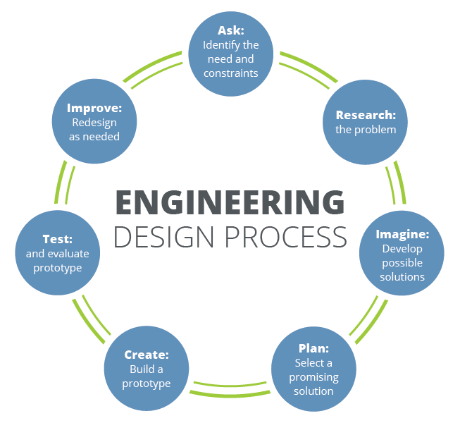
Notes:
Suggested time frames
-problem/need addressed on student worksheet (2 mins)
-requirements and constraints are part of the directions given (see lesson plan 3 minutes)
-brainstorming solutions will be on their student worksheet where they will draw their solutions (5 minutes)
-Students will share and evaluate their solutions (5 minutes)
-Students will design and build their prototype (15 minutes)
-Students will evaluate and test their prototype (5 minutes)
-Students will communicate their results with the rest of the class (10 minutes)

Slide 10
Resources
http://riddles-for-kids.org/water-riddles/
File:Brita water filter in use.JPG. (2012, June 16). Wikimedia Commons, the free media repository. Retrieved 00:53, April 9, 2018 from https://commons.wikimedia.org/w/index.php?title=File:Brita_water_filter_in_use.JPG&oldid=72762277.
File:Circle-question-blue.svg. (2017, December 8). Wikimedia Commons, the free media repository. Retrieved 01:05, April 9, 2018 from https://commons.wikimedia.org/w/index.php?title=File:Circle-question-blue.svg&oldid=271013147.
File:1972 Clean Water Act (15197722145).jpg. (2016, October 20). Wikimedia Commons, the free media repository. Retrieved 01:17, April 9, 2018 from https://commons.wikimedia.org/w/index.php?title=File:1972_Clean_Water_Act_(15197722145).jpg&oldid=210279564.
https://commons.wikimedia.org/wiki/File:Dead-end.svg

Slide 11
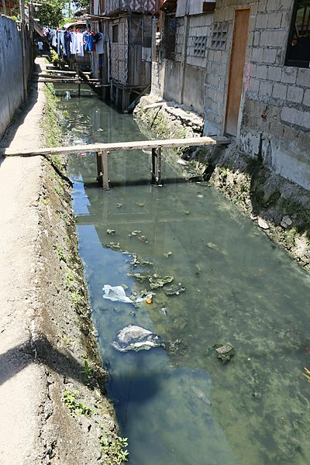
Notes:
Image of a polluted river running through Talisay City in the Philippines
Source/Rights: Wikimedia Commons, the free media repository. https://commons.wikimedia.org/wiki/File:AA_2_polluted_water_Talisay_City_Cebu_e.jpg

Slide 12
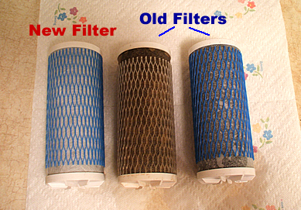
Notes:
Image comparing a new water filter (left) with older filters used a few times (right) and covered in foulants (center).
Source/Rights: Donna Hoffman, http://www.ezclearwater.com/wordpress/category/whole-house-water-filtration-system/

