Slide 1
Introduction to Nanotechnology

Slide 2
What is Nanotechnology?
Nanotechnology is the creation of functional materials, devices, and systems through control of matter on the nanometer length scale by exploiting novel phenomena and properties (physical, chemical, biological) present only at that length scale.
Notes:
Ask for some definitions.
Reveal page.
Give definition.

Slide 3
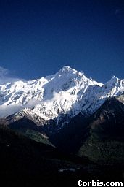
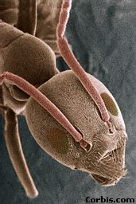
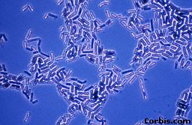
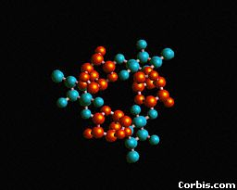
“Nano”: How small is that, really?
Mountain
1 km
1000 m
0.001 km = 1 m
Child
1 m
Ant
1 mm
0.001 m
1,000 mm = 1 m
Bacteria
1 μm
0.000001 m
1,000,000 μm = 1 m
Sugar molecule
1 nm
0.000000001 m
1,000,000,000 nm = 1 m
km = kilometer
m = meter
μm = micrometer
nm = nanometer
Notes:
Extend it upwards:
1 Mm : Texas
1 Gm : Orbit of moon
1 Tm : Orbit of Jupiter
Use interactive art display on next page to further illustrate size.

Slide 4
The Scale of the Universe
Micro to Macro: perspectives from a Planck length to a Gigaparsec.
http://scaleofuniverse.com/

Slide 5
Nanoscale

Slide 6
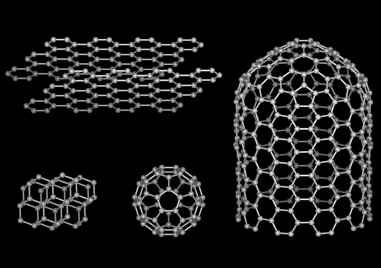
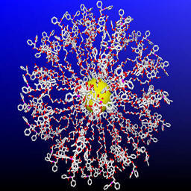
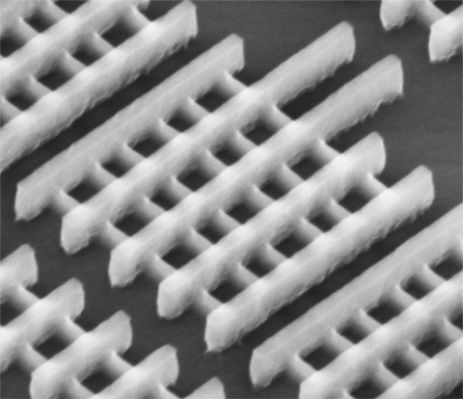
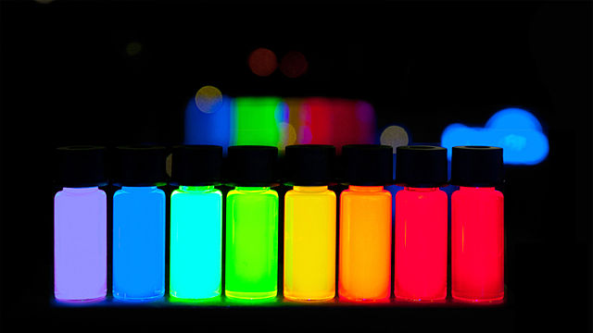
Types of Nanomaterials
Gold nanoshells
Carbon allotropes
Nano-silicon transistors
Quantum dots
Notes:
These transistors reach feature sizes of only 22 nanometers, down from 32 nm. To give you some perspective on what this exceptionally high integration means: 4,000 of those 22 nm structures fit across the width of a human hair, or similarly, 100 million of these transistors fit on the head of a pin.

Slide 7
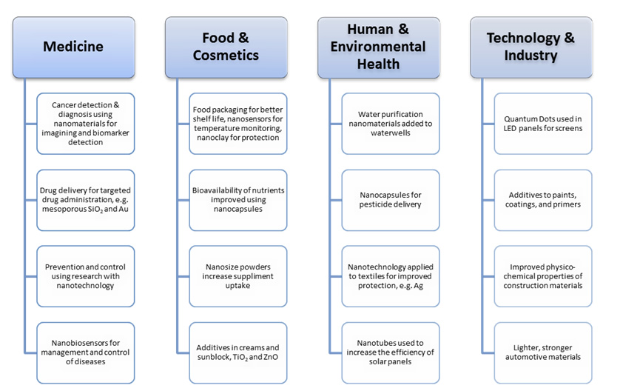
Applications of Nanotechnology
Source: http://www.gaeu.com/item/this-is-nanotechnology-one-of-the-fastest-growing-markets-in-the-world

Slide 8
Create Your Own
In groups of three, your job is to research a specific field of nanotechnology and create your own scavenger hunt.
Construction
Water treatment
Medicine
Environmental health
Electronics
Sports and kinesiology
Information technology
Food & cosmetics

