Slide 1


Wheeling it In!

Slide 2
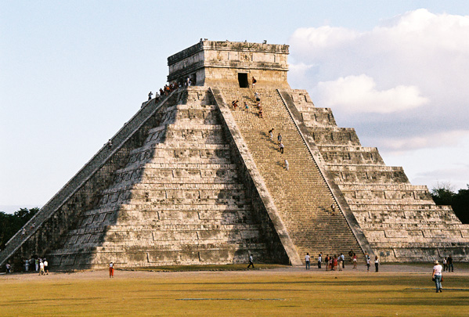
What have we learned so far?
Pyramid Building
Simple Machines
Rock Quarry
Angles
Wedges
Cutting Stone

Slide 3
You have stone, now what?
Can you imagine how ancient engineers might have transported stone blocks from rock quarry to building site?
Transportation!

Slide 4
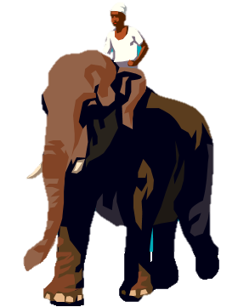
Some stones were huge!
The Great Pyramid in Egypt has 2.5 million stone blocks
Some pyramid blocks weigh as much as 9,000 kilograms (~10 tons)
That means one stone could weigh as much as two elephants!

Slide 5
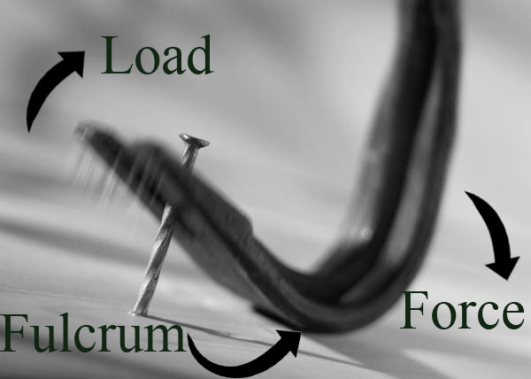
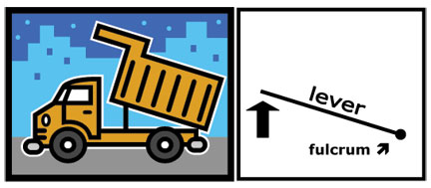
Lever
A simple machine provides a mechanical advantage
A bar pivoted on a fixed point (fulcrum) to which force is applied to do work
Makes lifting weight easier by using a fulcrum to redirect force over a longer distance
Examples: see-saw, dump truck, broom, crane arm, hammer claw, crowbar, fishing pole, bottle opener
Photos should be a
square like this.

Slide 6
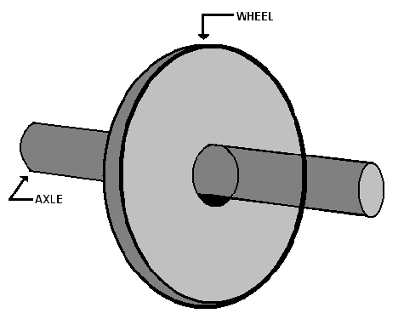
Wheel and Axle
A simple machine provides a mechanical advantage
Consists of a wheel and an axle
Makes it easy to move things by rolling them, and reducing friction
Examples: car, bicycle, office chair, wheel barrow, office chair, roller skates, skateboard
Photos should be a
square like this.

Slide 7
Why use a wheel and axle, or a lever?
Mechanical Advantage!
The trade off between longer time or distances traveled, for an easer way to do work
An advantage that allows for greater work at the expense of less energy expended
Makes life easier!

Slide 8
Everyday Examples
Photos should be a
square like this.
Can you think of any items at home or school that use a wheel and axle, or a lever?

Slide 9
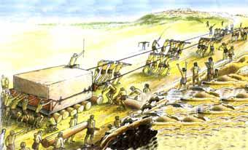
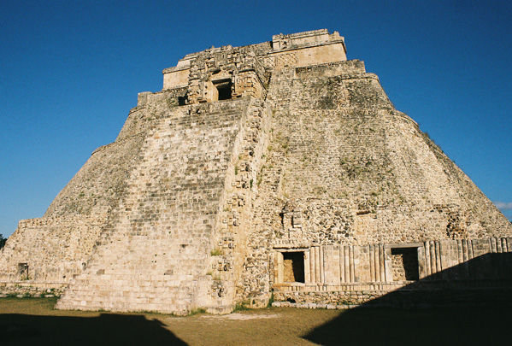
Historians and archaeologists believe that in ancient times…
Blocks of stone were rolled on wooden logs and pulled with rope
Once on site, stone blocks were hoisted up using multiple levers

Slide 10
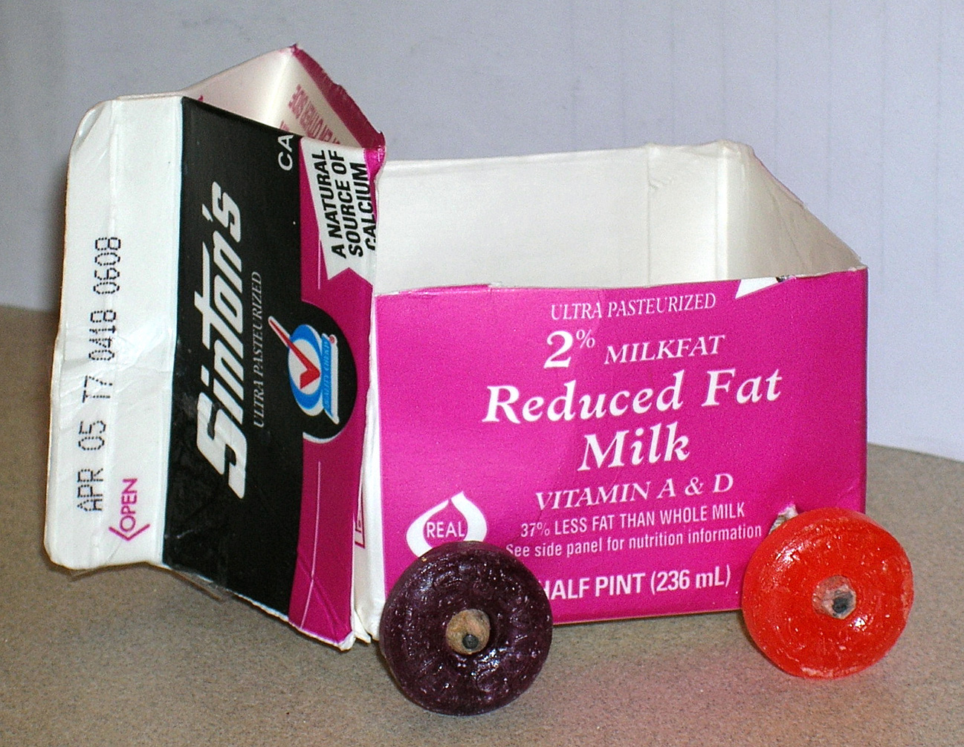
How would you design it?
Today you are going to build your own transportation system for moving rocks from a quarry to a building site
What will you consider in the design of your “cart”?

Slide 11
Engineering Design Process
Ask: Identify the Needs and Constraints: What is the problem? What do I want to do? What are the project requirements? What are the limitations? Who is the customer? What is the goal?
Research the Problem: Gather information and research what others have done. Talk to people from many different backgrounds and specialties to assist with researching what products or solutions already exist, or what technologies might be adaptable to your needs.
Imagine: Develop Possible Solutions: You work with a team to brainstorm ideas and develop as many solutions as possible. This is the time to encourage wild ideas and defer judgment! Build on the ideas of others! Stay focused on topic, and have one conversation at a time! Remember: good design is all about teamwork!
Plan: Select a Promising Idea: Revisit the needs, constraints and research from the earlier steps, compare your best ideas, select one solution and make a plan to move forward with it.
Create: Build a Prototype: Building a prototype makes your ideas real! These early versions of the design solution help your team verify whether the design meets the original challenge objectives. Push yourself for creativity, imagination and excellence in design.
Test and Evaluate Prototype: Does it work? Does it solve the need? Communicate the results and get feedback. Analyze and talk about what works, what doesn't and what could be improved.
Improve: Redesign as Needed: Discuss how you could improve your solution. Make revisions. Draw new designs. Iterate your design to make your product the best it can be.
And now, REPEAT!

Slide 12
References
The crowbar and dump truck images (below) are Copyright © 2004 Microsoft Corporation, One Microsoft Way, Redmond, WA 98052-6399 USA. All rights reserved. With notations by the ITL Program, College of Engineering and Applied Science, University of Colorado at Boulder.
The pyramid building (below) is Copyright © Nuffield Curriculum Centre UK, http://www.nuffieldcurriculumcentre.org/go/Default.html. Used with permission.
The five images below are Copyright © Luz Quiñónez, College of Engineering and Applied Science, University of Colorado at Boulder. Used with permission.
The rest of the images are Copyright © 2004 Microsoft Corporation, One Microsoft Way, Redmond, WA 98052-6399 USA. All rights reserved.

