Slide 1
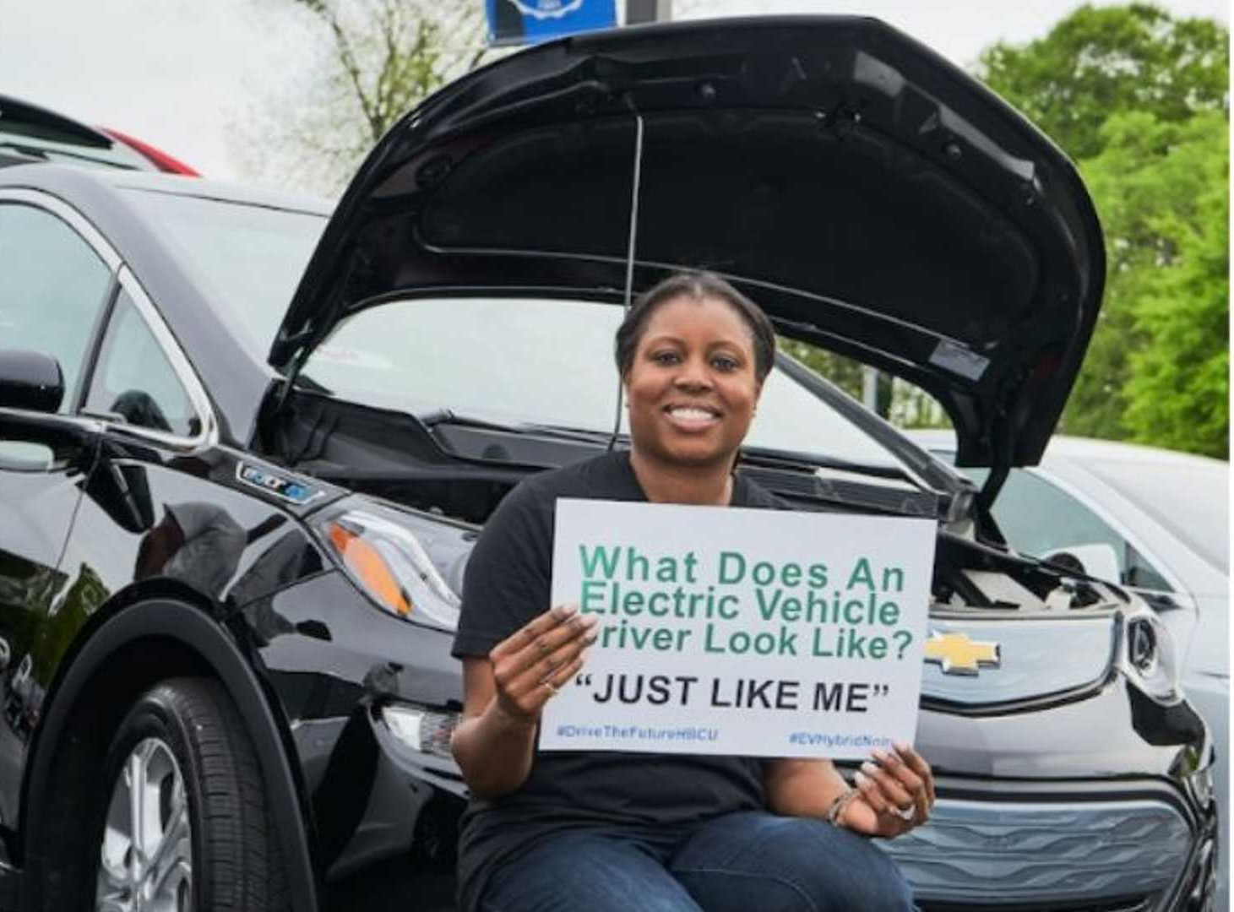
Creative Engineering
EV Design Challenge!
School:
Class:
Period:
Teacher:
Date:
(make copies for student teams to digitally share and complete as a group, and submit for formative assessments and final summative assessment:)
Engineering Digital Notebook
Team name - student names
Resource adapted from: https://www.nrel.gov/docs/gen/fy01/30828.pdf

Slide 2
Introduction: Creative Engineering
EV Design Challenge
Welcome to Creative Engineering Design EV Challenge! By working as an engineering design team, you will learn how the basics of electric vehicle (EV) technology and make your own model EV car that will run on rechargeable battery power.
Your team will design, build, test, and iterate a model EV, and apply and integrate the engineering design process, forms of energy, and related physics concepts to maximize the performance of your model EV.
You will learn about EV-related environmental justice concepts, including air quality, health, environmental and transportation connections. In a final design expo, your team will present about your final EV model, your design process journey, and your perspectives on engineering and environmental justice in regards to EVs. Teams can also participate in fun model EV race and aesthetic design competitions.

Slide 3
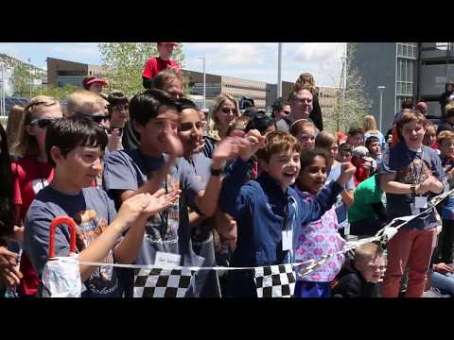
This EV engineering design challenge is inspired by the National Renewable Energy Laboratory’s alternative energy car competitions!
Watch the NREL Junior Solar Sprint video…

Slide 4
Engineering Design Process = Success
Design
You will experience first-hand the process of design. When you design your car, you will start with some ideas in your head and turn them into real-life models that work. Design is different than normal problem-solving, because:
You don’t know what the problems are (you discover and solve problems as you go along -- everyone’s challenges will be different).
There is never one right answer!
Engineers have to deal with trade-offs. For example, when an automotive engineer uses a larger engine for greater performance, this usually sacrifices fuel efficiency. In a sports car, performance and speed are very important. But in a city car, fuel efficiency is more important. So it is up to the designer to decide which are the most important goals. Even though there is no one right answer, some answers may be better than others for a particular application. Obviously the best-engineered car is the fastest!

Slide 5
Project Assignments:
Assignment 1 - Concept Sketch:
Car design considering size, weight, material, and aerodynamic qualities.
Assignment 2 - Drivetrain:
Motor circuit, chassis, gearing, bearings, axles and wheels integration.
Assignment 3 - Car Body:
Model car body design, considering aerodynamics and aesthetics.
Assignment 4 - Test Model EV:
Three timed trials, record car re-design plans. If time is available, iterate on car design and re-test.
Assignment 5 - Design Expo:
Slides, video, poster, or other team presentation of model EV design, function, and reflection questions.

Slide 6
Sample Project Timeline
Week | Focus | Overview of Days | Deliverables
Week 1 | Creating a plan to build the drive train and developing the initial design sketch. | M: Introduce model EV design project, student engineering notebook, explain collection of resources for final design expo at each stage. Tu: Brainstorm car design ideas, students start collecting and bringing in materials. W: Start designing individual car components and assessing component material choices. Th: Continue designing and selecting car component materials. F: Finalize car design and material choices. | Assignment 1: Final design of Concept Sketch
Week 2 | Creating a plan to build the drivetrain. Designing and creating a car body. | M: Get approval of final design and gather materials, start building chassis. Tu: Continue chassis building. W: Start building drivetrain using motor, battery, battery holder, alligator clips, gears or pulleys, axles and wheels. Th: Complete drivetrain, and finish building chassis. F: Connect drivetrain to chassis (front or rear), use bearings to connect axle and wheels to chassis, align gears on motor and axle. | Assignment 2: Drivetrain-motor circuit, gearing, axles and wheels, bearings, and chassis integration
Week 3 | Optimizing and testing performance. | M: Complete drivetrain to chassis, start building the car body. Tu: Finish car body and final car details. W: Test car and record data. Th: Revise car design based on trial results. F: Retest car to analyze redesign effectiveness. | Assignment 3: Car chassis, drivetrain, and body completed Assignment 4: EV car trials; redesign, iterate, and re-test, if possible
Week 4 | Presenting final EV model car. | M, Tu: Finalize presentation slides, video, or poster, of team’s car design choices. W-F: Design Expo team presentations. | Assignment 5: Design Expo Final Presentation (summative assessment)

Slide 7
Summative Assessment Rubric
 | No Evidence Observed 0 points | Surface Level 2.5 points | Deep Level 3.2 points | Transfer Level 4 points
Model EV Design | Concept Sketch is missing 3 or more look-fors. | Concept Sketch is missing 2 look-fors. | Concept Sketch is missing 1 look-for. | Before cutting or gluing materials, the team submits a Concept Sketch showing the preliminary ideas of the team for their EV design. Look-fors: Sketch is submitted on time. Sketch has all components and dimensions labeled for the chassis, body, bearings, axles, wheels, pulley/gear diameters, motor, battery holder, battery, alligator clips, on/off switch Sketch has a written explanation and clear visual for how the team plans to transfer energy from the motor to the wheels.
Model EV Build | Model is missing 3 or more look-fors. | Model is missing 2 look-fors. | Model iis missing 1 look-for. | Model EV showing the preliminary ideas of the team for their chassis and car body design. Look-fors: Model is submitted on time. Model has all components- chassis, body, bearings, axles, wheels, pulley/gears, motor circuit. Model has full integration of drivetrain: chassis, axles, wheels, gearing and motor Model effectively transfers energy from the motor to the wheels.
EV Aesthetics | Team’s car is missing 3 or more look-fors in the Aesthetics category. | Team’s car is missing 2 look-fors in the Aesthetics category. | Team’s car is missing 1 look-for in the Aesthetics category. | Before testing, the team’s car will be assessed on the following aesthetic look-fors. Effort was clearly put into: Neatly laying out or hiding motor circuit wires. Minimizing the amount of visible glue, tape, or other affixation methods. Consideration for aerodynamics Enhancing the overall aesthetic of the car (with stickers, paint, corporate sponsorship, LEDs) and reducing any needless or unappealing residue (barcodes, wrapping material, etc.)
EV Test | The team’s car cannot move. | The car completes the track in more than 40 seconds. | The car completes the track in 30-40 seconds. | The car completes the track in under 30 seconds.
Design Expo | Presentation is missing 3 or more look-fors. | Presentation is missing 2 look-fors. | Presentation is missing 1 look-for. | The group’s presentation (slides, video, or poster) includes all of the following look-fors: Explains what materials were used for each part of the car. Shares data from trials and what adjustments were made based on the data. States how energy is transferred from the motor to the wheels. Explains design choices and aesthetics of the car. Shares at least one area to improve or change in future projects. Shows how EVs can provide positive climate action, improve air quality, and benefit public health, especially for people of all ages in communities historically living near major roadway infrastructure (interstates) and disproportionately affected by emissions from fossil fuel-powered internal combustion engine (ICE) vehicles.

Slide 8
Team Roles | Assign Team Co-Leads
Lead Designer - This person is primarily responsible for creating the Concept Sketch and leading the overall design of the car.
Electrical Engineer - This person is primarily responsible for planning how the batteries, motors, resistors, and LEDs will connect, and also responsible for creating the Circuit Diagram.
Mechanical Engineer - This person is primarily responsible for planning how to connect the motor to the drive axle and optimizing the car’s Performance.
CAD Engineer- This person is primarily responsible for 3D-modeling the car body and enhancing the Aesthetics of the car.
Project Manager - This person leads discussions, resolves disputes, assigns tasks, manages time, and makes executive decisions. They should have strong leadership skills. They should also have one of the 4 roles listed above.

Slide 9
Model EV Design-Build Constraints
The electric battery-motor materials provided must power the model EV
The remainder of the vehicle must be your own design and can be made from any other material.
An on/off switch must be incorporated into the car design. The switch may be purchased or crafted from readily available materials such as aluminum foil, paperclips, fasteners, etc.
Vehicle Specifications:
1. The vehicle must adhere to all parameters, be structurally sound, and safe to contestants and spectators (e.g., no sharp edges, projectiles, etc.).
2. Size: The vehicle must not exceed the following dimensions: 30 cm (11.8 inches) by 60 cm (23.6 inches) by 30 cm (11.8 inches).
3. Weight: The vehicle must weigh a minimum of 750 g. If vehicles do not meet the minimum weight requirement.
Steering (Optional): A guide wire attachment, referred to as an eyelet, must be attached to the car.. A guide wire (such as a fishing line) will be no more than 1.5 cm from the surface of the track, will go through the attached eyelet on the car, will serve as the steering mechanism, and will keep the car on track.
Guide Wire: The eyelet must be used for steering only and must be directly hooked onto the guide wire.
Test track: Two end blocks and a fishing line guide wire stretched taut between the blocks (approx. 60cm x 10m)
EV Design Awards will be given for the fastest car, most aesthetic design, plus teamwork spirit award.

Slide 10
Model EV Materials & Equipment
EV motor circuit provided for each team: DC Motor Two AA rechargeable batteries AA battery pack for two batteries with on/off switch Two alligator clips Basic car components (team chooses component materials): Chassis: Stiff, lightweight frame material (cardboard, wood, plastic container, popsicle sticks, etc.) Or chassis can be CAD modeled and 3D printed or laser cut Drivetrain (attached to chassis to integrate motor, axles, wheels): Pulley system (2 pulley wheels, one on motor spindle, one on axle, connected by a rubber band) Or Gear system (2 interlocking gears, one on motor spindle, one on axle) Wheels & Axles: Axles (metal, wood, plastic, etc. dowel rods) Straws (glue to bottom of chassis, thread axle through) Toy wheels, plastic caps, etc. to attach to axles | Suggested additional materials for class use: Classroom battery charger and extra batteries Basic tool kit for the classroom (rulers/tape measures, hammers, screwdrivers, wrenches, pliers, etc.) Foam core, styrofoam Stiff base material (thin plywood, balsa wood, plastic or metal sheeting, etc.) Hot glue gun and glue sticks Duct tape, rubber cloth tape Scissors, utility knives, hand saws Sandpaper Markers Toy/model wheels, plastic bottle caps, spools Wood, metal, plastic dowel rods Cardboard boxes and tubes Cans (aluminum, tin) Plastic bottles Straws Popsicle sticks, craft sticks Rubber O-rings Rubber bands various widths Coat hangers, wire Silicone or other caulking Nails Screws, eyebolts Miscellaneous extra materials provided by teacher and students

Slide 11
Engineering Notebook
Getting Started:
This digital engineering notebook will provide you with information and ideas as your team builds their model EV car. Each team will keep a digital engineering notebook using these slides to document the model EV design-build-test. Include photos, videos, and narrative descriptions at each stage.
power source: how the EV battery-powered motor works
chassis: how to build the frame of the car
wheels and bearings: how to make wheels that turn
transmission: how to transfer power from the motor to the wheels
body shell: how the shell effects car performance
In general, when you design, it is good to keep the different parts in mind, but don’t worry about the details of each component until you are ready for them. Each build section is composed of four informational parts:
purpose
ideas
concept
suggested materials
The concept section will raise issues that will help you decide how to make the right decisions and build your team’s model EV car.
Experiment as much as possible early on and don’t worry about making mistakes, “mistakes” are essential to engineering! It is always the case with design that you don’t know what the problems are until you encounter them. So get your hands dirty and have fun!

Slide 12
Assignment 1: Model EV Concept Sketch
Your team’s first task will be to create a concept sketch. As part of your concept sketch your team will consider the following questions:
Chassis & Body: What object(s) will the team use for the chassis and body of their car? Consider size, weight, material, and aerodynamic qualities.
Drivetrain: How will the team transfer energy from the electric motor to the drive axles? Potential options include:
Option A: Use pulleys and rubber bands to connect the motor to a drive axle.
Option B: Use gears to connect the motor to the drive axle.
Wheels/Axles: What type and size of wheels and axles will the team use?
Optimizing Performance: How will the team optimize their car to perform well in all Triathlon events?
Increasing wheel traction to minimize slippage.
Reducing weight.
Reducing axle friction.
Increasing aerodynamics.
Selecting the optimum gear/pulley ratio for maximum torque and minimum slippage.
Optimizing the drivetrain to ensure the rubber bands, gears, or fan blade consistently transfer the maximum amount of energy from the motor to the wheels.
Optimizing alignment so the car drives straight.
Wiring the motor, battery and battery holder, alligator clips.
Aesthetics / Decoration: Stickers, paint, markers, logos, and LEDs will be available to decorate the car.

Slide 13
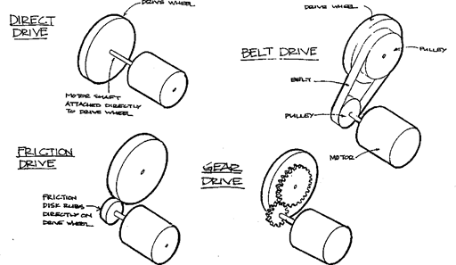
Drivetrain
Transmission
Purpose
A car’s transmission transfers the power from the motor to the wheels. While doing so, it may make the wheels spin at a different speed than the motor.
Ideas
There are different ways to transfer power from the motor to the wheels. Some popular techniques are direct drive, friction drive, belt drive, chain drive, and gears.
Some transmissions are easier to build then others, and not all are appropriate for a model EV car.
Concept: Speed vs. Force
The most simple type of transmission is direct drive, which means the motor is connected directly to the axle of the driven wheel. Direct drives are not common in vehicles; one of the few vehicles that uses direct drive is a unicycle. Every time your feet make one revolution, the front wheel makes one revolution.

Slide 14
Assignment 2: Drivetrain
Your team’s next task will be to design and build a drivetrain to power your model EV, and consider the following question:
Motor Circuit: Build and test your motor circuit using the required materials provided.
Gearing: Build your gear choice using selected materials. How will the team transfer energy from the electric motor to the drive axles?
Option A: Use pulleys and rubber bands to connect the motor to a drive axle.
Option B: Use gears to connect the motor to the drive axle.
Wheels/Axles: Select an axle and wheel combination. What type and size of wheels and axles will the team use?
Bearings: How will the team attach the wheels and axles to the chassis? How will the motor, gears, and axle and wheels integrate?
Increasing wheel traction to minimize slippage.
Reducing weight.
Reducing axle friction.
Increasing aerodynamics.
Selecting the optimum gear/pulley ratio for maximum torque and minimum slippage.
Optimizing the drivetrain to ensure the rubber bands, gears, or fan blade consistently transfer the maximum amount of energy from the motor to the wheels.
Optimizing alignment so the car drives straight.
Wiring the motor, battery and battery holder, alligator clips
Chassis: This is the foundation of the car. Will the drivetrain be front-wheel drive or rear-wheel drive?

Slide 15
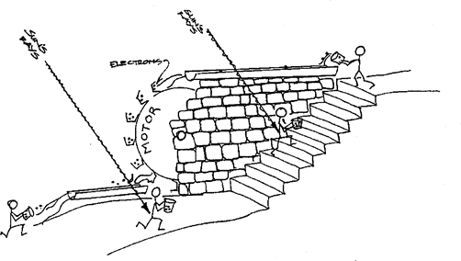
Power
Power
How does such a battery create power? To understand power more clearly, let’s look at a mechanical example to illustrate the main ideas. For example, imagine a water wheel, like the one illustrated::
In the battery, a very similar equation for power is true as for the water wheel. But instead of height, we have what is called voltage, and instead of buckets of water, we have electric current (or the number of electrons flowing through the motor).
The power coming out of the EV panel is the product of the voltage and the number of electrons flowing (the current):
Power = Voltage x Current

Slide 16
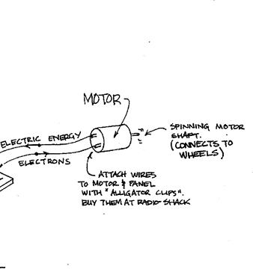
EV Motor
Power Source:
NiMH Battery and Electric Motor
Purpose
The purpose of the batteries are to story energy and to turn this energy into electrical energy. The electric motor then uses this electrical energy to power the wheels of the EV car.
When a battery is connected with wires to a motor to create a circuit, electrons will flow through the wire into the motor making it spin.
NiMH rechargeable battery

Slide 17
Materials Provided: EV Motor
Two rechargeable AA batteries
One DC Motor
Two alligator clips
Battery pack for two AA batteries with on/off switch
Classroom battery charger
Note: See the Tinkercad Circuits & EV Motor Workshop of this course for instructions on how to build the model EV motor.

Slide 18
EV motor circuit
(Insert your team’s images, video, notes, reflections, etc. to use in your group’s final design expo presentation)

Slide 19
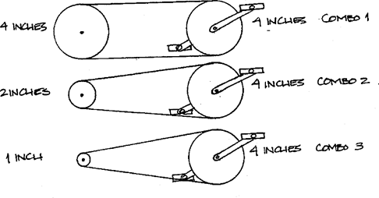
Gear Ratio
As mentioned before, most vehicles are not direct drive, so let’s look at another type of vehicle: a 3-speed bicycle. A bicycle uses a chain drive. It allows you to move the pedals, and the chain transfers the energy from the pedals to the rear wheel.
The chain glides over different sized sprockets, depending on the speed of the rider. Which sprocket combination will make the rider go the fastest, given the same pedaling rate, or cadence? (Hint: how many times will the back sprocket (and therefore the back wheel) turn with each rotation of the front sprocket?)
Each rotation of the front sprocket will make the back wheel rotate once in combo 1, twice in combo 2, and four times in combo 3. So, combination 3 will go the fastest. (these sprocket combinations can also be called gear ratios, because the new speed is calculated as the ratio of the driven (front) sprocket over the back sprocket.)

Slide 20
Gear Ratio Selection
Selecting the Proper Gear Ratio
So, how can you choose the best gear ratio? Experimentation is probably the easiest way to find out.
The idea is that your motor, like your legs when you ride a bike, like to go a certain speed. They also have a limit as to how much force they can exert. First you must find the speed at which the motor gives the most power (this is usually half the speed the motor will rotate if there is no load, or force, exerted on the motor shaft). Try to keep the motor turning at approximately that speed as you experiment with different gear ratios.
It helps if you build your car in such a way that you can change the gear ratios easily as you experiment. Remember, the ideal gear ratio may change some if you change different characteristics of your car (size, weight, etc.). Just remember, if your car is not going very fast it can either be that the wheel speed is too slow, or (like Jeff riding uphill) the force required to turn the wheel is too high. Try a different gear ratio!
Materials
The materials you choose vary greatly depending on the type of transmission you build. If you decide to build a belt drive, try stiff, rubbery materials for the belt - such as a slice of inner tube or an o-ring. Make sure your pulleys are pulled away from each other so that the belt is tight. One suggestion: one way to change the gear ratio on a pulley drive is to add or remove masking tape around the pulley, which changes its diameter.
If you use a friction drive, make sure you have enough traction on the friction disk, or it will slip (see the materials section for wheels and bearings). Also, make sure the friction gears are pressed against each other snugly to ensure traction.
In all cases, you will need wheel like parts to put on the motor shaft and the wheel, and you can get ideas from reading the suggestions for wheel materials.

Slide 21
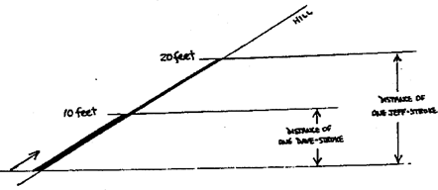
Force
Force
You may ask, then, why isn’t it the best to go for the highest speed possible? Well, you can’t get something for nothing! So what are you giving up when you gain speed? Let’s investigate…
Imagine two bikers approaching a very steep hill. Jeff and Dave are both in third gear, because they are going very fast. Dave downshifts into second. But Jeff decides to stay in third gear, because he knows that third gear is for going fast, and he wants to go up this hill very fast.
What happened? If only Jeff could’ve kept pedaling at the same rate, he would’ve beat Dave by a mile! Let’s look at each pedal stroke. Each time Dave and Jeff pedal once, Dave’s back wheel goes around once (let’s say it travels 10 feet), but Jeff’s back wheel goes around twice (20 feet).
Dave realizes that he only has to expend half the energy per pedal revolution than Jeff does, because Jeff goes twice as far each time. That is why Jeff started getting very tired, because his pedals were difficult to push. In other words, his pedals required more force than Dave’s did.
So does Dave expend less energy going up the same hill?
So, the bottom line is, when we gain a speed advantage, we are losing the force advantage. The pedals are more difficult to turn. You can gain either speed or force advantage, but not at the same time.

Slide 22
Gears & Transmission
(Insert your team’s images, video, notes, reflections, etc. to use in your group’s final design expo presentation)

Slide 23
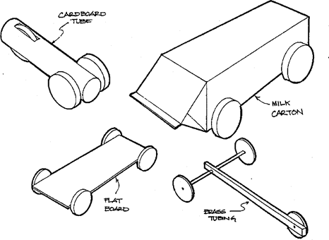
Chassis
Chassis
Purpose
The car’s chassis is its frame. It holds all of its main parts together.
Ideas
Some possible ideas for a EV car chassis are below. Try different ideas!
Try different materials!
Concepts: Weight and Stiffness
One thing you will discover when you build your EV car is that designing and building involves trade-offs. There is no ideal design. This is true with the chassis of your car.
One obvious consideration is that you don’t want your car too heavy. It is easier for your motor to push a light car than a big, heavy one. In EV cars, efficiency is very important, and you don’t want to waste energy.
But something you must also keep in mind is that a light car can be pushed easily by the wind too. Even if the wind does not blow the car over, it may make it harder to go in a straight line.

Slide 24
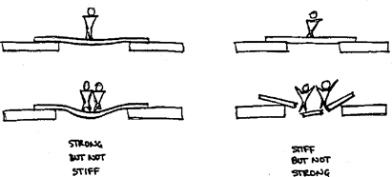
Materials
The first step to a lightweight chassis is choosing the right materials, but more importantly, is fairly stiff for its weight.
What is the difference between strong and stiff? Strong means it will not break easily. Stiff means it will not bend easily. For the model EV car, stiffness is very important.
Shape
Some heavier materials are also appropriate if they are constructed correctly. Other materials are made stiffer or stronger by sandwiching them between other materials. Orientation is also very important in determining stiffness. Material selection and the importance of shape and orientation of the materials offers options for managing the weight of the EV car.

Slide 25
Materials: Chassis
Materials
Any material that is light and stiff would be appropriate for building a model EV car. Some hollow and tube like pieces are very stiff for their weight. Arts and crafts stores and hobby stores are good sources. Some stores have scrap materials like cardboard. Or, look around your house for scraps. Some materials we found that are useful are:
stiff insulating foam (large hardware store or home improvement center)
foam core (like the back of your EV panel -- try arts and crafts stores)
balsa wood (a&c or hobby stores)
brass tubing (a&c or hobby)
cardboard tube (scrap from a&c store)
shoe box
soda bottle
rigid plastic container
corrugated cardboard (scrap from boxes)

Slide 26
Chassis
(Insert your team’s images, video, notes, reflections, etc. to use in your group’s final design expo presentation)

Slide 27
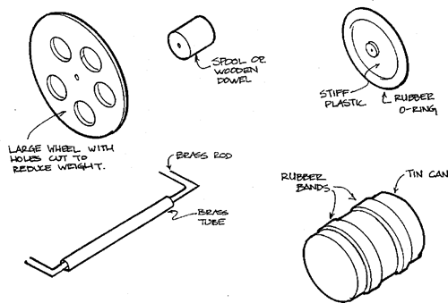
Wheels & Axles
Wheels and Bearings
Purpose
Wheels support the chassis and allow the car to roll forward. Bearings support the wheel while allowing them to rotate.
Ideas
Wheels can be large, small, narrow, wide.
Concept: Friction
Friction keeps things from sliding against each other. When you build your cars, there are some parts that you want to slide easily, and there are other parts you don’t want to slide at all.
Tire Traction
When you have two things that must roll against each other, like a wheel rolling along the road, friction keeps them from slipping. This type of friction is also called “traction,” and is important to remember when building your wheels. The heavier the wheel, the more energy it takes to get the wheel turning. Surprisingly, the bigger the wheel diameter (even if it is the same weight), the more energy it takes to get the wheel turning.

Slide 28
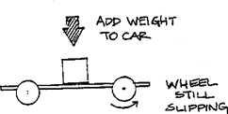
Weight & Traction
Weight Distribution and Traction
Traction and weight are issues to address or consider in designing cars. Consider front-wheel-drive or rear-wheel-drive for your team’s EV car design. All of the force is transmitted through the driven wheels.
Traction is important for transmitting the forces from the wheels to the road. If any of your wheels are spinning rather than rolling, you probably need more traction. Traction can be increased by adding a non-slip material around the wheels (like a tire) or by moving weight over the driven wheels. But, remember, it is also important to have efficient wheels, which are usually thin and lightweight. Weight distribution is very important, since you can increase traction just by moving existing weight from one part of the car to the other.

Slide 29
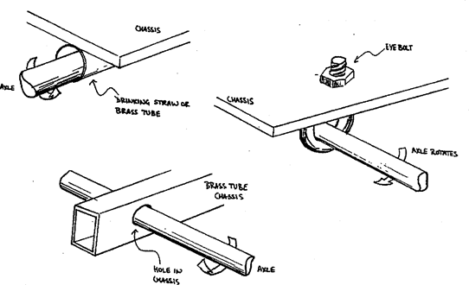
Bearings & Friction
Bearings
When you have two things rubbing against each other and you want them to move freely, otherwise friction slows things down and wastes energy.
One case where friction is very undesirable is in the wheel axle. The axle must be supported and attached to the chassis, but still must be able to turn. Components of the relative motion of two parts are called bearings. Some ideas bearings are sketched:
Lubrication
Lubrication helps parts slide against each other, so it is used in bearings to reduce friction. Different lubricants work better with different materials. Try various lubricants and see which ones work best in your car.

Slide 30
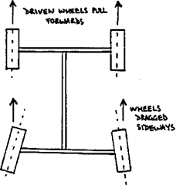
Wheels & Alignment
Wheel Alignment
Another problem that wastes energy is poor wheel alignment. When the wheels on your vehicle are not lined up properly, some of the wheels must slide sideways. One way this might happen is sketched below.
When the driven wheels try to pull the car one way, but the rest of the car wants to roll the other way, the traction in the wheels (normally a good thing) wastes quite a bit of energy.
Also, make sure that the axle goes through the center of the wheel. One suggestion is to use a compass, rather than tracing a circle, it you cut a circle out of a material. The compass will show you where the center of the circle is.
Taking time to align the wheels carefully the first time will make a huge difference in how well your car runs.

Slide 31
Materials: Bearings, Wheels & Axles
Materials
For wheels: Look around for anything round, or things which can be cut into circular shapes...look at home, arts and crafts stores, and hardware stores. Hobby stores sell model wheels, but they are more expensive and are not designed for building a model EV car. Ideas for materials are:
thin plywood
foam core
styrofoam
toy/model wheels
tape spool
brass tube
wood dowels
balsa wood
stiff plastic sheet
cardboard tubes
tin can
thread spool
plastic pipe
For traction: Things that are rough or rubber-like usually add traction. A few ideas:
rubber o-rings (hardware store) rubber bands
rubber sheet cloth tape
silicone or other caulking (hardware store)
For axle: The axle must be stiff, narrow and round. Some ideas:
nails
brass rod brass tubing
coat-hanger wire
For bearing: Some ideas of things that would support the axle:
Screw eyes/eyebolts (hardware store)
brass tubing
hard material (wood, aluminum, etc.) with a hole drilled into it brackets with screw holes pre-drilled
holes drilled directly into the chassis

Slide 32
Bearings, Wheels & Axles
(Insert your team’s images, video, notes, reflections, etc. to use in your group’s final design expo presentation)

Slide 33
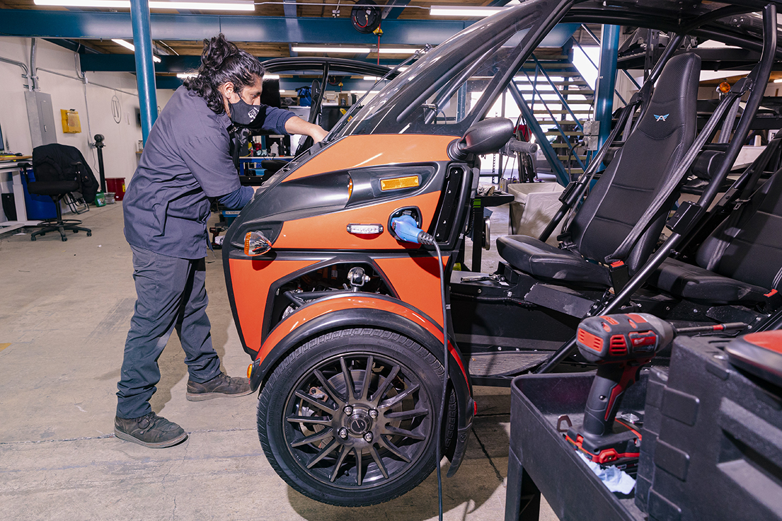
Assignment 3: Car Body
Body/Shell
Purpose
The body or shell of a real car has several purposes. It protects the passengers from wind and rain, it provides added safety in case of a crash, and it improves how the car looks. But it also changes how the car performs because a well designed shell can reduce the force of air on the car as it moves.
Ideas
Anything that meets the objectives for designing a functional, aesthetically pleasing EV car design is fair game!

Slide 34
Assignment 3: Car Body
Your team’s next task will be to design and build your model EV car body, and consider the following questions:
Car body: What object(s) will the team use for the body of their car? Consider size, weight, material, and aerodynamic qualities.
Aerodynamics: How will you design and build the body of your model EV to have the least air resistance?
Aesthetics / Decoration: Stickers, paint, markers, logos, and LEDs will be available to decorate the car.
Optional: Car & Track Connection: How will you design and attach the eye hook to the under chassis to attach the track guideline?

Slide 35
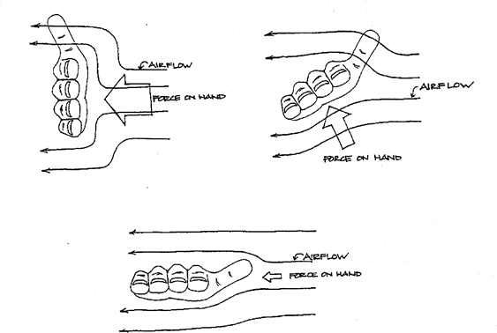
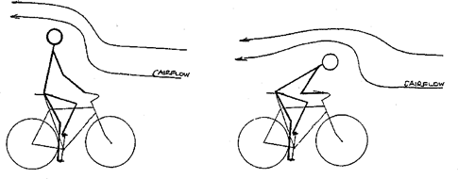
Aerodynamics
Concept: Aerodynamics
To see how much force air can have, you can try some simple experiments. While driving in a car, try (carefully!) holding your hand flat, and sticking it out of the window. Feel how much force the air has on your hand. What happens to the force when you tilt your hand?
Or while riding a bike down hill, compare how fast you can go while sitting upright, or leaning forward. If you crouch down, the air can go over you instead of hitting you in the chest, so you should be able to go faster. In either words, the force of the air on your body when you crouch down is less, so you are more aerodynamic.

Slide 36
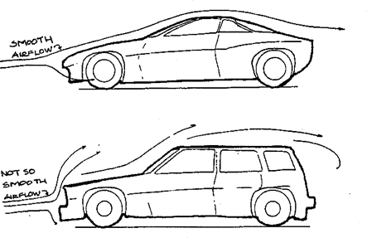
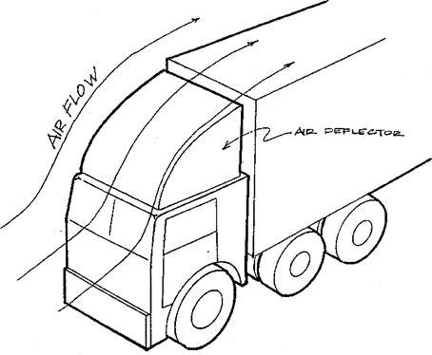
Aerodynamics & Aesthetics
Fast cars are shaped so that, when moving quickly, they can cut more easily through the air. As another example, you may have seen tractor-trailer trucks with big air deflectors on them. The reason for this deflector is to make the truck more aerodynamic, so the truck’s engine doesn’t have to work as hard and the truck driver saves money on gas. In some situations, the force of air helps you instead of hurting you. For example, what if you want to slow down very fast? How about using a parachute? Now the force of the air is helping you.
Materials
So how do you reduce the force of air on your EV car? One way might be to add a body or shell to it that deflects the air around the car. Some possible materials you might use are:
poster board
cardboard
foam core
stiff insulation foam (e.g. “Foamula” - can be bought at lumber stores)
mylar or plastic sheet
Insulation foam can be carved to shape, made smooth with sandpaper, and even painted to look nice.
(Warning: some paints, like spray paint, will “melt” foam, so always try your paint on a piece of scrap foam that you don’t need before using it on the real thing.)

Slide 37
Body/Shell
(Insert your team’s images, video, notes, reflections, etc. to use in your group’s final design expo presentation)

Slide 38
Assignment 4: Model EV Test
Test your team’s model EV:
Conduct time trials over a set distance and record the time in seconds. Calculate speed by dividing distance traveled by time to complete the distance. If extra time is available, iterate on car design and re-test:
Three Car Trials: Create a data table with distance, time, and speed columns (speed=distance/time). Record model EV cars results.
Re-design Ideas: How will the team propose to re-design your model EV to make it faster? To make it lighter? To make it sturdier?, etc.
Re-test Results: How did your re-designed EV model car perform? Run three more trials (data table with distance, time, calculate speed) Record your model EV cars results.

Slide 39
Assignment 4: Model EV Testing
(Insert your team’s images, video, notes, reflections, etc. to use in your group’s final design expo presentation)

Slide 40
Model EV Re-Design
(Insert your team’s images, video, notes, reflections, etc. to use in your group’s final design expo presentation)

Slide 41
Model EV Re-Test
(Insert your team’s images, video, notes, reflections, etc. to use in your group’s final design expo presentation)

Slide 42
Assignment 5: Model EV Final Project Deliverables
As a team, create a final Design Expo product of your choice to include:
Slides
Video
Poster
Other presentation ideas with teacher approval
Your team will present your final product and model EV car during the final Design Expo presentation in class and reflect on:
Demonstrate/explain your model EV design.
What components did you use to build your model EV?
How does your model EV motor circuit work? What is the motor power source (type/number of batteries)?
How did your team work together on the model EV project? Did you have team roles or a leader?
What successes did your team have in designing your model EV? What are you most proud of?
What challenges did your team face in designing your model EV? How did you overcome them?
If you had additional time and/or materials what future changes would you make to your model EV? Why?
What aspects of the Environmental Justice StoryMaps resonated most with your team in relation to EVs (air quality, health, community and environmental impacts, transportation connections)?

