Slide 1
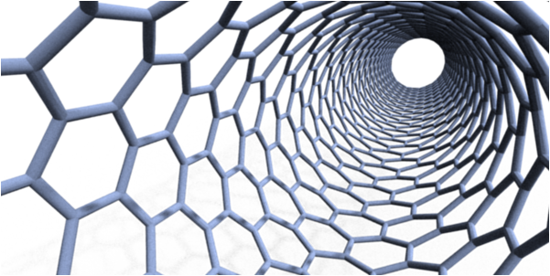
Introduction to Nanotechnology:
Insights into a Nano-Sized World
Notes:
Introductory presentation for lesson 1 of the NanoTech: Insights into a Nano-Sized World unit at TeachEngineering.org

Slide 2
What is nanotechnology?
Definition 1:
Nanotechnology is the creation of functional materials, devices, and systems through control of matter on the nanometer length scale, exploiting novel phenomena and properties (physical, chemical, biological) present only at that length scale.
Definition 2:
Nanotechnology is the engineering of functional systems at the molecular scale. It refers to the projected ability to construct items from the bottom up, using techniques and tools being developed today to make complete, highly advanced products.
Notes:
Source of definition 1: “Chem 570: Nanotechnology for Teachers,” Dr. John S. Hutchinson, Dean of Undergraduates, Professor of Chemistry, and Dr. Carolyn Nichol, Executive Director of School Science and Technology Programs, Associate Director of Education, CBEN, Rice University
Source of definition 2: K. Bowles, “Nanotechnology in the High School Curriculum: From Energy Conversion to Science Ethics,”: REU (RET) Nanotechnology Symposium, www.bowlesphysics.com (2004).

Slide 3
What is nanotechnology?
Some questions need to be answered…
What is the nano length scale?
Is nanotechnology new?
What “novel” and “exciting” phenomena are at this scale?
How do we use this to our advantage?

Slide 4
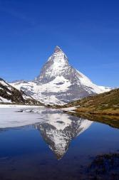

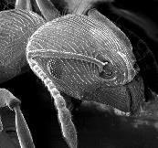
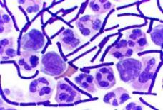
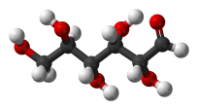
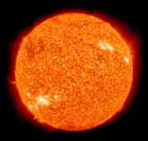
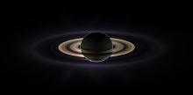
What does nano really mean?
mountain
1 km
1000 m
0.001 km = 1 m
child
1 m
ant
1 mm
0.001 m
1,000 mm = 1 m
bacteria
1 μm
0.000001 m
1,000,000 μm = 1 m
sugar molecule
1 nm
0.000000001 m
1,000,000,000 nm = 1 m
1 m = 1 BILLION nm
1 km = Saturn to Sun
Notes:
Use this slide to relate familiar and common creatures and natural objects of common units of measure to the smallness of the nano-meter length scale. Explain the bottom illustration (Saturn and the Sun) by saying: 1 m is to 1 billion nm as 1 km is to the distance from Saturn to the Sun.
Image sources:
Mountain = Matterhorn 4478 m, Walliser Alps, image released to public domain via Wikipedia, the free encyclopedia; http://en.wikipedia.org/wiki/File:Matterhorn_Riffelsee_2005-06-11.jpg
Child = “Children playing violin in a group recital, Suzuki Institute, Ithaca” (2001; edited) by Stilfehler, image released to public domain – Wikipedia, the free encyclopedia; http://en.wikipedia.org/wiki/File:Children_Playing_Violin_Suzuki_Institute_2011.JPG
Ant = “Scanning electron microscope image of an ant” (2005) U.S. Geological Survey from http://usgsprobe.cr.usgs.gov/picts.html
Bacteria = “gram stain anthrax” by John A. Jernigan, David S. Stephens, David A. Ashford, Carlos Omenaca, Martin S. Topiel, Mark Galbraith, Michael Tapper, Tamara L. Fisk, Sherif Zaki, Tanja Popovic, Richard F. Meyer, Conrad P. Quinn, Scott A. Harper, Scott K. Fridkin, James J. Sejvar, Colin W. Shepard, Michelle McConnell, Jeannette Guarner, Wun-Ju Shieh, Jean M. Malecki, Julie L. Gerberding, James M. Hughes, Bradley A. Perkins, and members of the Anthrax Bioterrorism Investigation Team. "Bioterrorism-Related Inhalational Anthrax: The First 10 Cases Reported in the United States". Emerging Infectious Diseases (Internet serial), 7(6), December 2001. From http://en.wikipedia.org/wiki/File:Gram_Stain_Anthrax.jpg (image in public domain because created by government employee)
Sugar molecule = “Glucose 3D Chain: white balls are H, red balls are O on a carbon chain” (2007) by Benjah-bmm27 from http://commons.wikimedia.org/wiki/File:D-glucose-chain-3D-balls.png
Saturn = Saturn eclipsing the sun, seen from behind the Cassini orbitor, NASA, image released to public domain – Wikepedia, the free enclyclopedia; http://en.wikipedia.org/wiki/File:Saturn-cassini-March-27-2004.jpg
Sun = The Sun photographed by the atmospheric imaging assembly of NASA’s Solar Dynamics Observatory, NASA, Image released to public domain – Wikipedia, the free encyclopedia; http://en.wikipedia.org/wiki/File:The_Sun_by_the_Atmospheric_Imaging_Assembly_of_NASA%27s_Solar_Dynamics_Observatory_-_20100819.jpg

Slide 5
How old is nanotechnology?
1965 Ferromagnetic fluids patented by S. Papel
1974 The word "nanotechnology" used
Early 1980s Quantum dots discovered by Alexei Ekimov
1985 Buckyball discovered
1991 Carbon nanotubes discovered
1997 Gold nanoshells discovered
1999 Doxil receives FDA approval
2008 Gold nanoshells therapy in human clinical trials
1687 Isaac Newton published “Principia,” laws of motion
1769 Watt invented steam engine
1839 Goodyear invented vulcanized rubber.
1885 Hertz discovered photoelectric effect
1916 Einstein published theory of relativity
1905-1925 Birth of Quantum Mechanics
1938 Electron microscope
1981 Scanning electron microscope
Notes:
Source of some slide content: “Chem 570: Nanotechnology for Teachers,” Dr. John S. Hutchinson, Dean of Undergraduates, Professor of Chemistry, and Dr. Carolyn Nichol, Executive Director of School Science and Technology Programs, Associate Director of Education, CBEN, Rice University

Slide 6
How old is nanotechnology?
In comparison, nanotechnology is fairly young.
Correction: Nano-sized objects have been around for centuries,
but the ability to see, understand and control them is recent
Why?
Quantum mechanics is needed to understand physics
  atomic properties
  wave properties
Tools are needed to see length scale
  transmission electron microscope
  scanning electron mmicroscope
  atomic force microscope
Processing technology is needed to control size, chemistry, shape, etc.
  scanning tunneling microscope
  atomic force microscope
  evaporation techniques
  self assembly (utilizing surface tension)
  wet chemistry techniques
←for modeling
←for imaging
←for manipulation & fabrication

Slide 7
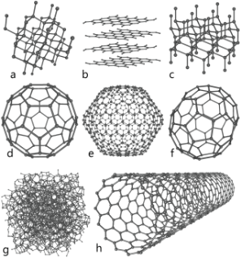
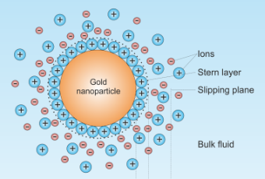
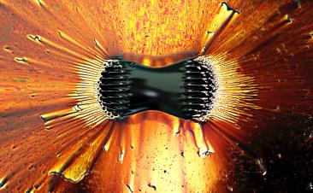
Types of Nano Phenomena
gold nanoshells
carbon allotropes
quantum dots
ferro fluids (magnetic)
Notes:
Top-left image: Carbon allotrope images showing (a) Diamond, (b) Graphite, (c) Londsdaleite, (d) C₆₀ bucky ball, (e) C₅₄₀, (f) C₇₀, (g) Amorphous carbon, (h) carbon nanotube. Source: 2006 Michael Strock, “Allotropes of carbon,” from http://en.wikipedia.org/wiki/File:Eight_Allotropes_of_Carbon.png
Top-right image: Gold nanoparticle with ions distributed about the surface. Source: 2011 (edited) Larryisgood, “Gold nanoparticles”, from http://en.wikipedia.org/wiki/File:Gold_nanoparticle_Zeta-potential.png
Bottom-left image: Quantum dot solutions showing fluorescents-dot size effects. Quantum dot size increases from left to right as solutions transition from violet to red. Source: 2009 X. Gao. Image reprinted by permission from Macmillan Publishers Ltd: [Nature] Sanderson, Katharine. “Quantum dots go large,” Special Report, Nature. Macmillan Publishers Ltd. 459 (11), pp. 760-761; June 2009. http://unanotech.com/wp-content/uploads/2011/06/Nature_Quantum_dots_go_large.pdf
Bottom-right image: Magnetic fluid under an externally applied magnetic field revealing individual (3-D) magnetic poles or spikes aligning with external magnetic poles with a surrounding oil emulsion. Source: 2006 Gregory F. Maxwell, “Ferrofluid”, from http://en.wikipedia.org/wiki/File:Ferrofluid_poles.jpg

Slide 8
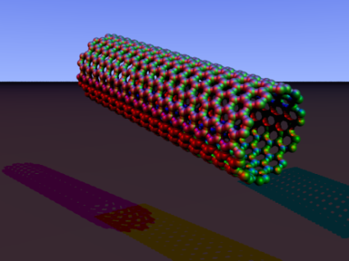
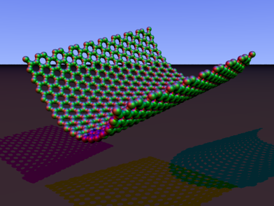
Single-Walled Carbon Nanotubes
Graphene: a sheet of carbon atoms. ➔
Roll up the sheet up to form SWNTs.
Notes:
Top-left image: Single walled carbon nanotube and carbon atomic arrangement. Single walled nanotubes may be engineered from fullerenes or other similar carbon allotropes by sectioning and implanting cylindrical sections or rolled graphene sheets. Source: 2007 Arnero, “carbon nanotube armchair povray”, from http://en.wikipedia.org/wiki/File:Carbon_nanotube_armchair_povray.PNG (public domain)
Bottom-right image:
2-D Graphene sheet showing hexagonal carbon atom arrangement being folded into nanotube. Graphene sheets are one (1) atom thick making this carbon allotrope the thinest-stable crystalline structure. Graphene maintains structural stability by having a wavy shape occupying a 3-D volume while possesing a 2-D structure.
Source: 2007 Arnero, “carbon nanorim zigzag povray,” from http://en.wikipedia.org/wiki/File:Carbon_nanorim_zigzag_povray.PNG
(public domain)

Slide 9
SWNT Properties and Applications
Exceptional mechanical strength
  Tensile strength > 37 GPa (steel 2 GPa)
  Young’s modulus ~0.62 – 1.25 TPa (steel 0.3 TPa)
Low density
  ~1.4 g/cm³
Steel ~8 g/cm³
Aluminum 2.7 g/cm³
High-performance, lightweight fibers
  Sports equipment: tennis racquets, golf clubs, baseball bats
  Body armor: replace Kevlar (PPTA) and Zylon (PBO)
  Futuristic applications: carbon nanotube rope from Earth to Moon
  High-performance concrete
  Road de-icing applications
Notes:
*NOTE* Instructors are encouraged to add images found on the Internet to enhance the information provided
Source of steel and aluminum info: Property Review by Baughman et al., Science, 297, 787 (2002)
Source of other information: “Chem 570: Nanotechnology for Teachers,” Dr. John S. Hutchinson, Dean of Undergraduates, Professor of Chemistry, and Dr. Carolyn Nichol, Executive Director of School Science and Technology Programs, Associate Director of Education, CBEN, Rice University

Slide 10
The World’s Smallest Radio
Star Wars theme song played from the world’s smallest radio
Notes:
Click “Star Wars Theme Song” to start a movie detailing the world’s smallest radio. This is the link:
http://www.physics.berkeley.edu/research/zettl/projects/nanoradio/media/nanoradio-starwars.mov
Tell the students: Physicists at the University of California Berkeley have built the smallest radio ever—a single carbon nanotube one ten-thousandth the diameter of a human hair—that requires only a battery and earphones to tune in to your favorite station. In this video, the nanotube is seen under a high-resolution transmission electron microscope so the radio can be observed in action. When not tuned in, the nanotube does not vibrate. As the researchers tune it to a frequency, the nanotube vibrates at radio frequencies, which blurs its image. The nanotube is about 700 nanometers long and 10 nm in diameter. The nanoradio, which is currently configured as a receiver, could also work as a transmitter, and is 100 billion times smaller than the first commercial radios. The nanoradio could be used in any number of applications—from cell phones to microscopic devices that sense the environment and relay information via radio signals. Because it is extremely energy efficient, it would integrate well with microelectronic circuits. The nanotube radio may lead to radical new applications, such as radio-controlled devices small enough to exist in a human's bloodstream.
Film clip and images from U.K. Sur, “World’s first single carbon nanotube radio”, Current Science, 94, 2, (2008), pp 166-167.
Description source: http://berkeley.edu/news/media/releases/2007/10/31_NanoRadio.shtml
Source of cartoon drawing of radio image: Microsoft clipart

Slide 11
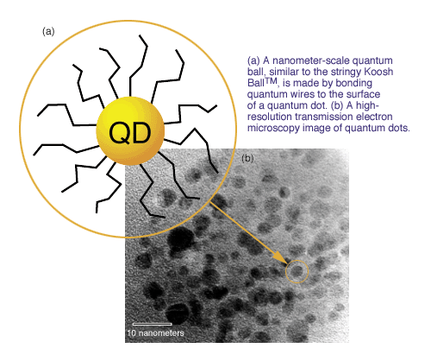
Quantum Dots
Notes:
(a) Nanometer quantum ball is made by bonding quantum wires the dot surface. (b) High-resolution transmission electron microstructure image of quantum dots. Source: 2009 Howard Lee, “Mighty Small Dots”, Lawrence Livermore National Lab from https://www.llnl.gov/str/Lee.html

Slide 12
Quantum Dots
insert image here
http://www.onlineinvestingai.com/blog/wp-content/uploads/2009/02/quantum_dots-300x224.jpg
insert image here
http://www.concepts.aero/system/files/quantum-dots.jpg
***Rotate image 90 degrees clockwise***
Notes:
Top-left image: Quantum dot image; schematic detailing electron excitation and hole formation creating a charge in GaAs semiconductor when excited by an external energy source. (insert image from provided URL)
Lower-right image: Quantum dot image; quantum dot size and color emission comparison chart. (insert image from provided URL)

Slide 13

Quantum Dot Applications
High-Performance Optical Properties
Optical beacons
LEDs (light-emitting diodes)
Solar cells
Cancer detection
Light bulbs
Next-generation screens
  computers
  cell phones
  televisions
Notes:
*NOTE* Instructors are encouraged to add images found on the Internet to enhance the information provided
Screen image source: US White House; http://www.whitehouse.gov/1is2many/apps-against-abuse

Slide 14
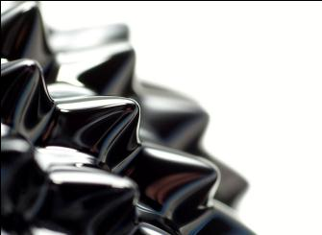
Ferrofluids (Magnetic Fluids)
insert image here
http://www.ucl.ac.uk/~ucfbpmb/ferrofluid%20copy.jpg
What makes up a ferrofluid?
Ferromagnetic nanoparticles
Surfactant (detergent)
Carrier fluid (kerosene, vegetable oil)
Notes:
Top-right image: Close-up photograph of ferrofluid influenced by magnetic field. Source: Opoterser (released into public domain)
from http://en.wikipedia.org/wiki/File:Ferrofluid_close.jpg
Bottom-left image: Ferro fluid image; simulated magnetic nano particles (dark spheres) with surfactant molecules attached (stringy beads) to particle surfaces. Surfactant prevents particle agglomeration within carrier fluid (white background). (insert image from provided URL)

Slide 15
Why Ferrofluids? Why Nano?
Without magnetic field nanosuspension behaves as a fluid.
Under controlled magnetic fields can manipulate properties
Nanoparticles behave as permanent magnets.
That’s a lot of magnets in a little fluid!!!
Ferrofluid Applications
Audio speakers
Seals (engineering applications)
Cancer treatments
(use magnetic field to heat particles and cook cancer cells)
Drug delivery systems
(manipulate drugs through induced magnetic field)
Toys
Notes:
*NOTE* Instructors are encouraged to add images found on the Internet to enhance the information provided

Slide 16
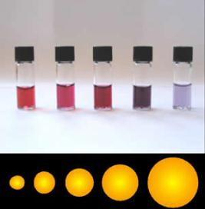
Nano Shells
Metal nanoshells are excellent optical absorbers
  Particularly gold, because of the strong optical absorption from the metal’s response to light
  Similar to quantum dots; shell diameter and thickness play a role in optical tuning
Shells are comprised of gold or metal layer engineered to a particular thickness
with a glass or dielectric core
insert image here
http://www.nanotech-now.com/images/Nanospectra-logo-sm.jpg
Notes:
Left image: Gold nanoparticle solution line-up showing particle size and solution color effects. It is apparent that short wavelength light is absorbed for small gold nanoparticles, hence red (long wavelength) light is transmitted. Source: 2010 Aleksandar Kondinski, “Gold255,” from http://en.wikipedia.org/wiki/File:Gold255.jpg
Right image: Gold nanoshell cut-away detailing structure. Dielectric silica core define nanoshell size where gold shell thickness is engineered for specific properties. (Insert image from provided URL)

Slide 17
Gold Nanoshell Synthesis
insert image here
http://education.mrsec.wisc.edu/SlideShow/slides/nanoparticles/Au_nanoshell_synthesis.jpg
insert image here
http://education.mrsec.wisc.edu/Edetc/SlideShow/images/nanoparticles/Au_wavelength.jpg
Near infrared peak absorption characteristics with gold shells
Wavelength that is not absorbed by skin
Important features when considering cancer treatment applications.
Notes:
*Demonstration* Use flashlight and skin demonstration to illustrate longer wavelengths are not absorbed.
Left image: Gold nanoshell synthesis starting with silica dielectric continuing with organic surface treatment to modify surface charges attracting gold particles to silica surface. (Insert image from provided URL)
Right image: Gold nanoshell thickness wavelength absorption properties. Thicker shells absorb smaller wavelengths of light. (Insert image from provided URL)

Slide 18
Nanoshell Applications
Optical imaging contrast agents
Photothermal ablation (cooking) of cancerous cells
Pharmaceutical delivery
Optically controlled microfluidics valves
Biosensing
insert image here
http://english.ipc.cas.cn/ns/es/201101/W020110121336809111199.jpg
Notes:
Image: Illustration of gold nanoshell infrared wavelength absorption characteristics engineered for localized drug delivery systems. Nanoshells are coated with specific drugs for treatment and are exctied via LASER (energy source) for releasing such drugs. Cut-away details engineered nanostructure and composition. Source: http://english.ipc.cas.cn/ns/es/201101/W020110121336809111199.jpg
(Teacher: Insert image from provided URL)

Slide 19
Misconceptions about Nanotechnology
insert image here
http://www.flickr.com/photos/kt/8727693/
This is science fiction!!!!
Notes:
Image: Fictional signage about flesh eating nanobots. This image is meant to be entertaining. Source: 2005 “Nanobot Protected Cubicle,” by Kevin Trotman from http://www.flickr.com/photos/kt/8727693/ (insert image from provided URL)

Slide 20


Consumer Uses and Projections
Motor vehicles
  Such as catalytic converters, interiors, coatings, adhesives, lighting
Electronics and computers
  Such as hardware, displays, recording media, batteries, electronic parts, lighting, ink and paper
Household products and improvements
  Such as packaging, cleaning products, coatings
Personal care
  Such as sunscreen cosmetics, over-the-counter health products, oral hygiene, eye glass coatings (anti-reflective, scratch resistant)
Sporting equipment
Clothing
Air and water filtration and purification
And more…
Notes:
*NOTE* Instructors are encouraged to add images found on the Internet to enhance the information provided
Sunscreen images source: US Library of Congress; http://www.loc.gov/rr/scitech/mysteries/sunscreen.html

Slide 21
Nanoworld as a Whole
Google “nanotechnology” and see ~24,100,000* results…
and growing everyday
Nanotechnology is in emerging technology that surrounds us:
  Consumer products contain it
  Advanced medical treatments, renewable energy methods and consumer products use it
  Our job is to understand, design, and control it
By 2015, nanotechnology revenues are estimated to reach $2.5 trillion ($2,500,000,000,000) worldwide
This is the future!!!!
Notes:
* Instructors need to update internet search facts since these numbers are always changing.
Source of revenues statistic: Working Party on Nanotechnology; DSTI/STP/NANO(2012)14; Directorate for Science, Technology and Industry, Committee for Scientific and Technological Policy, OECD/NNI International Symposium on Assessing the Economic Impact of Nanotechnology, Background Paper 3: The Economic Contributions of Nanotechnology to Green and Sustainable Growth
16 March 2012, Washington DC; pg 9; http://www.oecd.org/sti/nano/49932107.pdf

Slide 22
Acknowledgements
National Science Foundation Grant #0840889 for GK12 program funding.
Dr. John S. Hutchinson and Dr. Carolyn Nichol of Rice University for supporting information and images.

