Slide 1
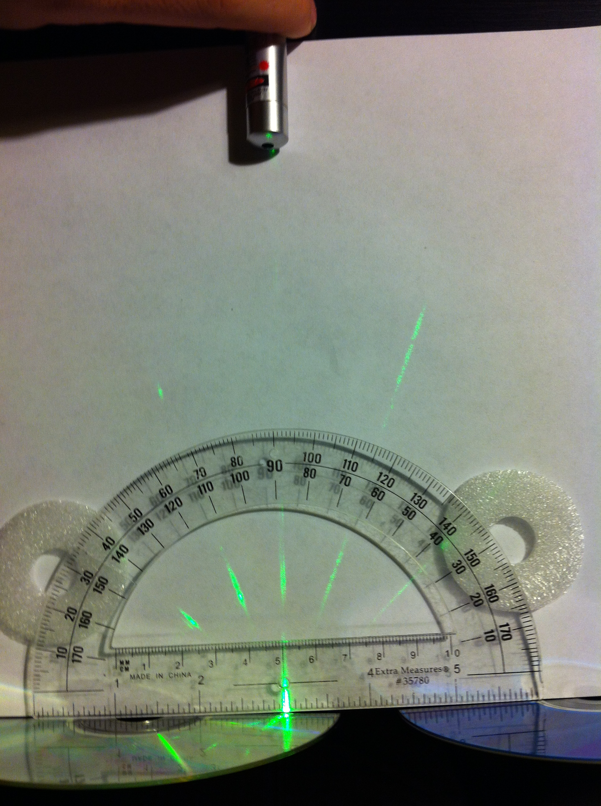
Estimating the storage capacity of a CD/DVD using diffraction

Slide 2
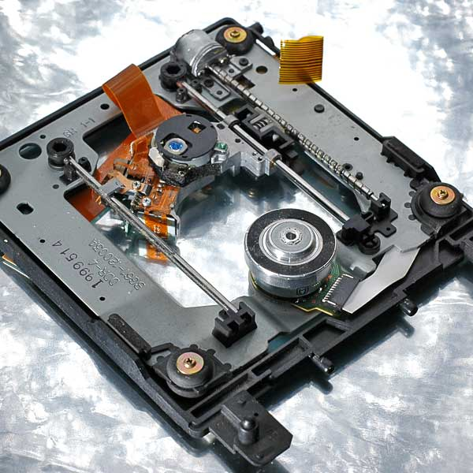
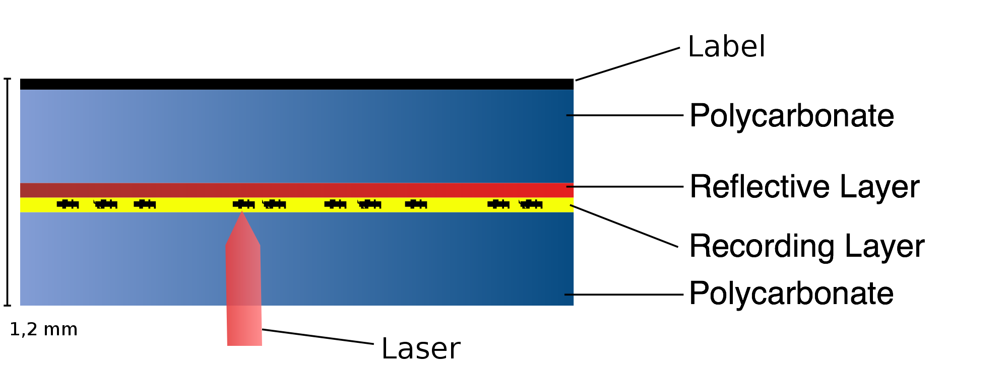
CD/DVD drive
Image top: http://en.wikipedia.org/wiki/File:Dismdvd.jpg
Image bottom: http://commons.wikimedia.org/wiki/File:DVD_querschnitt.svg (Creative Commons license)

Slide 3
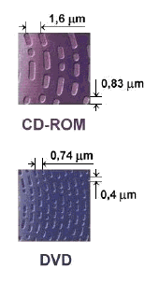
How does a CD/DVD store data?
Image: http://commons.wikimedia.org/wiki/File:DVD_CD_pits.PNG (Creative Commons license)

Slide 4
Distance between rows of pits
Diffraction order m = +1
Wavelength
Diffraction order m = -1

Slide 5
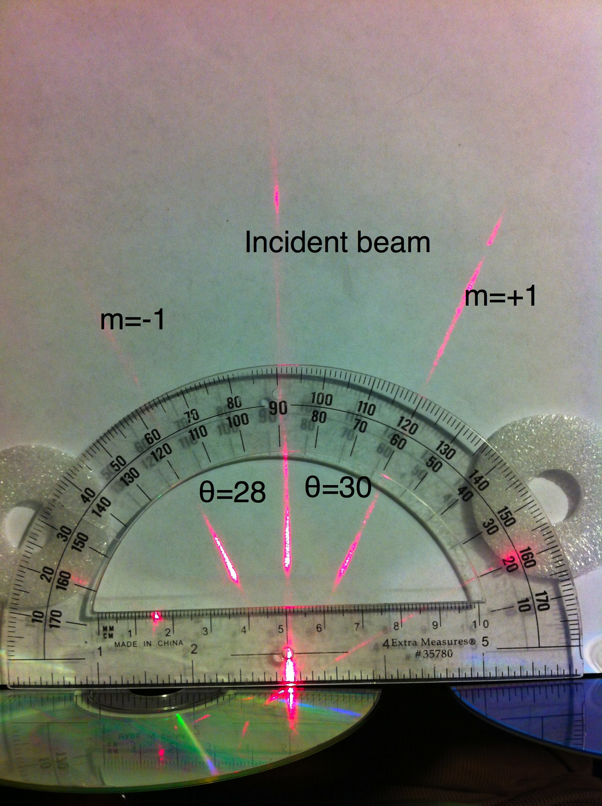
Measuring diffraction angles
You would record it as follows:
Also identify the wavelength of your laser.
Then calculate d.

