Slide 1
Human and Robot Sensors
Notes:
Human and Robot Sensors Presentation
Human and Robot Sensors lesson, TeachEngineering.org

Slide 2
Human and Robot Sensors Quiz
How many sensors or senses do humans have? List them.
Describe how any two of those human “sensors” work.
Give at least three examples of robot sensors that are similar to human senses.
Notes:
Pre-Lesson Quiz questions

Slide 3
Human and Robot Sensors Quiz
How many sensors or senses do humans have? List them.
Humans have 5 main senses: vision, hearing, smell, touch and taste. Our sensors include the eyes, ears, nose, skin and tongue.
Additional sensors include temperature sensors, body position sensors, balance sensors and blood acidity sensors.
Describe how any two of those human “sensors” work.
Eyes: Take in the surrounding light and relay it to nerve cells that send images to the brain.
Ears: Take in sound waves from the air and vibrate, sending vibrations through the inner ear to hair cells that send signals through the nerves to the brain.
Nose: Particles are inhaled into the nose and nerve cells contact the particles and send signals to the brain.
Skin: Sensors all over the skin are activated and send signals to the brain through the nervous system.
Tongue: Taste buds are made of small cells that have little hairs that are activated by particles in food. The hairs send signals through nerves to the brain.
Give at least three examples of robot sensors that are similar to human senses.
Light and ultrasonic sensors are like eyes (vision). Sound sensors are like ears (hearing). Touch, temperature and pressure sensors are like skin (touch).
Notes:
Pre-Lesson Quiz Answers

Slide 4
Lesson Objectives
The following slides include:
A rigorous background in human sensors and their engineering equivalents.
A review of human sensors, followed by robot sensors, to set the context for the hands-on activities involving sound sensors on the LEGO MINDSTORMS NXT robot.
How the robot takes sensor input, and uses it to make decisions to cause movements.

Slide 5
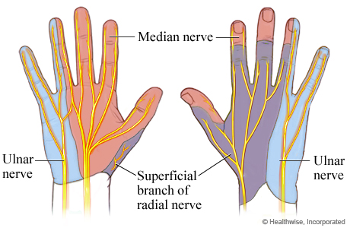
What is a Sensor?
A sensor is a device that measures a physical quantity
Touch example:
The skin in your fingers contains millions of sensitive nerve endings that can detect stimuli, such as temperature.
When you touch an object, sensors on your fingers send signals to your brain so that it recognizes it as being hot or cold.
This stimulus is converted to neuronal impulses that are sent via nerves to a specific region in the brain that interprets it as being hot or cold.
The same process happens with stimuli such as pressure and pain signals.

Slide 6
Human Sensors
Your sensory organs (eyes, ears, nose, tongue and skin) provide information to your brain so that it can make decisions. This is very similar to the working of robot sensors. Your brain continuously uses the information that it receives from your sensory organs to make your body work correctly.
Humans have 5 major senses:
Your eyes enable you to see the world
Your ears enable you to hear sounds
Your nose lets you smell the many scents in our world
Your tongue lets you taste
Your skin lets you feel objects through touch
Plus several additional sensors in the body that you do not notice directly:
Sensors in the inner ear give the brain information about balance
Sensors in our muscles inform the brain of our body positions
Sensors throughout your body that sense temperature
....and others

Slide 7
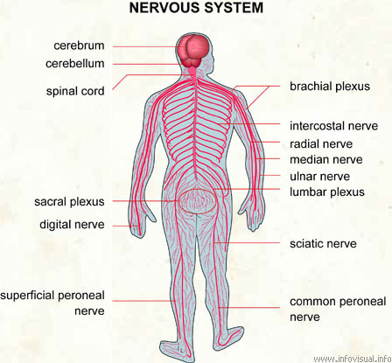
Human Sensors – Signal Transmission
When the sensors of the human body detect a stimulus, they send this information through the nervous system (similar to wires) to the brain.
The human nervous system has two main parts:
The peripheral nervous system is a series of branches of single nerves. These nerves connect to every sensor in your body. They send signals to other nerves, which send signals to more nerves until the signal reaches the second part of the nervous system: the central nervous system.
The central nervous system consists of your spinal cord and your brain. The spinal cord is composed of bundles of nerves that are surrounded by bones for protection. Once a signal from a sensor reaches the spinal cord, it is sent up the cord to the brain. The brain decides what to do based on the information received.

Slide 8
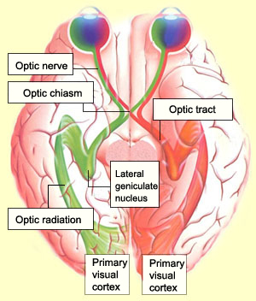
Vision: How Does the Brain Know What We Look At?
Light (stimulus) enters the eye.
It passes through the optic nerve.
Lateral geniculate nucleus (LGN) relays the information to the visual cortex.
Visual cortex processes this information.

Slide 9
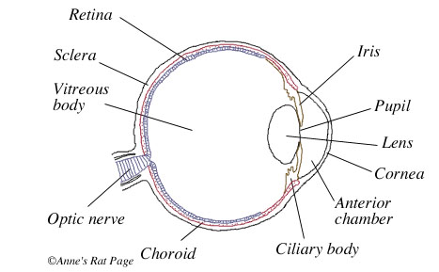
How Do Your Eyes Work?
First, light enters your eye, and is refracted, or bent, by the cornea, the outermost part of your eye.
Refracted light is directed right at the pupil, a small hole in the center of the iris, the colored part of the eye. The iris can change the pupil size to control how much light enters.
Light that goes through the pupil is redirected by the eye’s lens, which points the light at nerve cells in the back of your eye.
The back of the eye has two types of nerve cells:
Cones detect colors and fine details in good light.
They are concentrated in the center of the
back part of your eye.
Rods detect the presence of objects in bad light
and are concentrated on the sides of the back part of your eye.
Cones and rods send signals through the optic nerve to the brain.

Slide 10
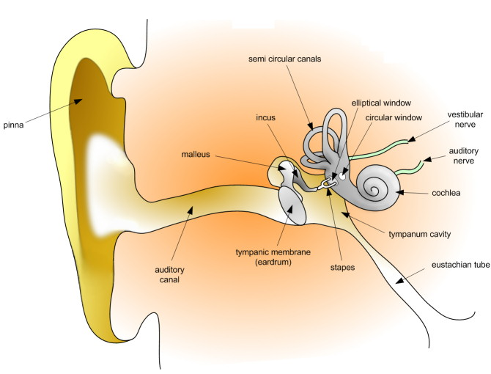
Sound: How Do Your Ears Work?
Sound waves enter the ear canal and cause the eardrum to vibrate.
Eardrum vibrations are carried through the hammer, anvil, and stirrup of the ear to a fluid-filled structure called the cochlea.
Different pitches cause different parts of the fluid in the cochlea to vibrate.
When cochlear fluid vibrates, it moves hairs connected to nerve cells, which send signals to the brain through the auditory nerve.
The brain helps you recognize the sound.

Slide 11
Parts of the Human Ear

Slide 12
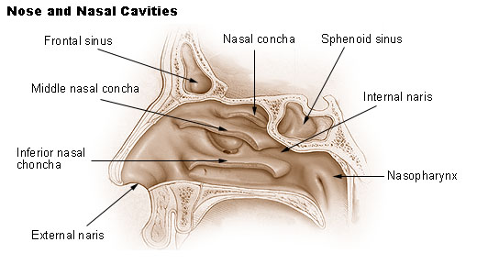
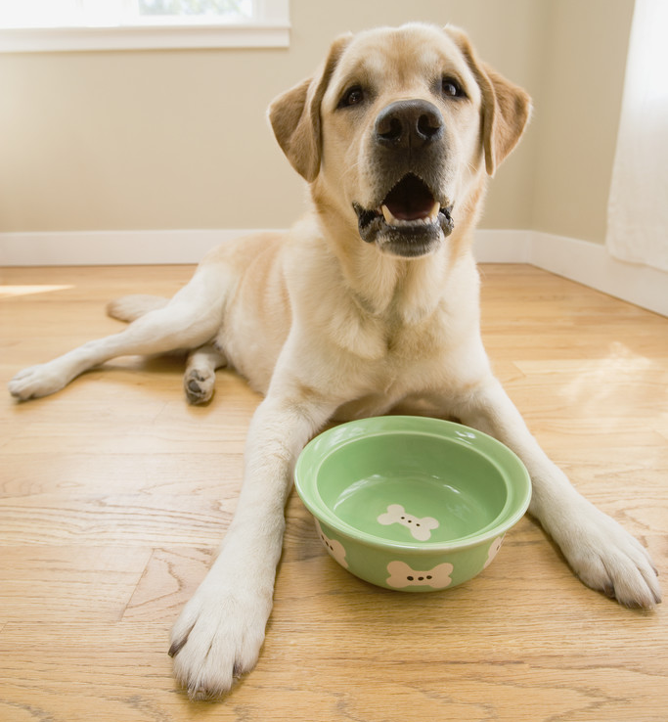
Smell: How Do We Smell Using Our Noses?
Small particles of almost everything around us can be found in the air.
These particles enter the nose when you breathe in and contact nerve endings in the upper nasal passage.
These nerve endings send signals through the nervous system to the brain, which makes sense of the smell.
Humans can distinguish between hundreds of different smells. Dogs can distinguish between thousands.
http://videos.howstuffworks.com/howstuffworks/461-how-smell-works-video.htm
Notes:
Show the short How Smell Works video (1:49 min) to the class: http://videos.howstuffworks.com/howstuffworks/461-how-smell-works-video.htm (makes human vs. dog comparison)

Slide 13
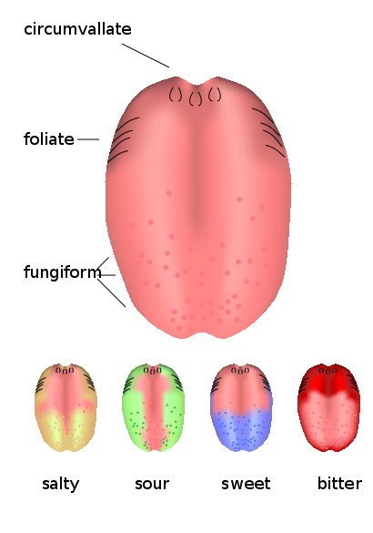
Taste: How Do We Taste Using Our Tongues?
The tongue has sensory receptors called taste buds that can detect one of 5 different flavors: sweet, salty, bitter, sour, umami
Umami is a flavor in many high-protein foods, such as meats, as well as cheeses, tomatoes and mushrooms, and is generally described as being a savory, meaty taste.
Taste buds are comprised of cells called gustatory receptor cells, which have tiny hairs that detect taste from the food that you eat. The hairs send information to the cells, which send signals through the nervous system to the brain, which interprets the information as taste.
What is the difference between taste and flavor?
Flavor includes taste, but also a little more. It comprises taste, smell, texture of food, and even other sensations such as pain when you eat something spicy. Eating food with your nose blocked shows a marked decrease in flavor, even though the taste is the same.

Slide 14
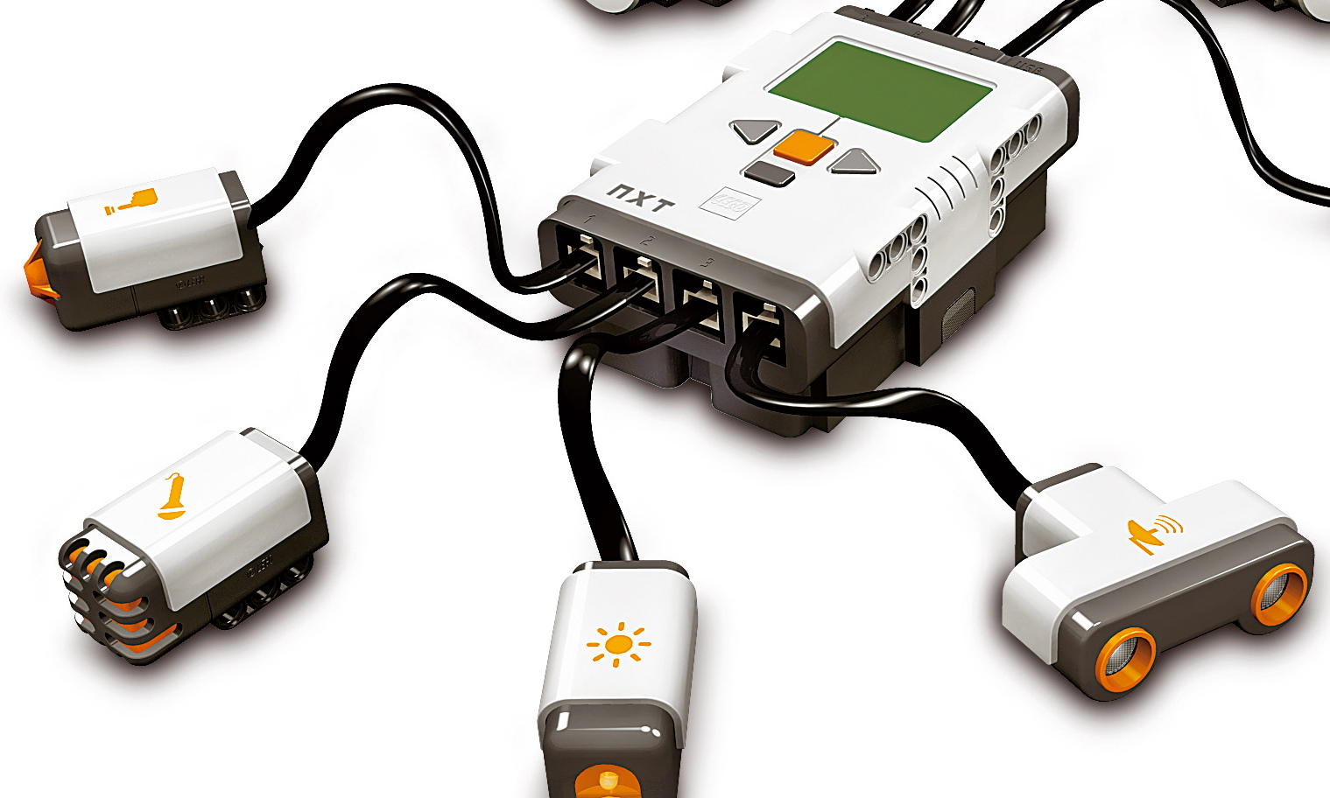
Robot Sensors
What do robot sensors do?
Gather information from the surroundings and send it to the computer brick.
Robot sensors can only be used if the robot’s program asks for information from them!
Similarly, the robot can only act on information from the sensors if its program tells it to do so!
How do sensors send signals to the computer brick?
The sensors send information through the wires (similar to the nervous system in the human body) that connect them to the computer brick, which uses the information if its program requires it.

Slide 15
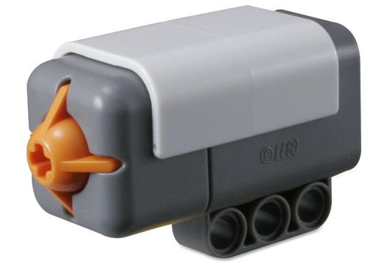
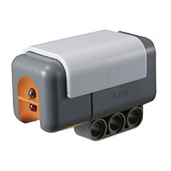
How Do Robot Sensors Work?
Touch Sensor
A touch sensor is a button-like protrusion.
When bumped, it sends a signal to the computer brick saying that it has been touched.
Light Sensor (works in two different ways)
Detects the amount of ambient light and converts it to a numerical value that is sent to the computer brick.
Determines the brightness of an object by sending out light and detecting how much is reflected back. It converts the amount of reflected light to a numerical value and sends it to the computer brick. If no object is in front of the sensor, it sends a value of zero.
touch sensor
light sensor

Slide 16
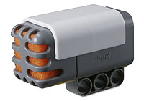
How Do Robot Sensors Work?
What is sound?
Sound is made of sound waves or vibrations in the air.
Louder sounds produce larger vibrations.
Higher pitch sounds produce more frequent vibrations.
Sound Sensor
In a sound sensor, a thin piece of material called a diaphragm vibrates when hit by sound waves (similar to a human eardrum).
If the diaphragm vibrations are large enough to be detected, the sound sensor sends a signal to the computer brick saying that it has heard a sound.
sound sensor

Slide 17
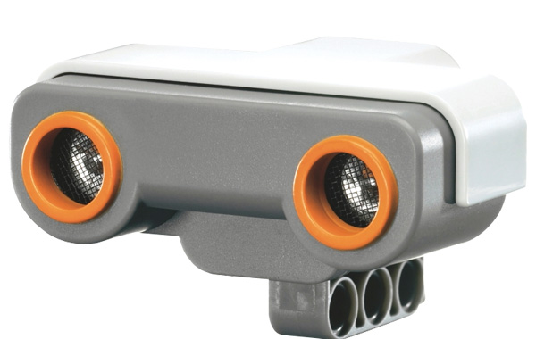
How Do Robot Sensors Work?
Ultrasonic Sensors have two parts:
A transmitter sends out a signal that humans cannot hear.
A receiver receives the signal after it has bounced off nearby objects.
The sensor sends out a signal and determines how long the signal takes to come back:
If the object is very close to the sensor, the signal comes back quickly.
If the object is far away from the sensor, the signal takes longer to come back.
If objects are too far away, the signal takes so long to come back (or is so weak when it comes back) that the receiver cannot detect it.
The ultrasonic sensor sends a message back to the computer brick, telling it the time taken for the signal to return. The computer brick uses this data to compute its distance to the object.
Can you name a similar process performed by animals?
ultrasonic sensor
Notes:
The way ultrasonic sensors work is similar to echolocation by bats and some marine animals.

Slide 18
What Are Robot Equivalents of Human Sensors?
Human Sensor | Equivalent Robot Sensor
eyes | light sensor, ultrasonic sensor
ears | sound sensor
skin | touch, temperature, pressure sensors
nose | none yet…
tongue | none yet…
Notes:
2013 update: Engineers are designing what are called “e-noses” and “e-tongues”—the human-made equivalent to the human nose and tongue sensors.
See: http://www.digikey.com/us/en/techzone/sensors/resources/articles/The-Five-Senses-of-SensorsSmell.html
See: http://www.digikey.com/us/en/techzone/sensors/resources/articles/The-Five-Senses-of-SensorsTaste.html

Slide 19
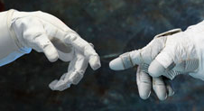
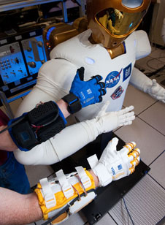
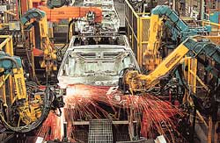
Real-World Examples Abound
Researchers study how pressure sensors in the human fingers and the multiple fingers work to help them design efficient robotic hands.
Touch sensors used in smart phones and tablets!
 Robonaut (L) and human-gloved hands (R)
Study of how the human eye works helps in the design of cameras with higher performance and speed.
Highly sophisticated robots use many types of sensors to perform precision work on assembly lines, such as painting & welding.
Notes:
Robonaut (left) and spacesuit-gloved hands (right) extend towards each other to demonstrate the collaboration between robots and humans in space projects.

Slide 20
Image Sources
Page 1a: photo of eyes; U.S. Department of Veteran Affairs http://www.lexington.va.gov/features/May_is_Healthy_Vision_Month.asp
Page 1b: photo of ear; State of Ohio http://www.tclw.das.ohio.gov/Default.aspx?tabid=325
Page 1c: photo of girl-bad smell; City of Mesa, AZ http://www.mesaaz.gov/energy/ngsmell.aspx
Page 5: Nerves in human hand; www.ptwellness.org
Page 7: Human nervous system diagram; http://www.infovisual.info/03/038_en.html
Page 8: Pathway from eye to visual cortex; ttp://thebrain.mcgill.ca/flash/d/d_02/d_02_cr/d_02_cr_vis/d_02_cr_vis.html
Page 9: Human eye diagram; http://www.ratbehavior.org/Eyes.htm
Pages 10 and 11: Human ear anatomy; Dan Pickard, Wikimedia Commons www.commons.wikimedia.org
Page 12a: dog photo; Microsoft clipart http://office.microsoft.com/en-us/images/
Page 12b: Human nose anatomy; www.commons.wikimedia.org
Page 13: Taste buds on human tongue; http://commons.wikimedia.org/wiki/
Pages 14-17: LEGO® parts and sensors; www.LEGO.com
Page 19a&b: gloved hands and robot arms; NASA http://www.nasa.gov/mission_pages/station/main/robo-glove.html
Page 19c: assembly line robots; NASA http://mynasa.nasa.gov/worldbook/wbkids/k_robot.html

