Slide 1
Strength of Shapes
Exploring Structural Engineering Fundamentals
Notes:
Strength of Shape Presentation
Triangles & Trusses lesson, TeachEngineering.org

Slide 2
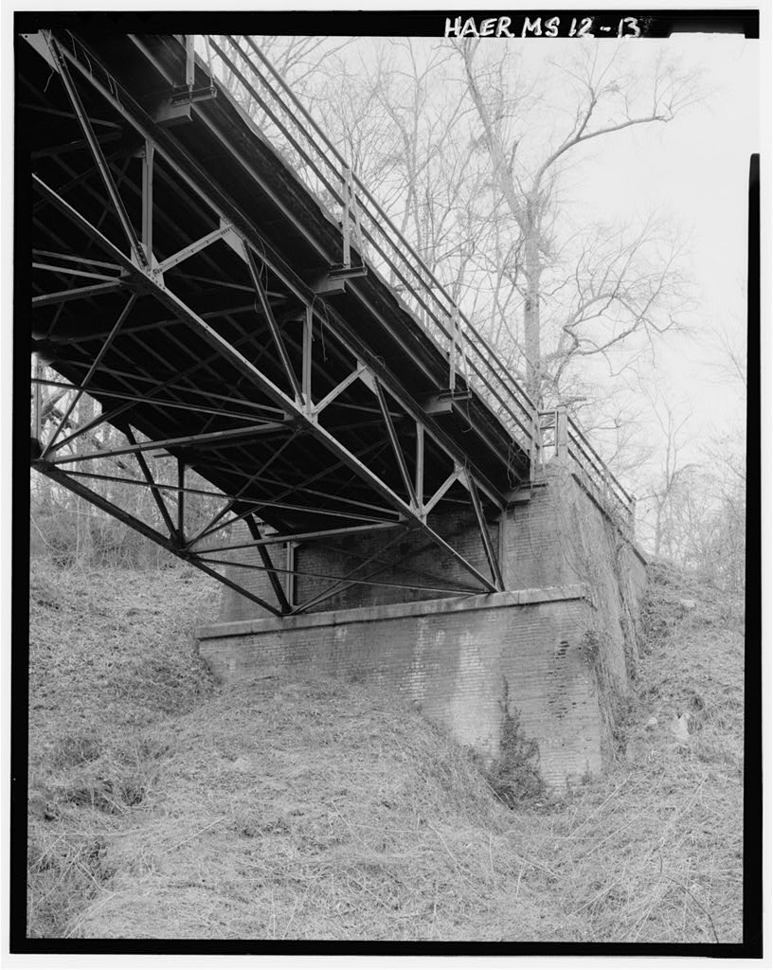
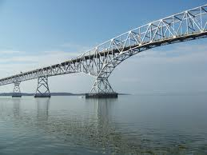
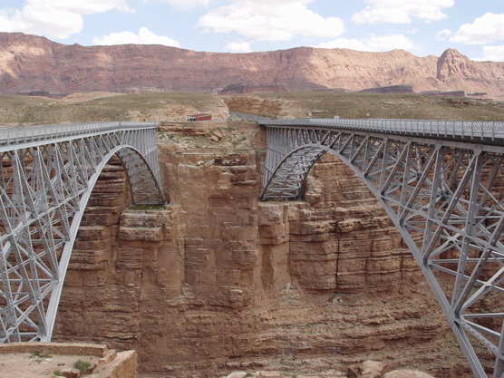
Shapes in Bridges
Notes:
Suggested text: When we look carefully at bridges, we can see how structural engineers use different shapes to make the overall design. We can see triangles and squares. We can even see parabolas.
Image sources:
Top left: http://upload.wikimedia.org/wikipedia/commons/6/6f/Gov._Harry_W._Nice_Bridge.jpg
Bottom left: http://www.nps.gov/glca/historyculture/images/Navajo_Bridges_1.gif
Right: http://lcweb2.loc.gov/pnp/habshaer/ms/ms0200/ms0205/photos/344693pv.jpg

Slide 3
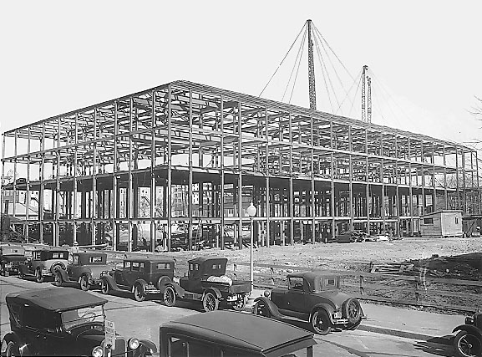
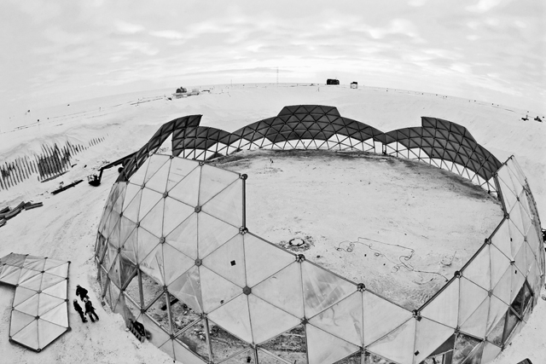
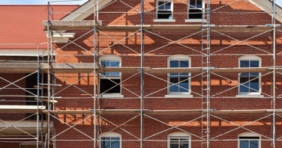
Shapes in Buildings
Notes:
Suggested text: Structural engineers use the same types of shapes in buildings. Many building frames are simply repeating squares, as shown in the top left. The bottom left image shows how a square is reinforced by adding a diagonal cross brace in this scaffolding, which divides the square into two triangles. The image on the right shows an Antarctic goedesic under construction. Geodesic domes are like soccer balls and can be viewed as a group of pentagons and hexagons. But, if we break each of those shapes down, we can see that they are fundamentally composed of triangles.
Image sources:
Top left: http://www.osmre.gov/IMAGES/southbldg4.jpg
Bottom left: http://www.presidio.gov/about/Pages/historic-preservation.aspx
Right: http://antarcticsun.usap.gov/AntarcticSun/features/images/dome_demo_jan%207_fisheye.jpg

Slide 4
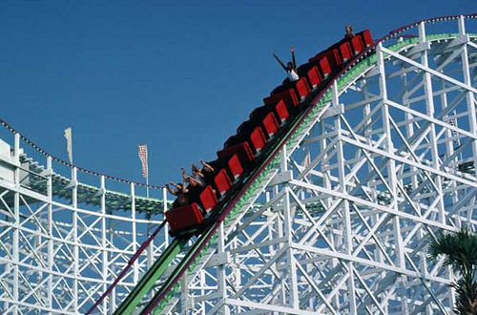
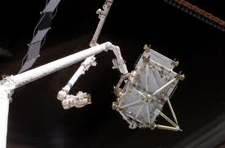
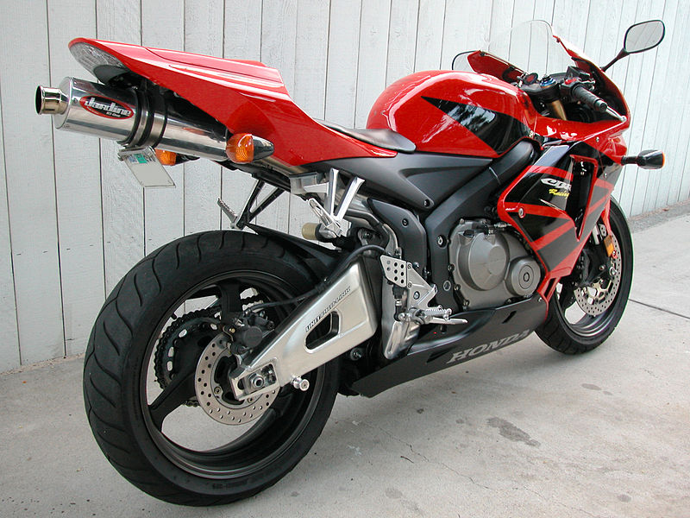
Shapes in Other Things!
Notes:
Suggested text: Even when we get outside the realm of civil or architectural engineering, we can see how engineers rely on the known strength of shapes. A motorcycle frame uses many triangles to support the wheels and seats. Cranes, designed by mechanical engineers, use triangles and squares in their frames. Even satellites use these basic geometries.
So what have we noticed as a common theme? (Hopefully, students answer that all of these structures use triangles.)
Image sources:
Top left: http://www.robertreeveslaw.com/blog/wp-content/uploads/2011/09/Roller-Coaster-Accident.jpg
Top right: http://www.executivegov.com/wp-content/uploads/2011/12/Crane.jpg
Bottom left: 2006 Rich Niewiroski Jr., Wikimedia Commons http://commons.wikimedia.org/wiki/File:2006HondaCBR600RR-002.jpg
Bottom right: http://www.asc-csa.gc.ca/images/recherche/images/5cba4ffa-7be8-4333-b514-93b76fab4cf6.jpg

Slide 5
Relative Strength of Shapes
On your paper, sketch what you think will happen to these shapes if we apply the force shown in GREEN (assume the sides are rigid)
Notes:
Suggested text: On your paper, sketch each of these regular polygons: square, diamond and triangle. If we push straight down on the shape, putting the whole shape into compression, what will happen to the shape? Draw, using a different pen or pencil or dashed line, how the shape would look if you pushed on it. Assume that the sides of the shape are rigid and won’t change length or bend.

Slide 6
Relative Strength of Shapes
The TRIANGLE is the only shape that won’t collapse!
WHY?
Notes:
Suggested text: Take a look a this! If you push down on top of the square, it will no longer be a square, but instead take the shape of a rhombus, which is a type of parallelogram. This is called “racking.” If we push down on the top of the diamond, it will collapse down. But what about the triangle?

Slide 7
Relative Strength of Shapes
The other shapes collapse because the angles between the structural members change.
Notes:
Suggested text: The reason that the square and diamond collapse is because the angle between the structural members can change without having the length of the members change or bend. Remember back to geometry when we talked about how polygons are defined? In this case, both quadrilaterals simply require the sum of the angles to equal 360 degrees, but each angle can change.

Slide 8
Triangles
The TRIANGLE cannot collapse because the angles are fixed based on the opposite side length.
c
A
B
b
a
C
Notes:
Suggested text: Triangles are unique in that sense. The angle between two structural members is based on the length of the opposite member. Do you remember this from geometry? The angle “a” is fixed based on the relative length of side “A.” Just like the angle “b” is fixed based on the relative length of “B” and “c” based on “C.” This is why a triangle cannot collapse!

Slide 9
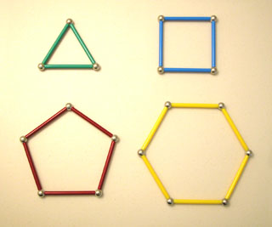
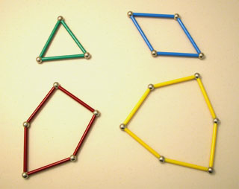
Relative Strength of Shapes
All other shapes can be deformed because the angles are not fixed. Draw these shapes in a way that will keep them from collapsing.
Notes:
Suggested text: As we showed, other regular polygons can be deformed without changing the length of the sides. A square loses its shape as its right angles collapse, and a pentagon and hexagon can be deformed. But the shapes stay “closed” because the sum of the interior angles is kept constant. For a shape with “n” sides, the sum of the interior angles equals 180*(n-2). So a triangle’s angles sum to 180 degrees, or 180*(3-2) degrees. A square’s angles sum to 360 degrees, or 180*(4-2). So what can we do to the other shapes, the squares, pentagons and hexagons, to keep them from collapsing? Draw these shapes on your paper and add what would be necessary.
Image courtesy of Skyline High School in Longmont, CO

Slide 10
Relative Strength of Shapes
Make TRIANGLES!
Notes:
Suggested text: Did you break the shapes into triangles? Since we know a triangle cannot collapse, and we know that these regular polygons can always be reduced to triangles (that’s how we figure out the sum of the interior angles, remember?), breaking our polygons down into triangles keeps them from collapsing!
Image courtesy of Skyline High School in Longmont, CO

Slide 11
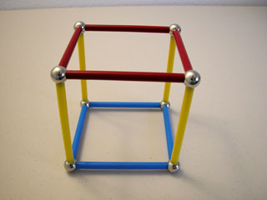
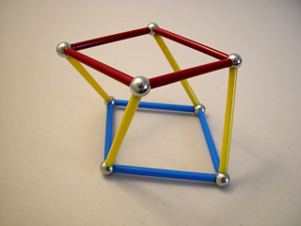
3D Shapes
The same thing applies in 3D
Notes:
Suggested text: The same issue applies in three dimensions. As shown, this cube can collapse by “racking,” just like the square we saw collapse in two dimensions. So what would we do to make a strong 3D structure?
Image courtesy of Skyline High School in Longmont, CO

Slide 12
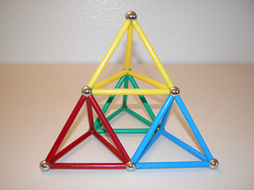
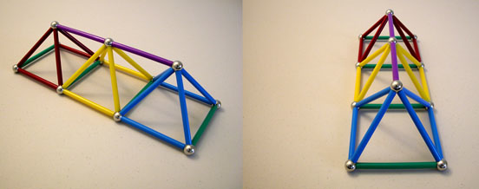
3D Trusses
The same thing applies in 3D
Notes:
Suggested text: We make 3D triangles? Specifically, we can make rectangular or triangular pyramids! This is why structural engineers rely on triangles, both in 2D and in 3D, to make strong structures! A 3D structure made of individual structural members like this is called a “truss,” and is used throughout engineering as a strong lightweight structure!
Image courtesy of Skyline High School in Longmont, CO

Slide 13
Strength of Shapes
Exploring Structural Engineering Fundamentals

