Slide 1
Viscous Fluids
Notes:
Viscous Fluids Presentation (pptx)
Viscous Fluids lesson at TeachEngineering.org

Slide 2
Viscous Fluids
Viscosity is how engineers measure the resistance of fluids when being deformed:
τ= μ(du/dy)
The less viscous the fluid, the greater its ease of movement.
Viscosity is useful for calculating the force needed to move a fluid. For example, in these industries:
petroleum
printing
food and beverages
Notes:
This is similar to measuring the force as a function of displacement for solids. Another way to describe stiffness is the measure of a material’s resistance to deformation. Less stiff materials move with greater ease. This is similar to how we define the viscosity of fluids.
Tau is shear stress (also defined as F/A). Nu is the proportionality constant called viscosity. du/dy is the shear velocity.

Slide 3
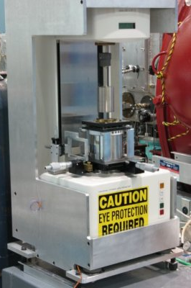
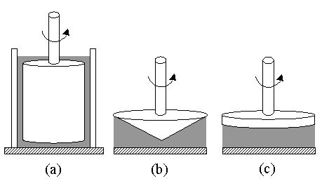
Measuring Viscosity: Rheometer
Notes:
Cone and plate (b) and parallel plate (c) configurations are used for very high-viscosity fluids such as pastes and gels. Cylinder configuration (a) is used for all other fluids, especially low-viscosity fluids.
Photo source: National Institute of Standards and Technology http://www.ncnr.nist.gov/programs/sans/equipment/rheometer.html
Diagram source: National Institute of Standards and Technology http://ciks.cbt.nist.gov/~garbocz/SP946/node14.htm

Slide 4
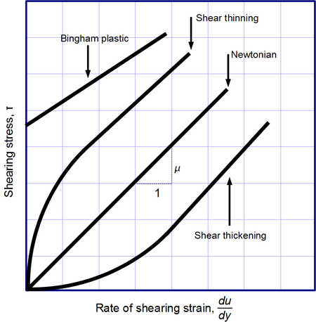
Fluid Behavior: Newtonian
Newtonian identified by
linear behavior
constant viscosity that is independent of velocity
Slope is defined as the viscosity
Examples:
water
gasoline
most gases
Notes:
Diagram source: Dhollm, Wikipedia {PD} http://en.wikipedia.org/wiki/File:Viscous_regimes_chart.png

Slide 5
Fluid Behavior: shear thinning
Shear thinning identified by: viscosity decreases as velocity increases
Scientists do not fully understand what causes this phenomenon
Examples:
ketchup
whipped cream
paint
motor oil
Notes:
Diagram source: Dhollm, Wikipedia {PD} http://en.wikipedia.org/wiki/File:Viscous_regimes_chart.png

Slide 6
Fluid Behavior: shear thickening
Shear thickening identified by: viscosity increases as velocity increases
Due to closely packed particles that are combined with enough fluid to fill the space between them
Examples:
body armor
viscous coupling unit (traction control)
cornstarch
Notes:
At low velocities, the fluid dominates the behavior. At high velocities, the fluid cannot keep up with the particles and cannot fill the spaces between them, which causes friction between the particles.
Diagram source: Dhollm, Wikipedia {PD} http://en.wikipedia.org/wiki/File:Viscous_regimes_chart.png

Slide 7
Fluid Behavior: Bingham plastic
Bingham plastic behaves as a solid at low stresses, but flows as a viscous fluid at high stresses
Due to particles in material having weak bonds that can be broken, allowing material to flow. Yet, when stress is gone, the bonds form again.
Example:
toothpaste
Notes:
Toothpaste will not be pushed out of the tube until a certain pressure is applied to it and then it comes out as a solid plug. Bingham plastics will not flow until yield stress is reached. Slope is the viscosity. Intersection of y-axis is yield stress.
Diagram source: Dhollm, Wikipedia {PD} http://en.wikipedia.org/wiki/File:Viscous_regimes_chart.png

